Slide 1
Learning objectives
Learning outcomes
We are learning about the physical and emotional changes that occur in young people during puberty and the impact this can have.
By the end of the lesson you will be able to…
Describe the physical and emotional changes that occur during puberty
Identify ways of managing the changes that occur during puberty
Explain where to seek advice and support about the changes that occur during puberty
KEY VOCABULARY
Puberty, hormones, desire, emotional, angry, insecurity, pain, acne, body conscious, pituitary gland, prefrontal cortex

Slide 2
What is puberty and when does
this happen to a person?
Notes:
You can communicate whether this is carried out in silence upon entrance as a thinking activity and baseline assessment, discussed in pairs, or shared as a whole class.
NOTE: The outcome of the lesson stimuli should be a clear message that puberty can occur between a very large age range, anything from 8-19, and sometimes earlier or later than this. The variety in these ages is perfectly normal and there is no ‘right’ age to start puberty.

Slide 3
SELF ASSESSMENT
Answer these four baseline questions using a confidence scale:
0
10
NOT CONFIDENT
EXTREMELY CONFIDENT
A) How confident are you about knowing the physical changes that occur during puberty?
B) How confident are you about knowing the emotional changes that can occur during puberty?
C) How confident are you in knowing how to manage the changes that occur during puberty?
D) How confident are you in knowing where to look for guidance and support about puberty?
Notes:
Ask students to answer the three baseline questions on a confidence scale: (0=not confident, 10=extremely confident).

Slide 4
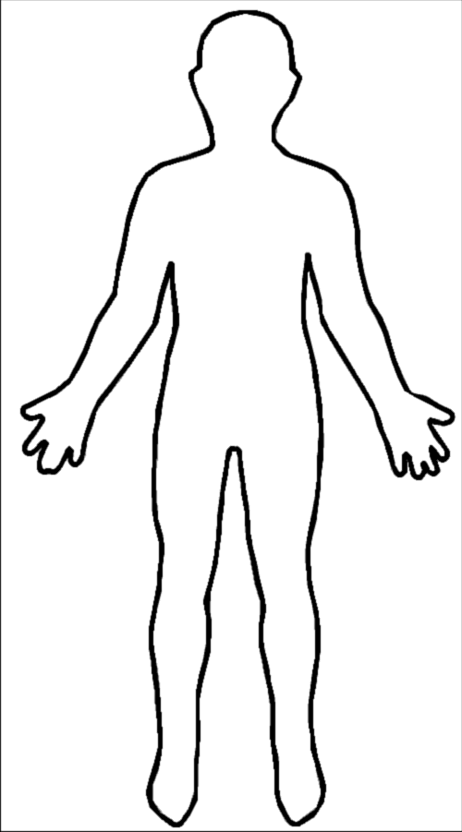
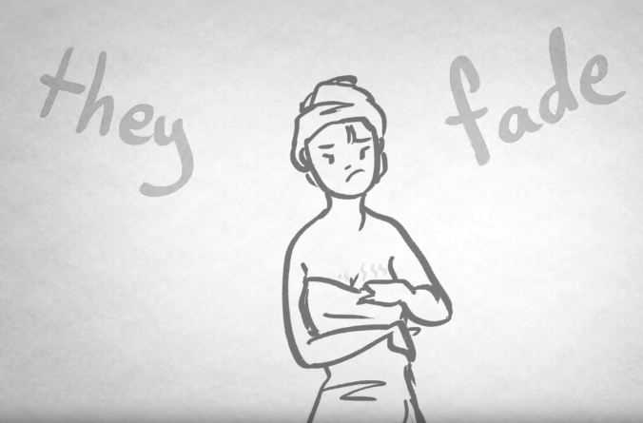
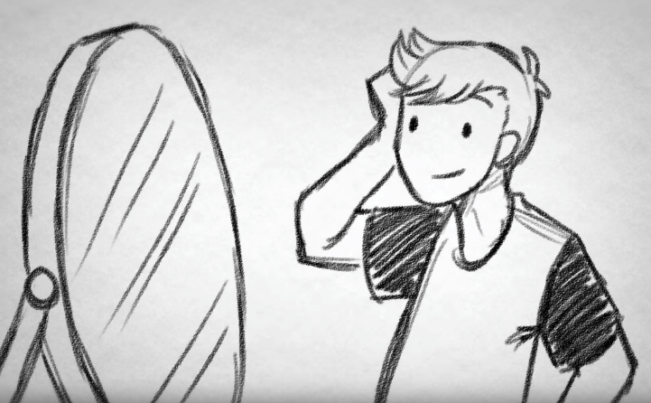

THE BODY
2
1
Puberty in girls (4:29)
Puberty in boys (5:01)
Get into groups of no more than 4 people. Draw the outline of a body.
Watch the videos and annotate your diagrams with the physical changes that occur during puberty.
Notes:
Activity 1.
You can change the number of students per group, however it would be advised not to go above four as students as it becomes more difficult to physically access the sheet and contribute to the activity.
Activity 2.
Show students the first video on the physical changes in girls and ask them to mark where the physical changes take place and label a description of what may happen. Then repeat the process with the second video for the physical changes in boys. (These could be carried out same-sex groups or mixed sex-groups)
Girls (4:29) https://bcove.video/2xGClMT
Boys (5:01) https://bcove.video/2DLKIwb
Students can watch individually on devices, or if this is not possible you can play them from the projector.

Slide 5


THE BODY
Watch the following video and using a different coloured pen add to your diagram the emotional changes that can take place.
3
Can puberty affect your head as well as your body?
Notes:
Activity 3.
Play video from 2.38-5.40 only as this part of the resource is the appropriate to the task. Ask students to use a different coloured pen to add additional notes on their diagrams about the emotional changes that can take place during puberty.

Slide 6
THE BODY
Discuss the following questions:
ALL
What are the similarities and differences in physical and emotional changes that occur in males and females?
What are challenges that young people face with changing through puberty?
How can young people support each other during puberty?
FURTHER CHALLENGE
What could be challenging about feelings of attraction or arousal during puberty?
What are the challenges of boys and girls developing at slightly different times?
Young people can start to be more aware of their bodies and what other people think during puberty, what could be the impact of this?
Are there any challenges associated with puberty that would differ depending on someone’s sexual orientation or gender identity?
Notes:
These questions have been differentiated to help facilitate progression through the activity. However you can choose the questions that would be appropriate for your students.

Slide 7
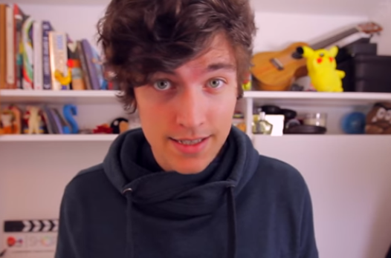
CAN YOU HELP?
1
Watch this video
Kick the PJ talks about growing up
Notes:
Activity 1
Show the video at https://riseabove.org.uk/article/kickthepj-talks-about-growing-up/ (2.31).
Students can watch individually on devices, or if this is not possible you can play them from the projector.

Slide 8
CAN YOU HELP?
2
Choose a question from the Rise Above Advice column.
Lately I can’t stop thinking about the person who sits next to me in maths class. I can hardly talk when I see them. There is a rumour they are going out with some else and the thought makes me feel sick. Can you help?
- Lovesick
My two best friends have both had their periods for the last year and I’m really worried that I haven’t started mine yet. Is there something wrong with me?
- Late bloomer
Over the past few months I keep thinking about sex and two nights ago I think I had a wet dream. Sometimes I get an erection and I’m really worried that it might happen in school. Can you help?
- Embarrassed in Essex
I have loads of spots on my face and back and they won’t go away.
I have tried loads of different make-up but nothing covers it and people in my class keep making jokes. It makes me not want to go out with my friends any more. Can you help?
- Spotty
I love being on the football team, but recently I keep losing my temper and getting upset. I can’t talk to the team about how I’m feeling – no one talks about that stuff. I don’t know what’s going on. Can you help?
- Flying off the handle
4
Notes:
Activity 2
Assign or let students choose a scenario. Explain that they will need to write a reply as if they were the Rise Above response team, and it will be published in a ‘concerns page’ for a local teen magazine. The following slide outlines the success criteria of their response.

Slide 9

CAN YOU HELP?
3
Use the Rise Above website to gather ideas to help write a reply from the Rise Above response team. The response to the young person is to be published in a ‘concerns page’ for a local teen magazine.
SUCCESS CRITERIA
Identify the challenges faced by the young person
Promote a healthy body image
Present a range of possible solutions
Advise on where to get support
Notes:
Activity 3
Remind students that there is a lot of content on the Rise Above website to gather ideas. Pupils can write their reply from the Rise Above response team to the young person to be published in a ‘concerns page’ response for a local teen magazine. Their responses should:
Identify the challenges faced by the young person
Promote a healthy body image
Present a range of possible solutions
Advise on where to get support
This activity can be carried out individually/pairs/groups depending on the resources available to the students. . If pupils can not access the website individually, you can explore the website at the front of the class and facilitate possible outcomes for each scenario in turn.
Explain to students that Rise Above was created by young people for young people, and that it is a safe and anonymous space for them to find helpful information and talk about the things that matter to them.

Slide 10
Choose one area that you have covered
during the lesson
Draft a top tip of no more than 15 words to offer advice, support or guidance in that area.
If you, or anyone you know needs support in this area, speak to a trusted adult, a teacher, tutor or head of year. You can also get support from the Brook website https://www.brook.org.uk/
Notes:
Review the top tips as a whole class and signpost students to Brook website https://www.brook.org.uk/ for additional support, as well as reminding them to speak to a teacher, head of year, trusted adult or friend if they have any concerns about themselves or someone they know.

Slide 11

PLENARY
SELF ASSESSMENT
Answer these four baseline questions using a confidence scale:
0
10
0 = not confident
10= extremely confident
NOT CONFIDENT
EXTREMELY CONFIDENT
A) How confident are you about knowing the physical changes that occur during puberty?
B) How confident are you about knowing the emotional changes that can occur during puberty?
C) How confident are you in knowing how to manage the changes that occur during puberty?
D) How confident are you in knowing where to look for guidance and support about puberty?
Notes:
Ask students to answer the three baseline questions on a confidence scale: (0=not confident, 10=extremely confident).

