Slide 1
DEALING WITH CHANGE
Learning objectives
Learning outcomes
We are learning about change and how to deal with some of the challenges that can arise with change.
By the end of the lesson you will be able to…
identify changes and transitions that can take place during adolescence
describe the impact that change can have
explain different ways of managing change and where to seek support
Key Vocabulary
Change, new, relationships, transition, routine, unknown, challenge, expected, unexpected, support

Slide 2
DEALING WITH CHANGE
CHANGE IS ALWAYS
NEGATIVE
DISCUSS
Notes:
Ask students to think about the statement above. You can decide whether this is carried out in pairs, small groups as a whole class.

Slide 3
DEALING WITH CHANGE SELF ASSESSMENT
How confident are you in identifying changes that can take place in adolescence?
How confident are you in understanding the effect that change can have? (e.g. on friendships, mood, routines, confidence etc.)
How confident are you in knowing strategies to manage change and where to seek support?
0
10
NOT CONFIDENT
EXTREMELY CONFIDENT
Notes:
Students should answer the three baseline questions on a confidence scale: 0 = not confident, 10 = extremely confident.

Slide 4
DEALING WITH CHANGE THE IMPACT OF CHANGE
Imagine it is the end of the school year. What are some changes that could take place for a student?
Think about personal interests, relationships, home life, school life, homework, exams, college, work and society.
Highlight expected changes in one colour and unexpected changes in another colour.
Draw emojis that show the impact of each change or write possible emotions associated with the change.
Watch the first part of the video Let's talk about change!
Notes:
Show the first part of the video ‘Let’s talk about change!’ (0:00-1:13) https://riseabove.org.uk/article/lets-talk-about-change/
Ask students to imagine it is the end of the school year. Ask them to think of all the examples of changes that could take place for a student and write these out. Areas to think about: personal interests, relationships, home life, school life, homework, exams, college, work and society.
Then ask students to take two different coloured pens or highlighters. They should choose one colour to identify expected change and one colour to identify unexpected change. Ask them to go through their lists and highlight the changes accordingly.
Next to each of these changes, ask students to draw some emojis that could show the impact or effect of the change (KS4 students can write the emotion rather than using an emoji).
Instruct pairs to pick three different examples of change from their lists and discuss the challenges and opportunities that could arise from this change.

Slide 5
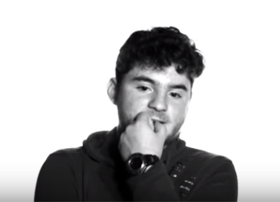
DEALING WITH CHANGE DISCUSSION QUESTIONS
ALL
What changes will everyone face?
Do you think some changes are easier to deal with than others? Why?
Is it true that change always causes stress?
When in life can change be positive and welcomed?
When in life is change exciting and inspiring?
Notes:
You can conduct this discussion in pairs or small groups if this is more suitable for your classroom environment.

Slide 6
DEALING WITH CHANGE DISCUSSION QUESTIONS
FURTHER CHALLENGE
Do you think some life changes are expected? If so, can you think of any examples?
Do you think some life changes are unexpected? If so, can you think of any examples?
What times in your life do you think the most change will take place and why?
Notes:
For further challenge, pairs or small groups can discuss the questions on the slide.
Some examples of expected changes might be puberty, exams, homework, new teachers, new timetable. Some examples of unexpected changes might be new relationships, friendships either starting or ending, divorce, moving home, losing jobs or starting work, etc.

Slide 7
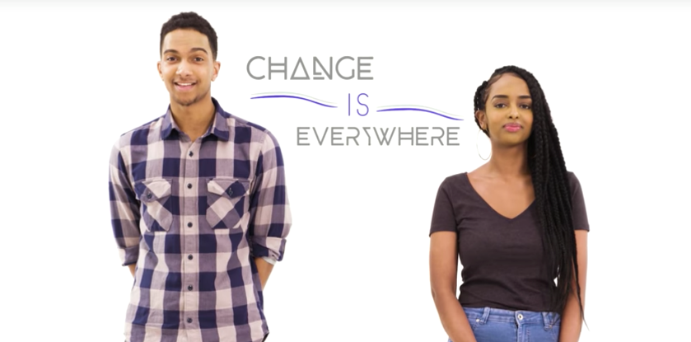
DEALING WITH CHANGE MANAGING CHANGE
Watch the following videos:
Let's talk about change! Second part
Dealing with change!
While watching, look out for strategies to manage change.
Notes:
Show students the following videos: Second part of ‘Let’s talk about change!’ video (1:13 – 3:05) https://riseabove.org.uk/article/lets-talk-about-change/ ‘Dealing with change!’ video (3:17) https://riseabove.org.uk/article/dealing-with-change/
If time permits and students require further stimuli, then this video can also be used: ‘Life swap’ video (2:55) https://riseabove.org.uk/article/life-swap-dealing-with-change/

Slide 8
DEALING WITH CHANGE MANAGING CHANGE
SCENARIOS
Someone who is starting a new school or job
Someone who has just moved to this country
Someone who is going through physical changes (e.g. puberty)
Someone whose parents are separating
Someone who has experienced a change in their friendship group
What advice would you give to each of the students above? You can use strategies from your own list or the list on the next slide.
Notes:
In groups of four, give students five different scenarios. Ask students to match the scenarios with possible management strategies on the next slide (each scenario could match up to multiple strategies).

Slide 9
DEALING WITH CHANGE MANAGING CHANGE
STRATEGIES:
Talk to someone you trust
Make time for relaxing activities
Have realistic expectations
Eat and drink healthily
Create a daily routine
Reduce time on social media
Spend time doing activities you enjoy such as listening to music or playing sports
Set achievable goals
Give yourself time to adjust
Think positively and use self encouragement
What advice would you give to each of the students on the previous slide?
You can use strategies from your own list or the list above.
Notes:
As a whole class or in large groups, ask students to share and discuss their choices.

Slide 10
DEALING WITH CHANGE MANAGING CHANGE
Explore the Rise Above Website and discuss the following questions:
ALL
What signs might you see in someone finding it hard to manage change?
Can you think of any strategies that are missing?
Will all of these strategies work for everybody?
FURTHER CHALLENGE
What have all of these strategies got in common?
Why can managing change be difficult at times?
What is the relationship between managing change and resilience?
Notes:
Instruct students to explore the Rise Above website using the questions on the slide to support their discussion.

Slide 11
DEALING WITH CHANGE SELF ASSESSMENT
How confident are you in identifying changes that can take place in adolescence?
How confident are you in understanding the effect that change can have? (e.g. on friendships, mood, routines, confidence etc.)
How confident are you in knowing strategies to manage change and where to seek support?
0
10
NOT CONFIDENT
EXTREMELY CONFIDENT
Notes:
Students should answer the three baseline questions on a confidence scale: 0 = not confident, 10 = extremely confident.

Slide 12
DEALING WITH CHANGE PLENARY: COMPLETE THE SENTENCE
Choose one of the following to complete:
Something I know now which I didn’t before is…
Something I now think/believe about change is…
Something I can do now as a result of this lesson is...
Notes:
Ask students to complete the sentences on the slide.

Slide 13
DEALING WITH CHANGE
It’s really normal to have lots of different feelings when change occurs.
If you are worried about changes affecting you or a friend, remember you can always speak to an adult at home or your teacher, or you can visit Rise Above: riseabove.org.uk
Childline https://www.childline.org.uk/info-advice/ (Or call 0800 1111)
Notes:
Remind students that it is really normal to experience different feelings during times of change. If things become difficult, they should speak to a trusted adult in school, at home or visit one of the sites listed on the slide.

