Slide 1
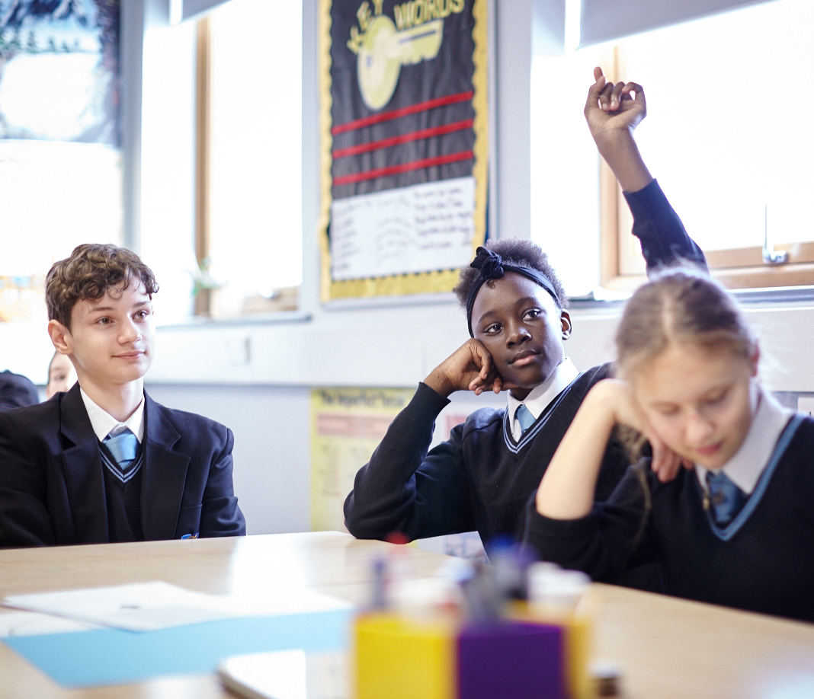

Discuss your answer with the person next to you.
Notes:
Ask students to create a mind map or list of words to encourage them to think about pre-existing knowledge on this topic.

Slide 2
Learning Outcomes
Learning Objectives
By the end of the lesson you will be able to…
define the terms wellbeing and social media
outline a range of strategies to improve wellbeing (including how to use social media responsibly)
explain the importance of balance in online and offline activities
In this lesson, we
are exploring what wellbeing means,
how social media could impact wellbeing and actions that young people can take, both online and offline, to promote their own wellbeing.

Slide 3
SELF ASSESSMENT
For each of the following questions, how confident are you in:
A
B
C
defining the terms wellbeing and social media?
outlining a range of strategies to improve wellbeing (including how to use social media responsibly)?
explaining the importance of balance in online and offline activities?
0
10
Notes:
Students should answer the three baseline questions on a confidence scale: 0 = not confident, 10 = extremely confident.

Slide 4
You are the school’s new Youth Panel, which has been set up to advise other students on how they might use social media in a safe way that could support their wellbeing.
Part A:
Create a definition suitable for young people of:
You can use symbols, emojis and numbers if needed.
Wellbeing
Social media
Notes:
You may wish to set a time limit for this task.
Once students have made their definitions, ask them to swap with other groups and discuss the similarities and differences. Click to reveal each definition.

Slide 5
When someone is safe, content, can manage challenges, reach their potential, develop strong relationships with others and make a positive contribution to their community
Technology that allows us to communicate and share ideas with others

Slide 6
In your Youth Panels, draw the table below
You said it
Watch the first part of the video and complete the first two columns of the table in your groups.
Notes:
Play the first part of the video to students, up to 02:07.
https://bcove.video/2GkuNDk

Slide 7
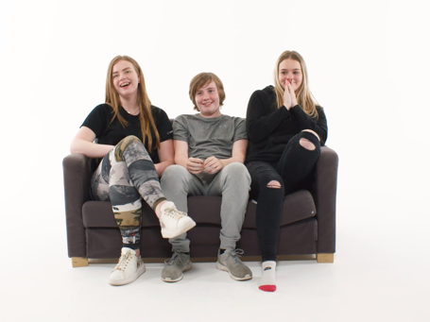
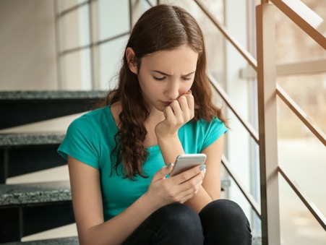
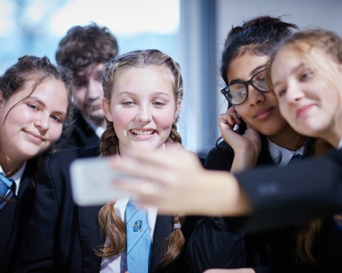
Discussion questions:
What were some of the opinions that the young people in the video have of social media use?
What are some
of the potential benefits and challenges you think are most applicable to teenagers your age, and why?
What strategies can a young person use to promote their wellbeing?

Slide 8
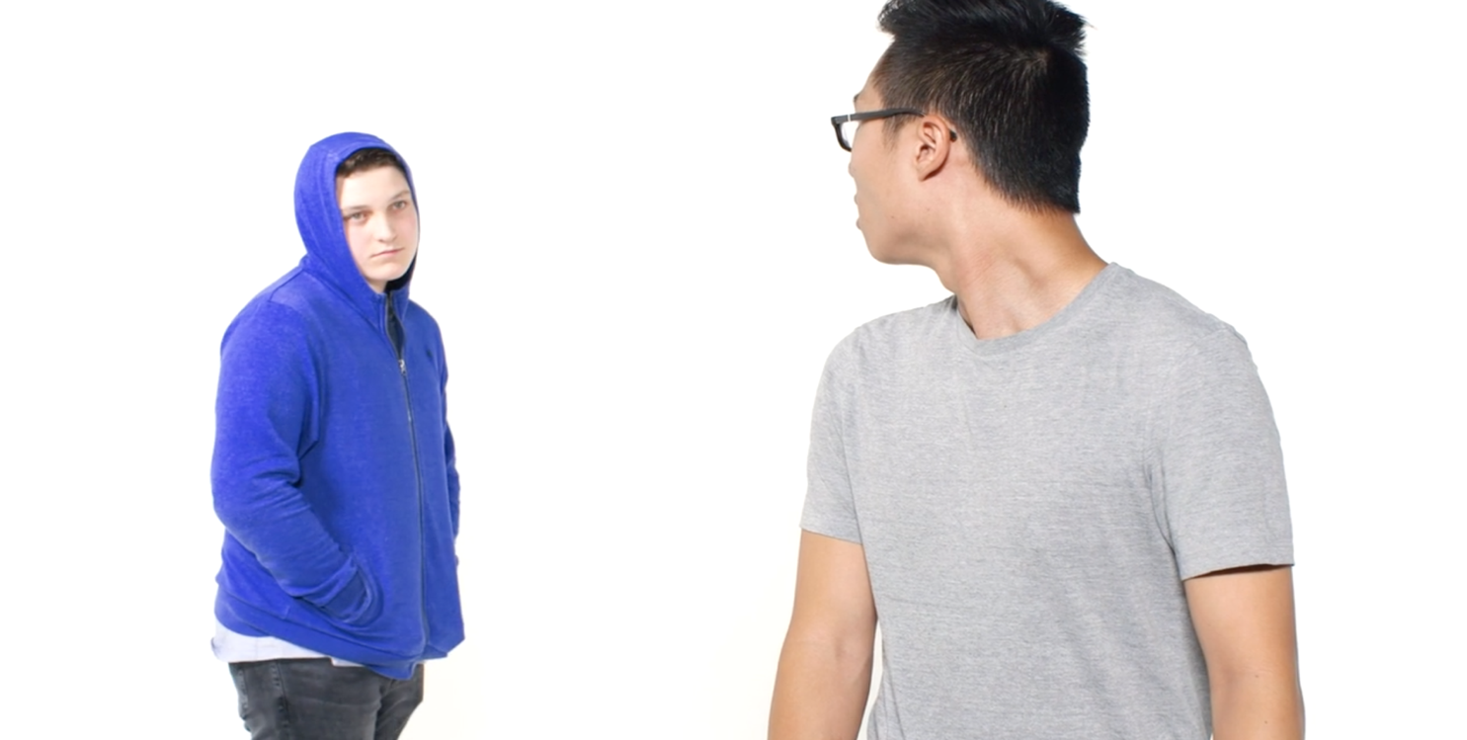
In your Youth Panel, can you
add anything else to your table?
You will be working together to create a short podcast or radio show to share the practical advice you have learned with other students.
Notes:
Watch the end of the video (https://bcove.video/2GkuNDk - from 02:07 onwards). Using what they have learned in the video and their own experiences, ask students to complete the final column in the table; solutions to promote wellbeing. A list of actions on the next slide can be used to support students if needed.

Slide 9
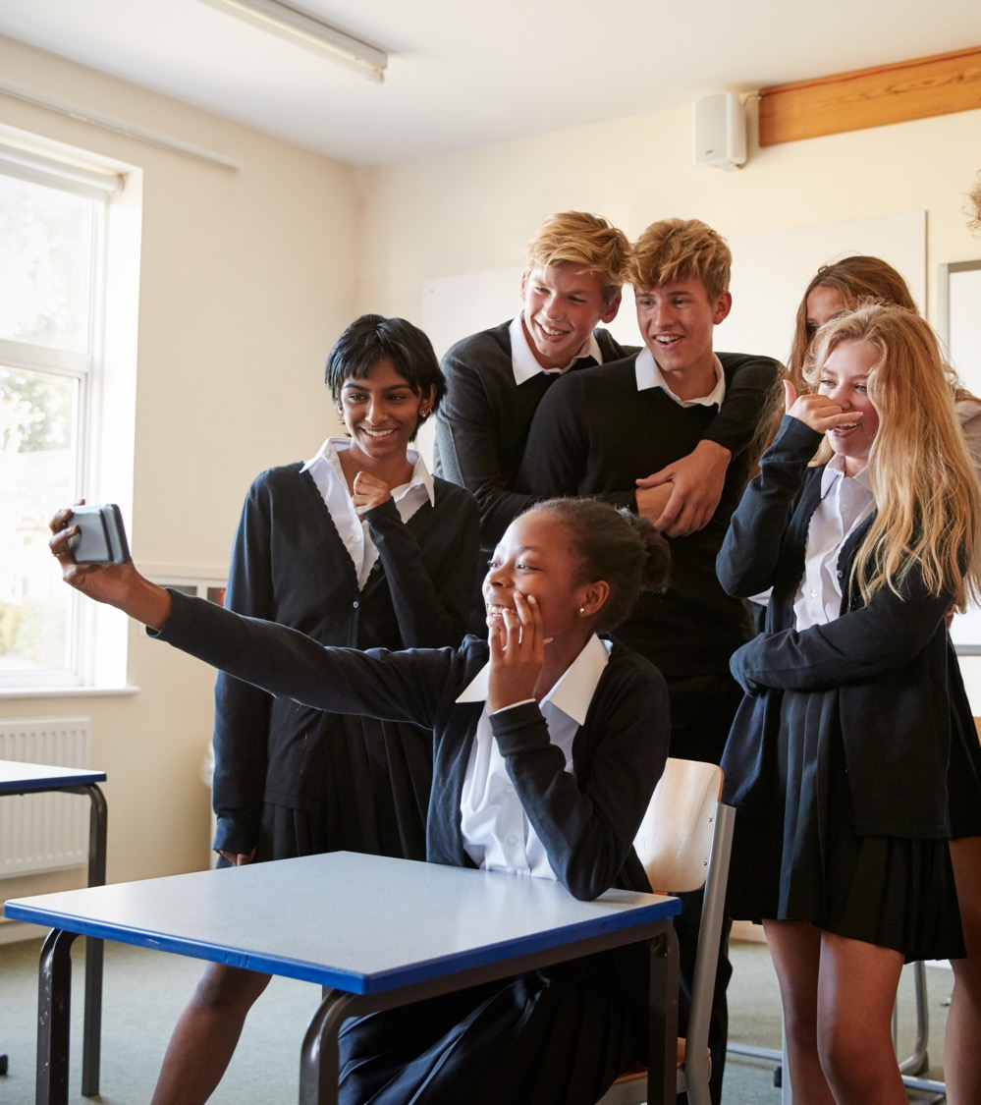
Look at the actions. Can you add anything else to your table?
Exercise, sport and physical activity
Eating healthily
Getting enough sleep
Relaxation techniques
Helping others
Doing things you enjoy
Exploring nature
Learning new things
Creative expression
Spending real time with friends
Staying in touch with friends online
Doing family activities
Doing homework or school projects
Seeking support
Notes:
You may wish to share this slide with students to provide them with additional ideas for their podcast on actions that can be used to support a young person’s wellbeing. Note, that some of these actions are better achieved offline and some are better achieved online.

Slide 10
Which types of social media young people may use most often
Practical advice on how social media might be used to support wellbeing
Some potential benefits and potential challenges a young person may face when using social media to support their wellbeing
An explanation of the importance of balance in online and offline activities
Specific advice for a special guest, such as a student who has just moved to a new secondary school.

Slide 11
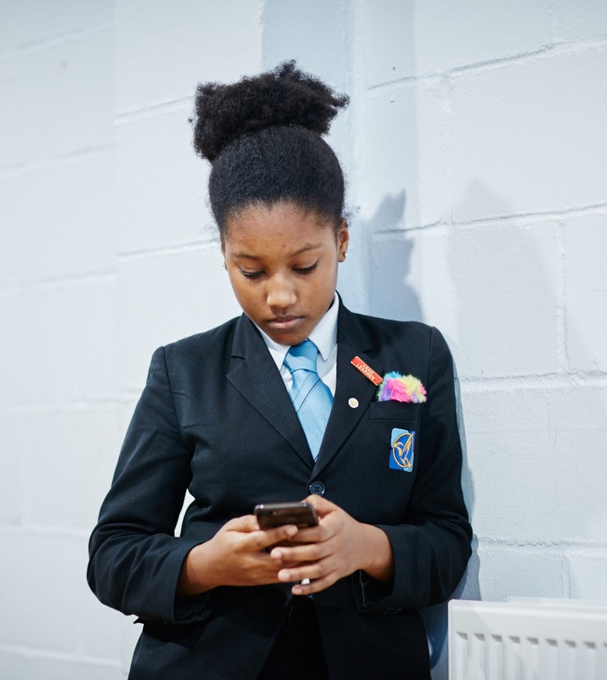
What are the main factors that promote wellbeing?
Is there such a thing as too much social media? If so, what would that look like?
How might a person’s wellbeing change over time?
Why might a young person’s
family be concerned about
social media use? Are these
valid concerns? Why/why not?

Slide 12
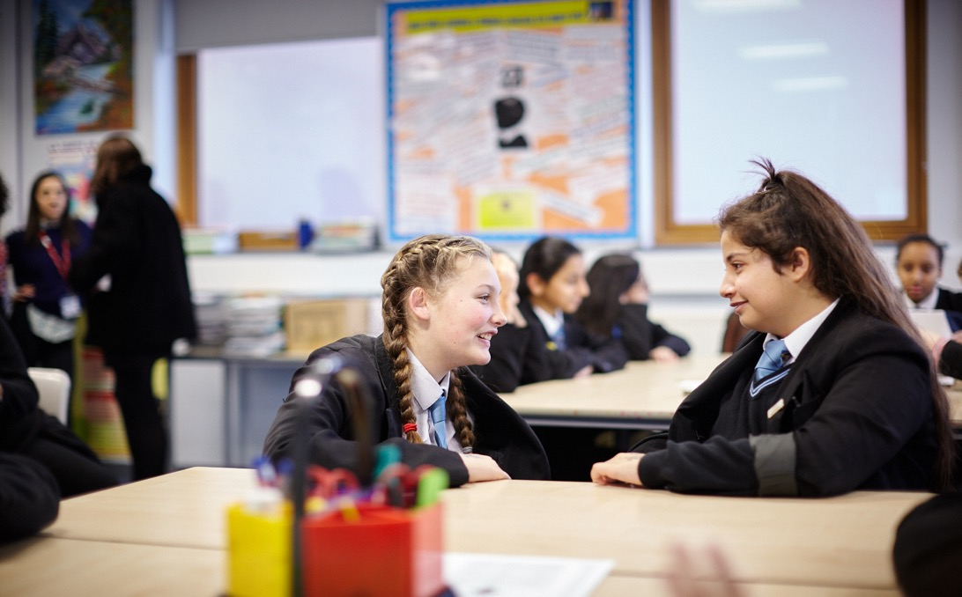
Discuss your answer with the person next to you.

Slide 13
SELF ASSESSMENT
For each of the following questions, how confident are you in:
A
B
C
defining the terms wellbeing and social media?
outlining a range of strategies to improve wellbeing (including how to use social media responsibly)?
explaining the importance of balance in online and offline activities?
0
10
Notes:
Students should answer the three baseline questions on a confidence scale: 0 = not confident, 10 = extremely confident.

Slide 14
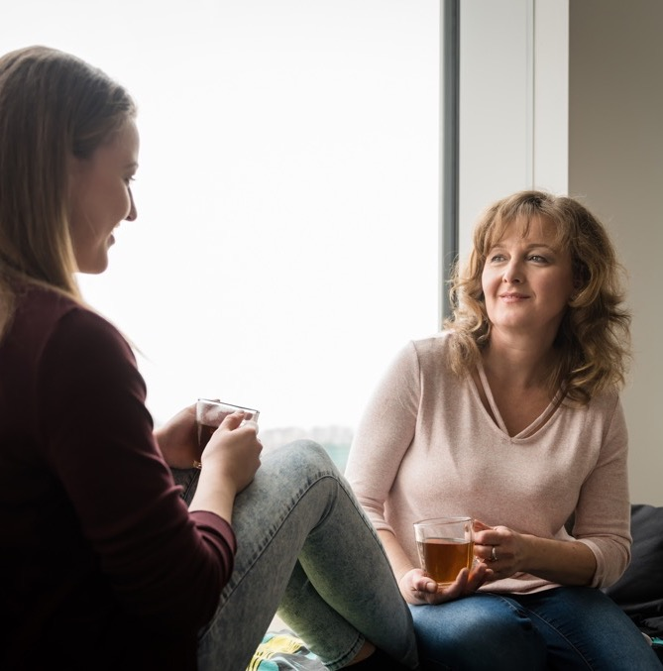
People can struggle with wellbeing at different times in their life. If you are worried about it or if a lack of positive wellbeing is making things difficult, you can speak to a trusted adult or ask them to make you an appointment with your GP.
You can also call Childline on 0800 1111 or visit www.childline.org.uk
Notes:
Explain to students that Childline is a free, confidential service where they can talk about anything that might be worrying them and it will be kept confidential. The service runs 24 hours, 7 days a week so students can go online or call at any time.
For teachers or families who want to find out more about helping young people to stay safe online, you may wish to recommend:
NSPCC online safety information (https://www.nspcc.org.uk/preventing-abuse/keeping-children-safe/online-safety/)
NetAware (https://www.net-aware.org.uk/), a comprehensive no-nonsense guide to 38 different social networks, apps and games, including explanation of privacy settings and assessment of suitability for different age groups
Royal College of Paediatrics and Child Health (https://www.rcpch.ac.uk/resources/health-impacts-screen-time-guide-clinicians-parents)

