Slide 1
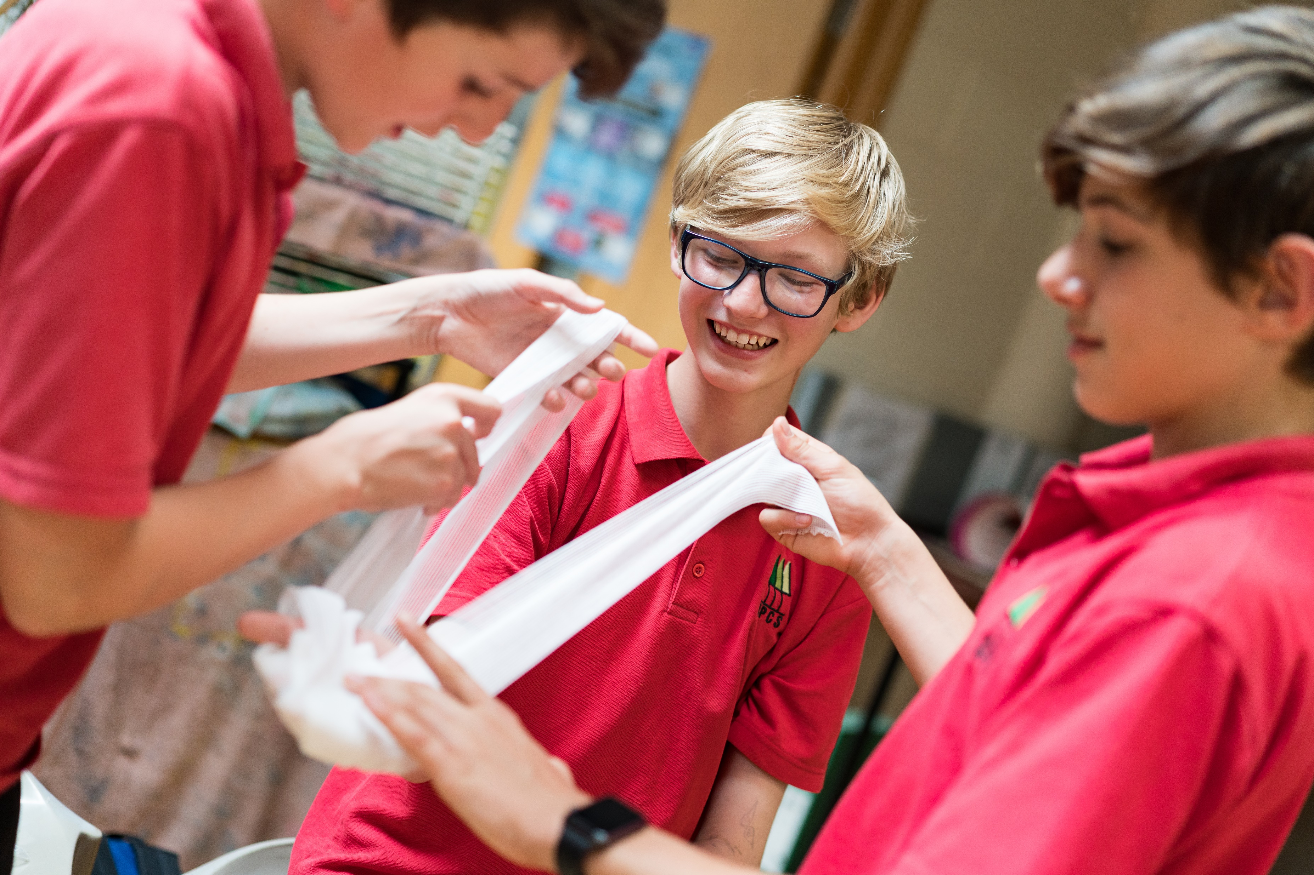

Bleeding
KS3 - Bleeding

Slide 2


Bleeding
A short course to learn how to help someone who is bleeding.

Slide 3
Learning outcomes
I can identify when a casualty is bleeding
I can assess and provide first aid to a casualty who is bleeding
I can seek medical help if required for a casualty who is bleeding

Slide 4
Blood starter activity
Have a guess…
  What percentage of the human body is made up of blood?
  Does your blood contain gold?
  How many kilometres would an adult's blood vessels stretch if they were laid out in a single line?
  Is all blood red?
  How many litres of blood are in an average adult?
  Does blood keep us warm or cool?
Notes:
Blood makes up approx. 7% of the human body.
YES there is gold within your blood! Approx. 0.2 milligrams in an adult’s body (a TINY amount).
AN adults blood vessels would stretch to approx. 1,600 KM
NO – snails, lobsters and spiders have BLUE blood.
An average adult has 4.5 – 5.5 litres of blood inside them.
YES! It does both!

Slide 5
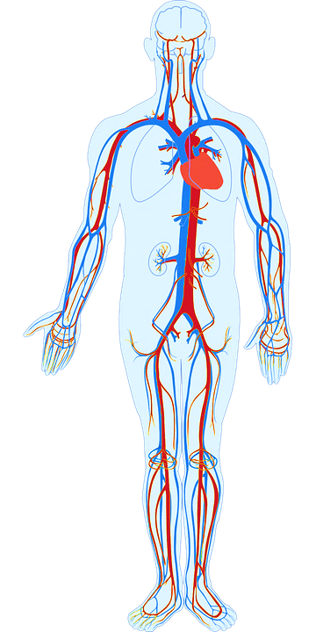
Blood
Basic anatomy:
Blood contains lots of different things and circulates around inside our body. It provides our body with the things we need to survive.
The H_ _ _ _ pumps blood around the body.
Blood travels around the body inside of blood
V_ _ _ _ _ _ which are all different sizes. These are called arteries, veins and capillaries.
Notes:
A: Heart
B. Vessels

Slide 6
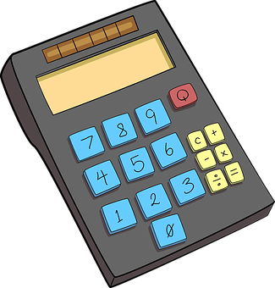
Blood mathematics A7
In small groups use the worksheet to complete the pie chart and learn about the contents of our blood.

Slide 7

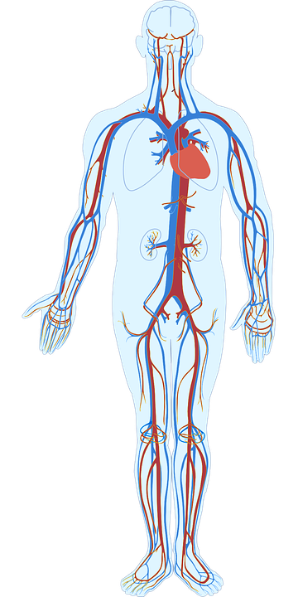


What do you see?
Notes:
To note is the colour of the blood flow.
Red is blood that is rich in oxygen travelling FROM the heart. Blue is the blood that is carrying CO2 back to the lungs to be expelled (exhaled) and re oxygenated. It is a closed complex system. Any interruption to this (e.g. blood loss - injury) causes issues as organs may not then receive the oxygen they need to survive and keep our body functions stable.

Slide 8
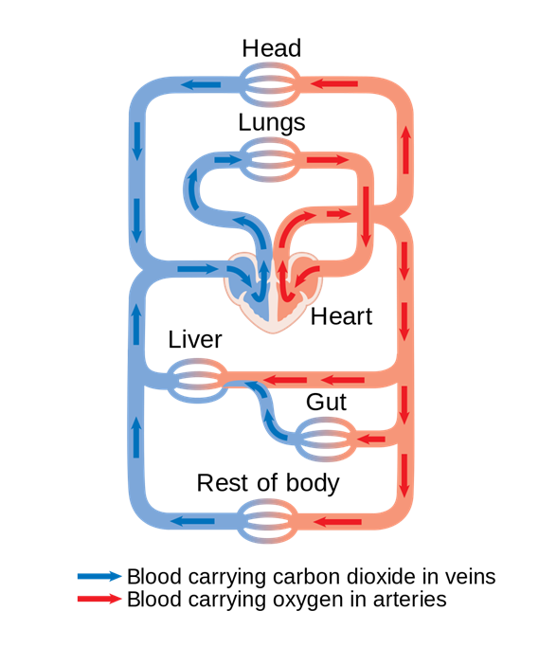
Activity A38
Circulatory system
This activity tasks the students with creating a model of the circulatory system; they can use research or the pictures provided to help.
Use our downloadable worksheet, which can be found on the St John Ambulance website.

Slide 9

What do you think?
A SIGN is something you can see.
Signs and symptoms of someone who is bleeding could be…
A SYMPTOM is something that the casualty can feel.
Notes:
Write answers onto white board ready for next slide to compare.

Slide 10
Answers
Signs and symptoms of someone with an internal or external bleed could be:
pale, clammy, cold skin
rapid pulse/heart beat
rapid breathing/shortness of breath
feeling dizzy
distress and anxiety
grey/blue tinge to the lips
bruising and pain at site of the injury
loss of responsiveness
Question:
Would you call for help if you saw someone with these signs?
Explain your answer.

Slide 11
Watch this video (warning content contains scenes of bleeding)
https://youtu.be/kRrkE8A4ceI
KS3 – Bleeding
Notes:
NOTE*** please ensure students are ok to watch scenes where blood is present***

Slide 12

Your turn: Severe bleeds
1. Put on gloves
2. Apply pressure to the wound
(but only if there is nothing stuck in it)
3. Apply a dressing to the wound
the pad goes over the injury
use bandage to secure it in place
make sure the bandage is not too tight
call 999/112
4. Apply second dressing, if needed
no more than two dressings at a time
5. If an object is in the wound, do NOT remove
put a pad on either side of the object
bandage carefully over the pads without pushing the object in any further

Slide 13
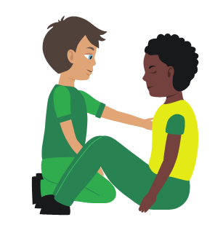
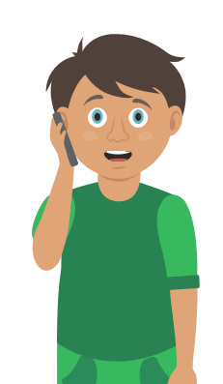
Your turn: Nosebleed
1. Sit
the casualty down leaning forward
2. Ask
them to pinch the soft part of their nose for 10 minutes
3. Check
if the bleeding has stopped
if still bleeding pinch nose for a further 10 minutes
5. Help
if bleeding has not stopped after a maximum of 30 minutes seek medical help
4. Recheck
if still bleeding pinch for a further 10 minutes

Slide 14
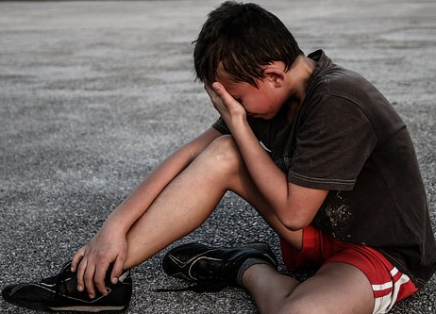

Activity
A9
Group work
QUESTION:
How might a casualty feel if injured and bleeding?
QUESTION:
What could you wear (if it is possible) when dealing with someone who is bleeding? Why?
QUESTION:
What should you do straight away when you see someone who is bleeding?
Notes:
Q1 discuss, sad, afraid, scared, anxious, dizzy, shocked etc
Q2 gloves- hygiene and infection control
Q3….next xlide

Slide 15

Activity answers A9
Reassure
Positioning
Pressure
Primary survey
Call for help
Be alert for shock
Immobilise
Notes:
Check answers to confirm learning from video and session content
Key learning points are reassure, immobilise, pressure, be alert for shock, positioning and call for help.

Slide 16
Shock
What is shock?
Shock is a life-threatening medical condition which is caused by a lack of blood flow to tissues and organs in the body.
The decreased blood flow means there is a lack of oxygen to the organs, this can lead to tissue damage. Shock requires quick treatment to prevent organ failure.
Signs and symptoms of someone suffering from shock could be:
Rapid, shallow breathing
Cold, clammy skin
Rapid, weak pulse
Dizziness or fainting
Weakness
Sweating
Chest pain

Slide 17
Your turn: Dealing with shock
1 Treat
any injuries that may have caused shock
2 Help
the casualty to sit down, then lie down
3 Raise
and support the casualty’s legs if possible
4 Call
999/112
5 Reassure
them and loosen any tight clothing
6 Keep
the casualty warm

Slide 18

Key words
Definitions….
Veins
Plasma
Capillaries
Red blood cells
Platelets
Arteries
Heart rate
White blood cells
Circulation
Shock

Slide 19



Check your learning
I am able to:
Identify when someone is bleeding
Give first aid to a casualty who is bleeding
Call for help correctly, if it is necessary
YES UNSURE NO

Slide 20

Thank you!

Slide 21
Blood mathematics A7
In small groups use the worksheet to complete the pie chart and learn about the contents of our blood.

Slide 22
Activity A38
Circulatory system
This activity tasks the students with creating a model of the circulatory system; they can use research or the pictures provided to help.
Use our downloadable worksheet which can be found on the St John Ambulance website.

Slide 23
Activity A7
Let’s make blood
Students now have the opportunity to create a model of our blood. Students will learn about basic blood content and the function of blood. Use our downloadable worksheet which can be found on the St John Ambulance website.

Slide 24
Activity A11
Make a stethoscope
Students now have the opportunity to construct a basic stethoscope. They can listen to each other’s hearts and learn how a real stethoscope works. Use our downloadable worksheet which can be found on the St John Ambulance website.
Notes:
Quite a basic modelling activity but used in conjunction with noting heart rate increases after exertion etc can be useful

Slide 25
Watch this video (warning content contains scenes of bleeding)
https://youtu.be/yydY4OAE9DU

