Slide 1
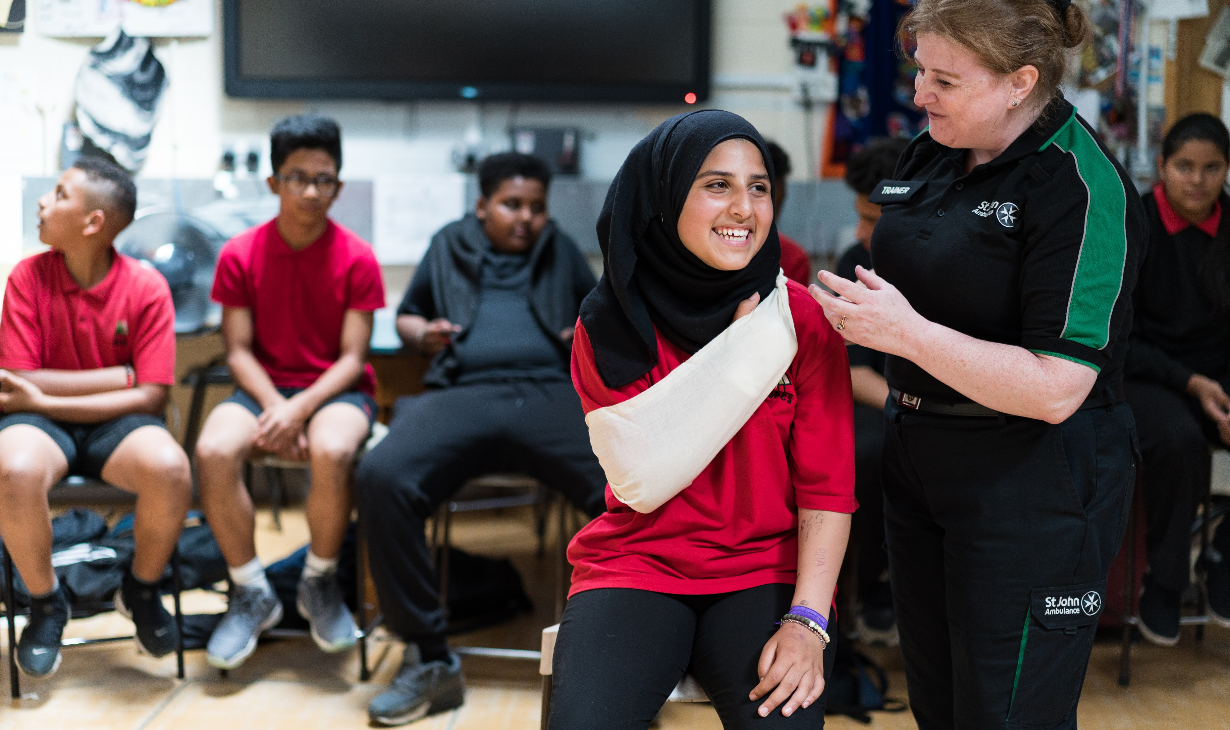

Bone, muscle and
joint injuries
KS4 – Bone, muscle and joint injuries

Slide 2
Bone, muscle and joint injuries
A short course to learn how to deal with bone, muscle and joint injuries.
Notes:
Please ensure all students are not likely to be adversely affected by contents of this topic. There are scenes of bleeding and injury within the resources.

Slide 3
Learning outcomes
identify the difference between a bone, muscle and joint injury
give first aid to a casualty who has a bone, muscle or joint injury
recognise when I need to call for help for a casualty who has a bone, muscle or joint injury

Slide 4
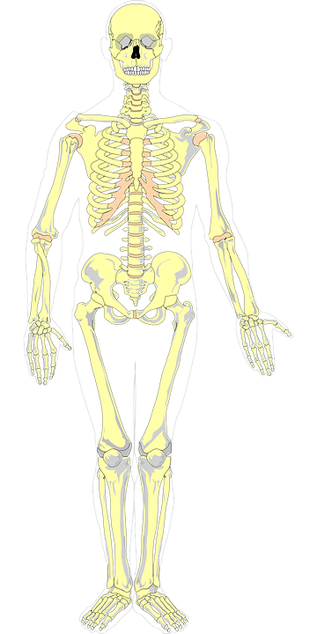
The musculoskeletal system
The skeleton supports, moves, protects and makes blood cells.
Our muscles are controlled via signals from the brain.
Our muscles are attached to our bones via tendons.
The human skeleton consists of 206 bones.
The types of joints within our body are hinge, fixed and ball and socket.
S&C: The tissue that connects two bones together is called a L_ _ _ _ _ _ _.
Notes:
Ans: Ligament

Slide 5
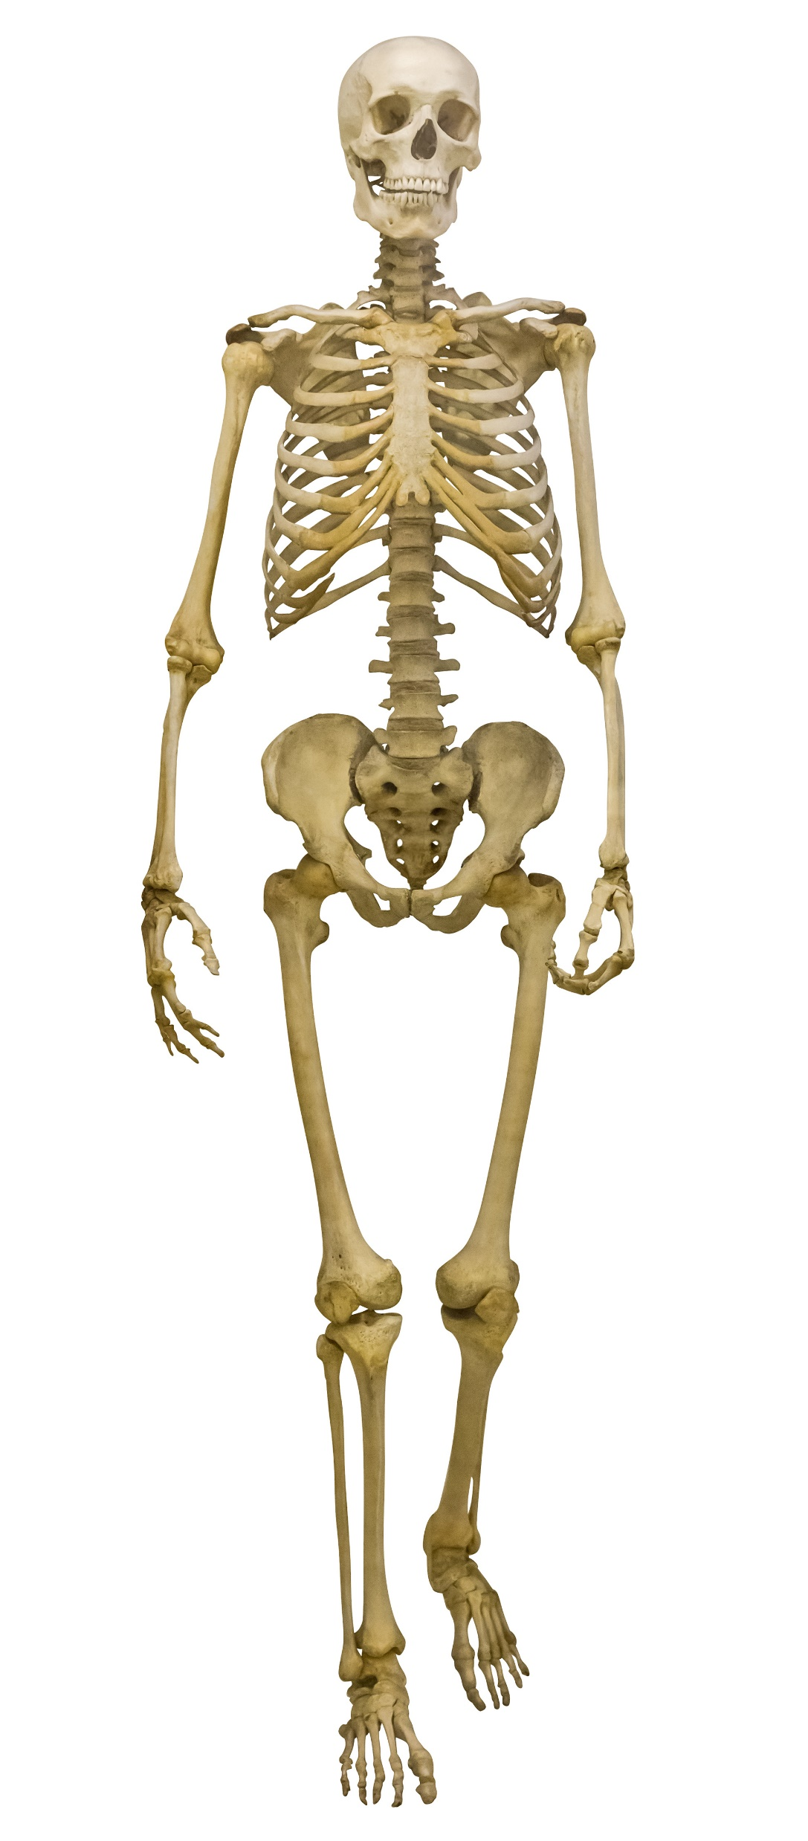
The musculoskeletal system
In pairs/small groups see if you can name some bones of the bones in a human skeleton.
S&C: Can you name any others?
KS4 – Bone, muscle and joint injuries
Notes:
Other option is printable skeleton - Once skeleton has been formed students have some labels in a pack
Blue labels are bones and red labels are muscles – basic anatomy- can groups work together and name some of the bones and muscles that form human anatomy.
Peer assess other groups work to compare and share.

Slide 6
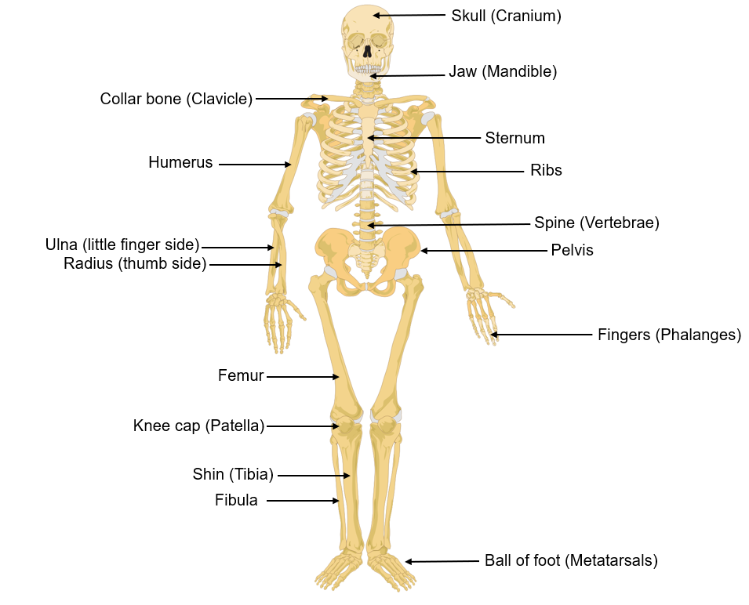
The musculoskeletal system
KS4 – Bone, muscle and joint injuries
Notes:
peer check from sheet

Slide 7
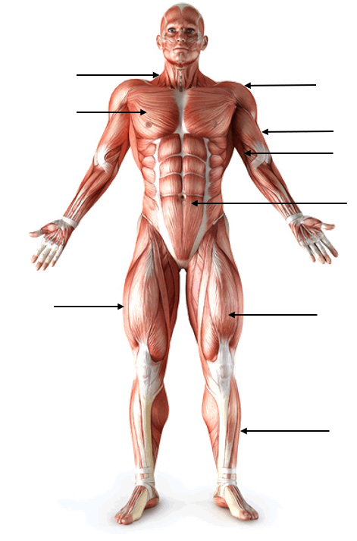
The musculoskeletal system
In pairs/small groups identify some of the muscles found in the human body.
KS4 – Bone, muscle and joint injuries
Notes:
S and C put a post it of muscle on area if student can name muscles as well

Slide 8
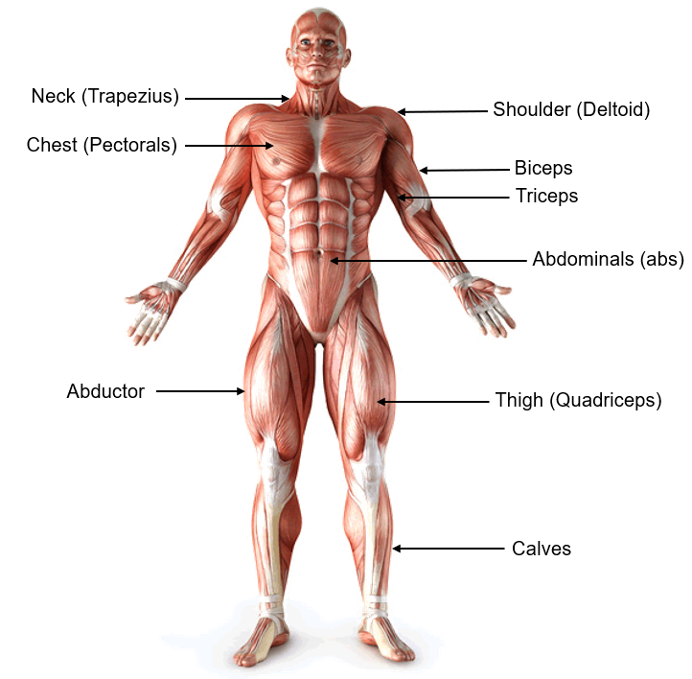
The musculoskeletal system
KS4 – Bone, muscle and joint injuries
Notes:
S and C put a post it of muscle on area if student can name muscles as well

Slide 9
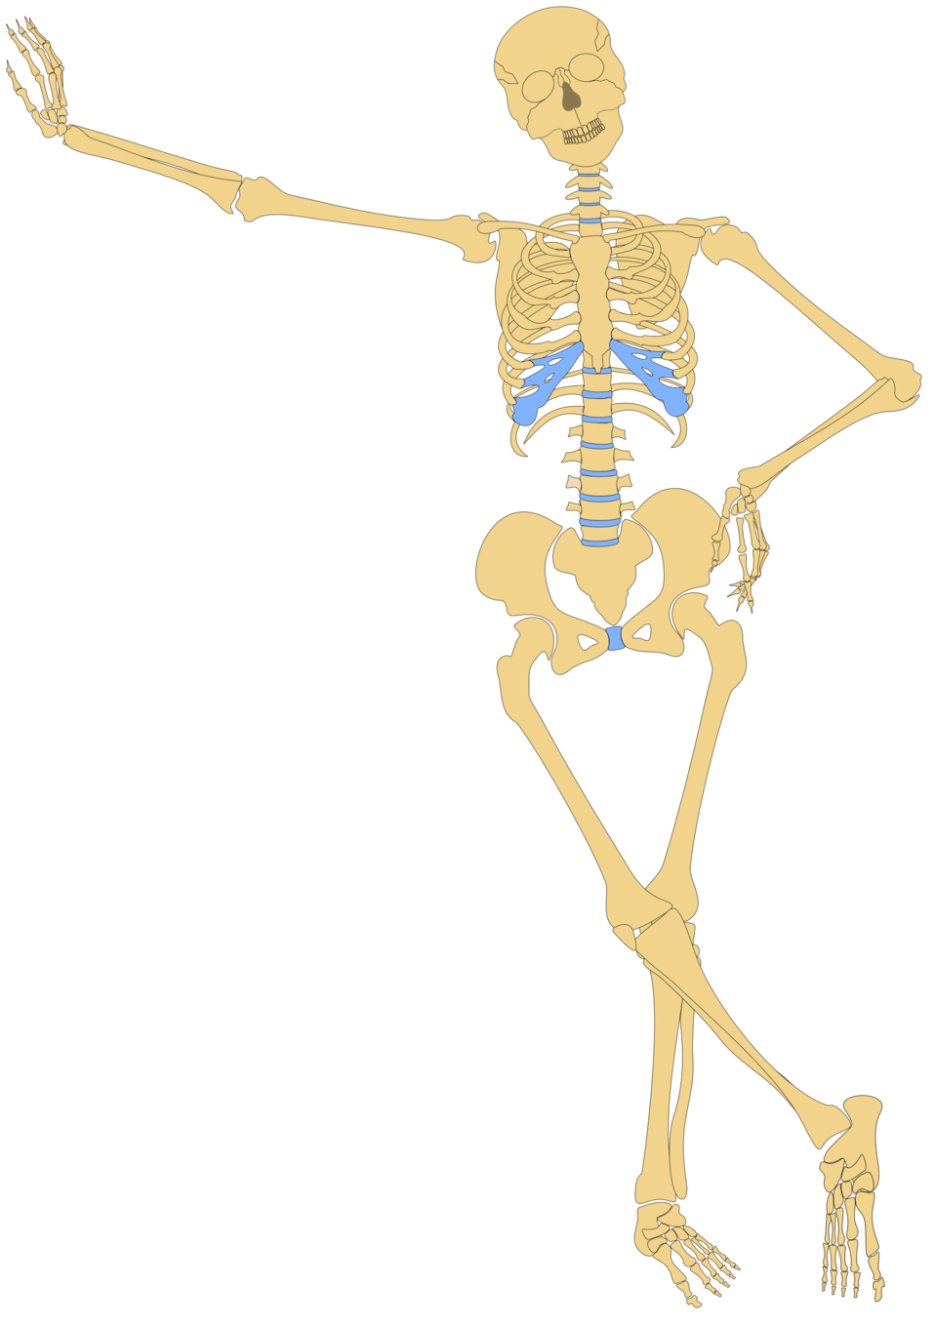
Activity A45
The musculoskeletal system
In pairs/small groups, create and label your own skeleton
S&C: Add labels to the skeleton to name some of the bones/muscles in our body without looking at the answers Use the downloadable worksheet which can be found on the St John Ambulance website.
Notes:
Once skeleton has been formed students have some labels in a pack
Blue labels are bones and red labels are muscles – basic anatomy- can groups work together and name some of the bones and muscles that form human anatomy.
Peer assess other groups work to compare and share.

Slide 10
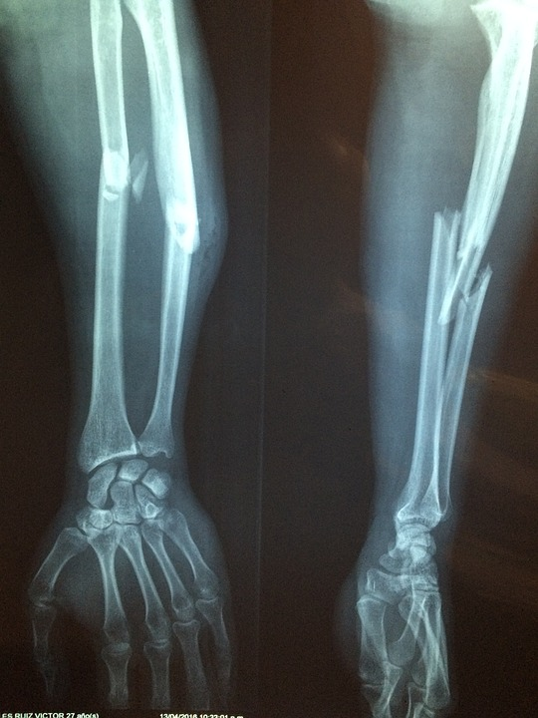
Broken bones
Broken bones are also called fractures.
Recognition:
Deformity, swelling and bruising at the site of injury
Pain and difficulty moving injured part
There may be:
Bending and/or shortening of limb
A wound where the broken bone can be seen

Slide 11
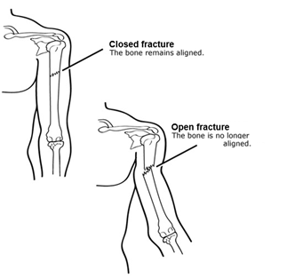
Types of fracture A47
Closed fracture
Skin around the fracture is intact
Bones may be unstable
There may be internal bleeding
Casualty may develop shock
Open fracture
Broken end of the bone may pierce through the skin
There may be a wound at the fracture site
There is a risk of infection

Slide 12
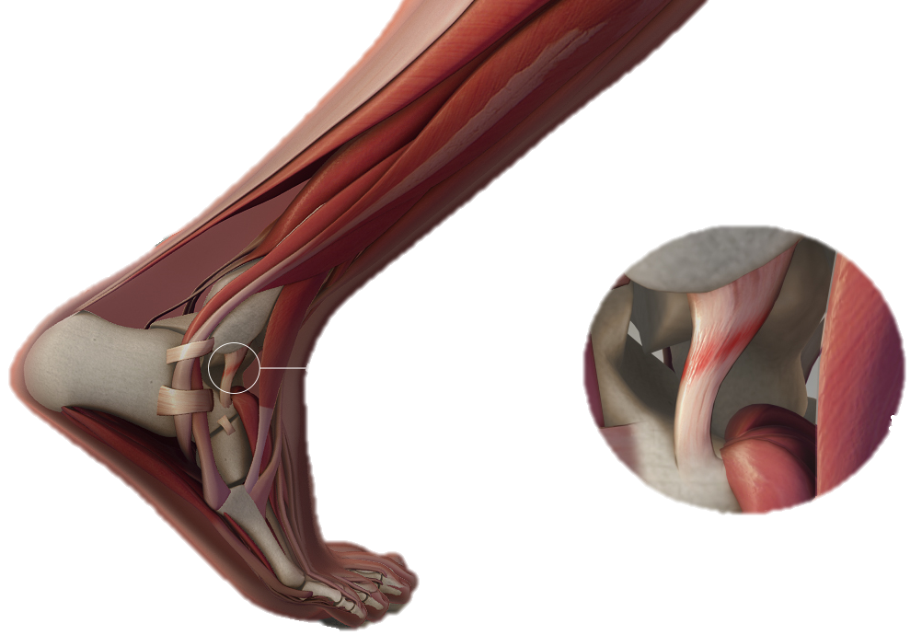
Sprains
A sprain is the stretching or tearing of ligaments (the tough bands of fibrous tissue that connects two bones together in a joint)
For example, the ankle.

Slide 13
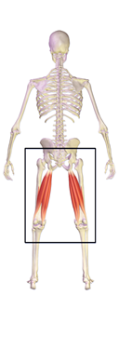
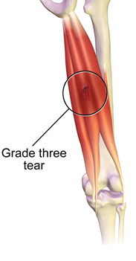
Strains
A strain is the stretching or tearing of the muscle or tendon. A tendon is a fibrous tissue that connect muscle to bones.
Remember: sTrain = Tendon
Notes:
Help to remember STRAIN = T for tendon!

Slide 14
Sprains and strains
Recognition:
Pain and tenderness
Pain and difficulty moving the injured area, especially if it is a joint
Swelling and bruising in the area

Slide 15
Video – fractures
https://youtu.be/2v8vlXgGXwE
KS4 – Bone, muscle and joint injuries
Notes:
Warning – ensure students are not affected by scenes of injury

Slide 16
Your turn: Fractures
Support injured area
Protect injury with padding and try to m move as little as possible
Support the injury with slings or bandages if the casualty allows
Call 999/112
  Note: an arm injury could be taken to hospital in a car, if the casualty is not in shock. Leg injuries should be taken in an ambulance
Treat for shock if needed and monitor casualty until ambulance arrives

Slide 17

Your turn: Sprains and strains
Help casualty to sit down
Support the injured part, preferably raised.
(Rest)
Cool the area with a cold compress
(ICE)
Apply comfortable support to the injured area
(Comfort)
Support the injured area in a raised position to help minimise the swelling
(Elevate)
If severe pain persists, send the casualty to hospital
Notes:
Use RICE to help remember this – Rest, Ice, Comfort, Elevate

Slide 18
Types of injury A46
Bone
Joint
Muscle
Closed fracture
Strain
Sprain
Knee injury
Shin splints
Dislocation
Open fracture
Bruises
Notes:
BONE- closed and open fracture
JOINT- Sprain (ligaments inside joint), dislocation
MUSCLE-Strain , knee injury, bruises,, shin splints (although also tendons and bone tissue affected)

Slide 19
Types of injury
Bone
Joint
Muscle
Closed fracture
Strain
Sprain
Knee injury
Shin splints
Dislocation
Open fracture
Bruises
Notes:
Fractures:
Elderly – bones more fragile (falls etc)
Sports –
Impact injuries – RTA
Etc

Slide 20



Check your learning
I am able to:
Identify the difference between a bone, muscle or joint injury
Help someone that has a bone, muscle or joint injury
Recognise when I need to call for help when someone has a bone, muscle or joint injury
YES UNSURE NO

Slide 21

Thank you!

Slide 22
Activity A45
The musculoskeletal system
In pairs/small groups, create and label your own skeleton
S&C: Add labels to the skeleton to name some of the bones/muscles in our body without looking at the answers Use the downloadable worksheet which can be found on the St John Ambulance website.
Notes:
Once skeleton has been formed students have some labels in a pack
Blue labels are bones and red labels are muscles – basic anatomy- can groups work together and name some of the bones and muscles that form human anatomy.
Peer assess other groups work to compare and share.

Slide 23
Types of fracture A47
Closed fracture
Skin around the fracture is intact
Bones may be unstable
There may be internal bleeding
Casualty may develop shock
Open fracture
Broken end of the bone may pierce through the skin
There may be a wound at the fracture site
There is a risk of infection

Slide 24
Your turn: Fractures
Complete the steps...
1.
2.
3.
4.
5.

Slide 25
Your turn: Sprains and strains
Complete the steps...
1.
2.
3.
4.
5.
Notes:
Use RICE to help remember this – Rest, Ice, Comfort, Elevate

