Slide 2
The convention was agreed in 1989.
It came into force 1990.
54 Articles – the fundamental things that all children need in order to survive and develop to their full potential.

Slide 3
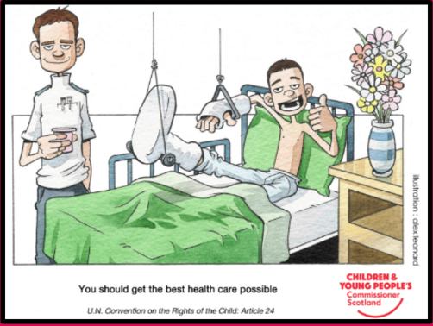
You have the right to the best possible health.

Slide 4
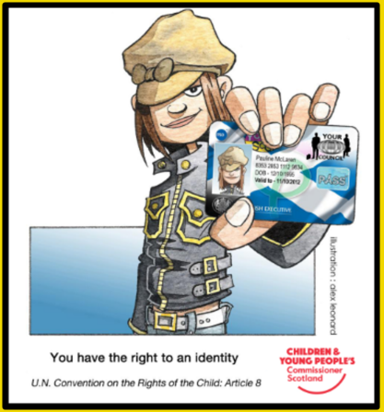
You have the right to an identity.

Slide 5
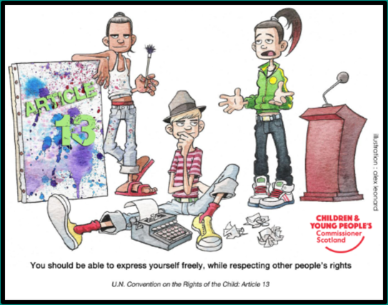
You have the right to express yourself freely whilst respecting other people’s rights.

Slide 6
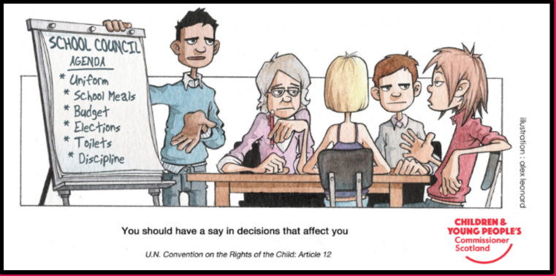
You have the right to have a say in the decisions that affect you.

Slide 7
You have the right to the best possible mental health.
(Article 24)

Slide 8
What are the solutions?
Young people’s happiness with life as a whole is at its lowest since 2010.
What are the roots of the problem?

Slide 9
You have the right to an identity.
The Light In Your Eyes https://vimeo.com/282840220

Slide 10
What are the solutions?
Young people’s happiness with life as a whole is at its lowest since 2010.
Government cuts in funding.
Multiple problems.
‘Jokes’.
Fear of crime.
Identity.
Lack of support from family or friends.
No one to talk to.
Poverty.

