Slide 2

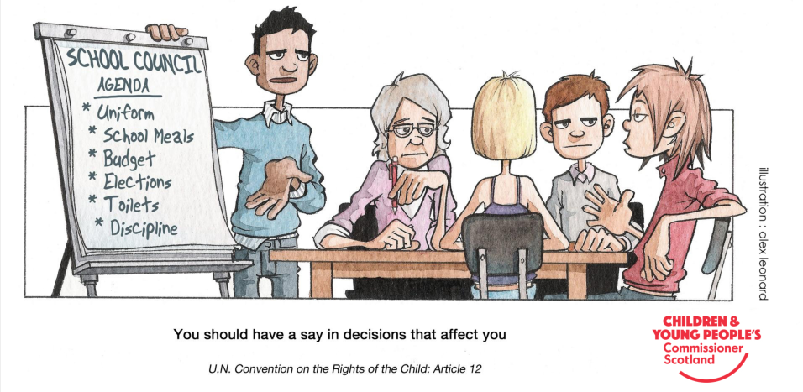
You have the right to have a say in the decisions that affect you.

Slide 3

The Children’s Society fights child poverty and neglect, and helps all children have a better chance in life.
Last year The Children’s Society worked directly with 9,872 vulnerable children to help improve their lives.
The Children’s Society also campaigns to change Government policies, so that we can improve the lives of children – especially those who are vulnerable due to poverty, mental health problems or abuse.

Slide 4

The Children’s Society works with children all over the UK to put pressure on decision makers (such as local and national government) to improve lives for vulnerable children. Campaigning works!
Here are some examples of what has been achieved:
The problem: Nearly a million children living in families in energy debt were growing up in cold homes that put their health at risk.
The change: Thousands of people supported our Debt Trap campaign asking energy companies to show some warmth. Five of the ‘Big Six’ energy companies changed their policies to better protect families with children.
The problem: The Government proposed cuts to support for working families which would seriously harm the lives of millions of children living in poverty.
The change: The Children’s Society worked with members of the House of Lords to urge the Government to rethink its approach. The Government abandoned its proposed changes, helping 2.4 million children across the country.

Slide 5

#HereForYou – Instagram
UOKM8? – TheLADBible Group
In Your Corner – Time to Change

Slide 6

Counsellors in school.
Peer support/buddying schemes in school.
Low cost clubs or trips.
Less academic pressure.
More Government funding to support vulnerable children with services such as youth clubs and counselling.
Relaxation classes in school.
Celebrate difference.
Be kind, respect each other.
Positive identity.
Use the 5 Ways to Well-Being to support your own and others’ mental health.
More funding to tackle crime and keep people safe.
Young people’s happiness with life as a whole is at its lowest since 2010.
Government cuts in funding.
Multiple problems.
Fear of crime.
Lack of support from family or friends.
No one to talk to.
Identity.
‘Jokes’.
Poverty.

Slide 7

RESEARCH and PLANNING
ACTION
EVALUATE

Slide 8
What change?
How to present?
How will you know it has worked?
Who has power?
How can you influence?
Key message?
What information and resources do you need?
Plan your campaign

Slide 9
Reflections on your campaign
What did we do?
What impact did it have?
What did we learn?
What could we improve?
What do we want to do next?
How can we achieve that?

