Slide 1
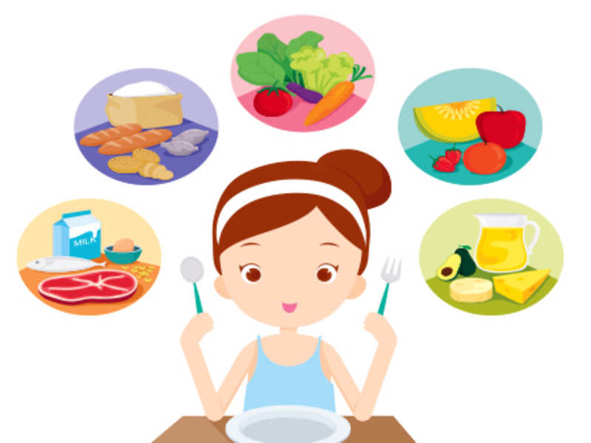
Healthy Eating – What Does It Mean?

Slide 2
Do You Know What Healthy Eating Means?
Is it just eating fruit
and vegetables?
Is it about not
eating chocolate?
Notes:
Who thinks they know what healthy eating is?
Don’t answer now , just have a think about it as we go through the assembly
Is it just…..

Slide 3
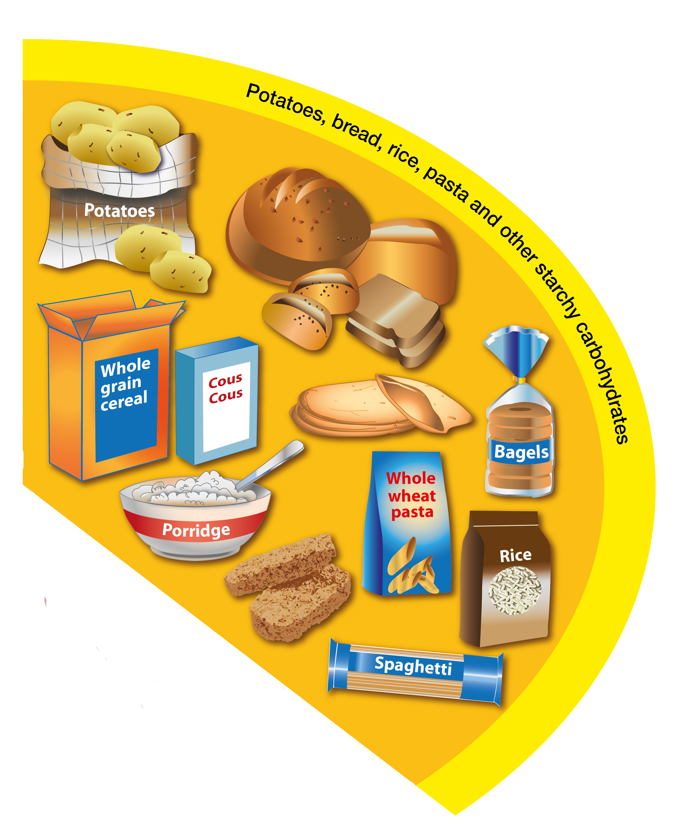
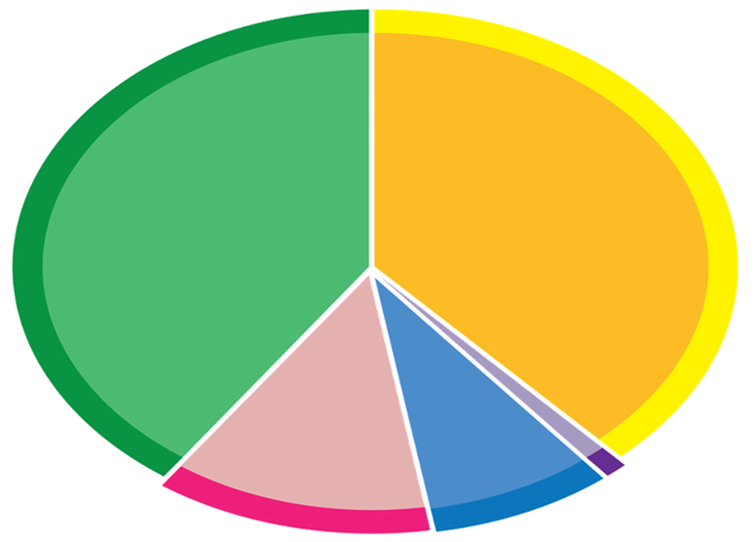
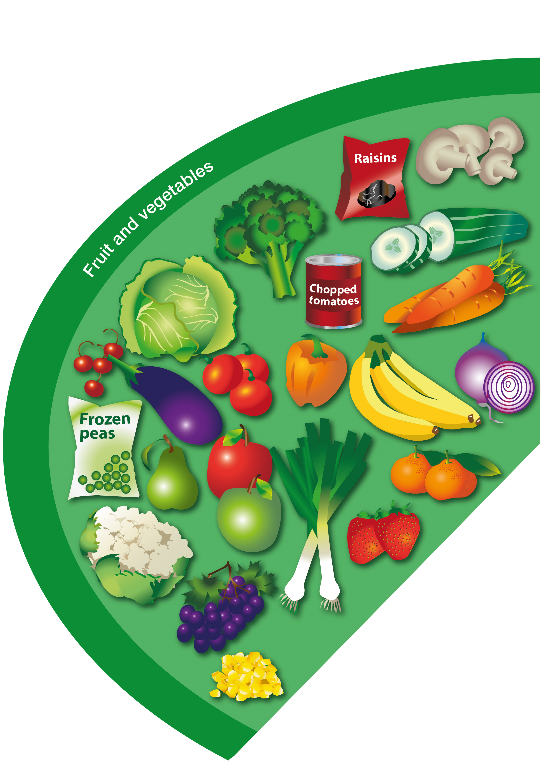
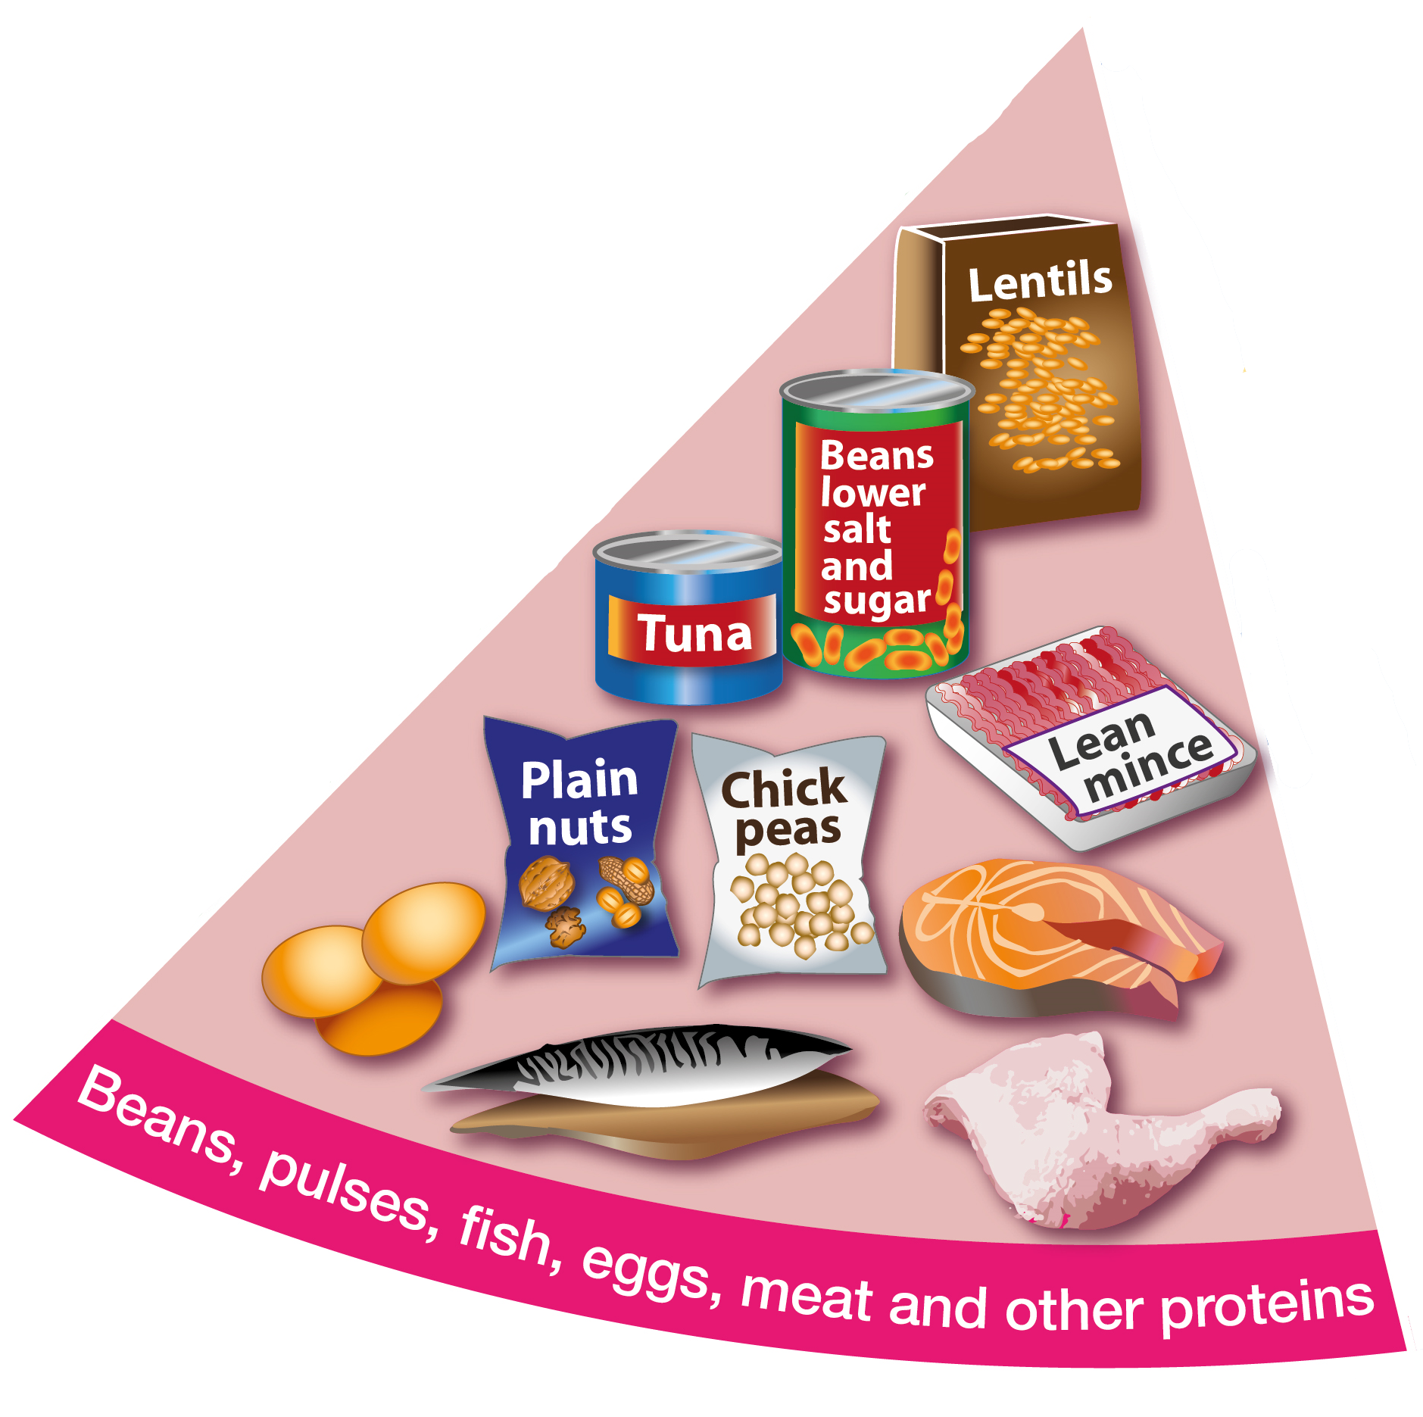
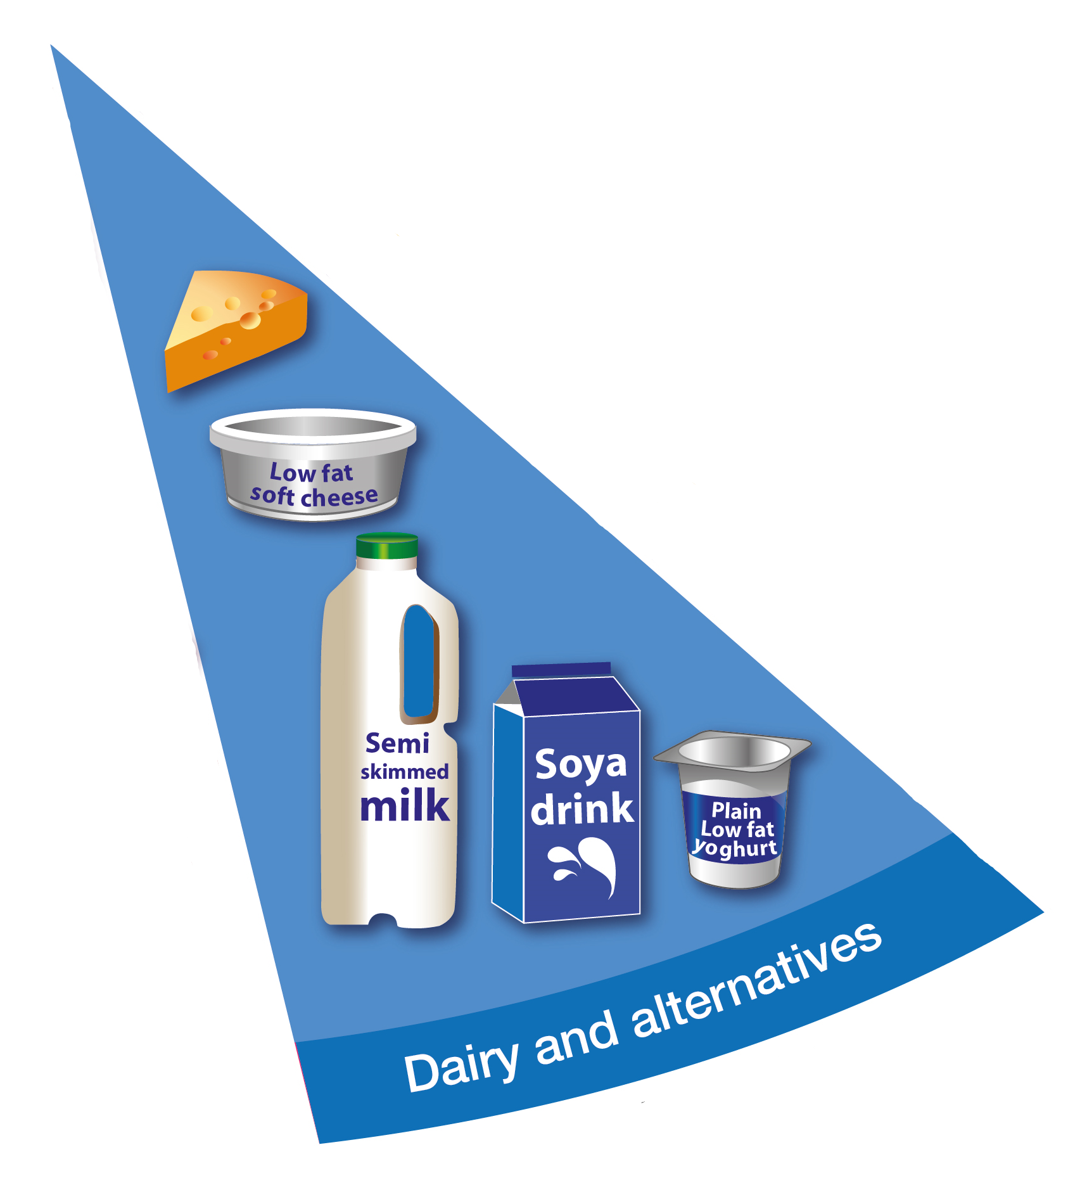
Eatwell Guide
Fruit & Vegetables
Carbohydrates or Starchy Foods
Dairy
Proteins
Notes:
Who has seen this before?
Do you know what it is or what it means?
Green – 39% fruit & veg
Yellow – 37% carbs
Pink – 12% protein
Blue – 8% Dairy
Per day - everything

Slide 4
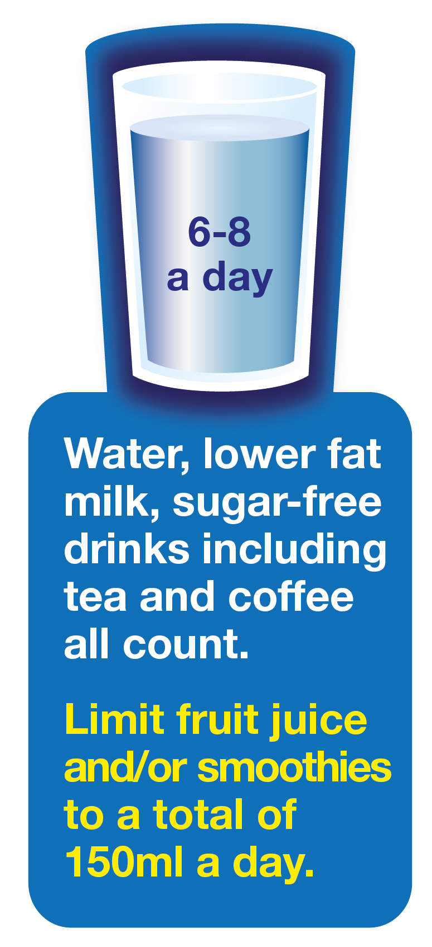
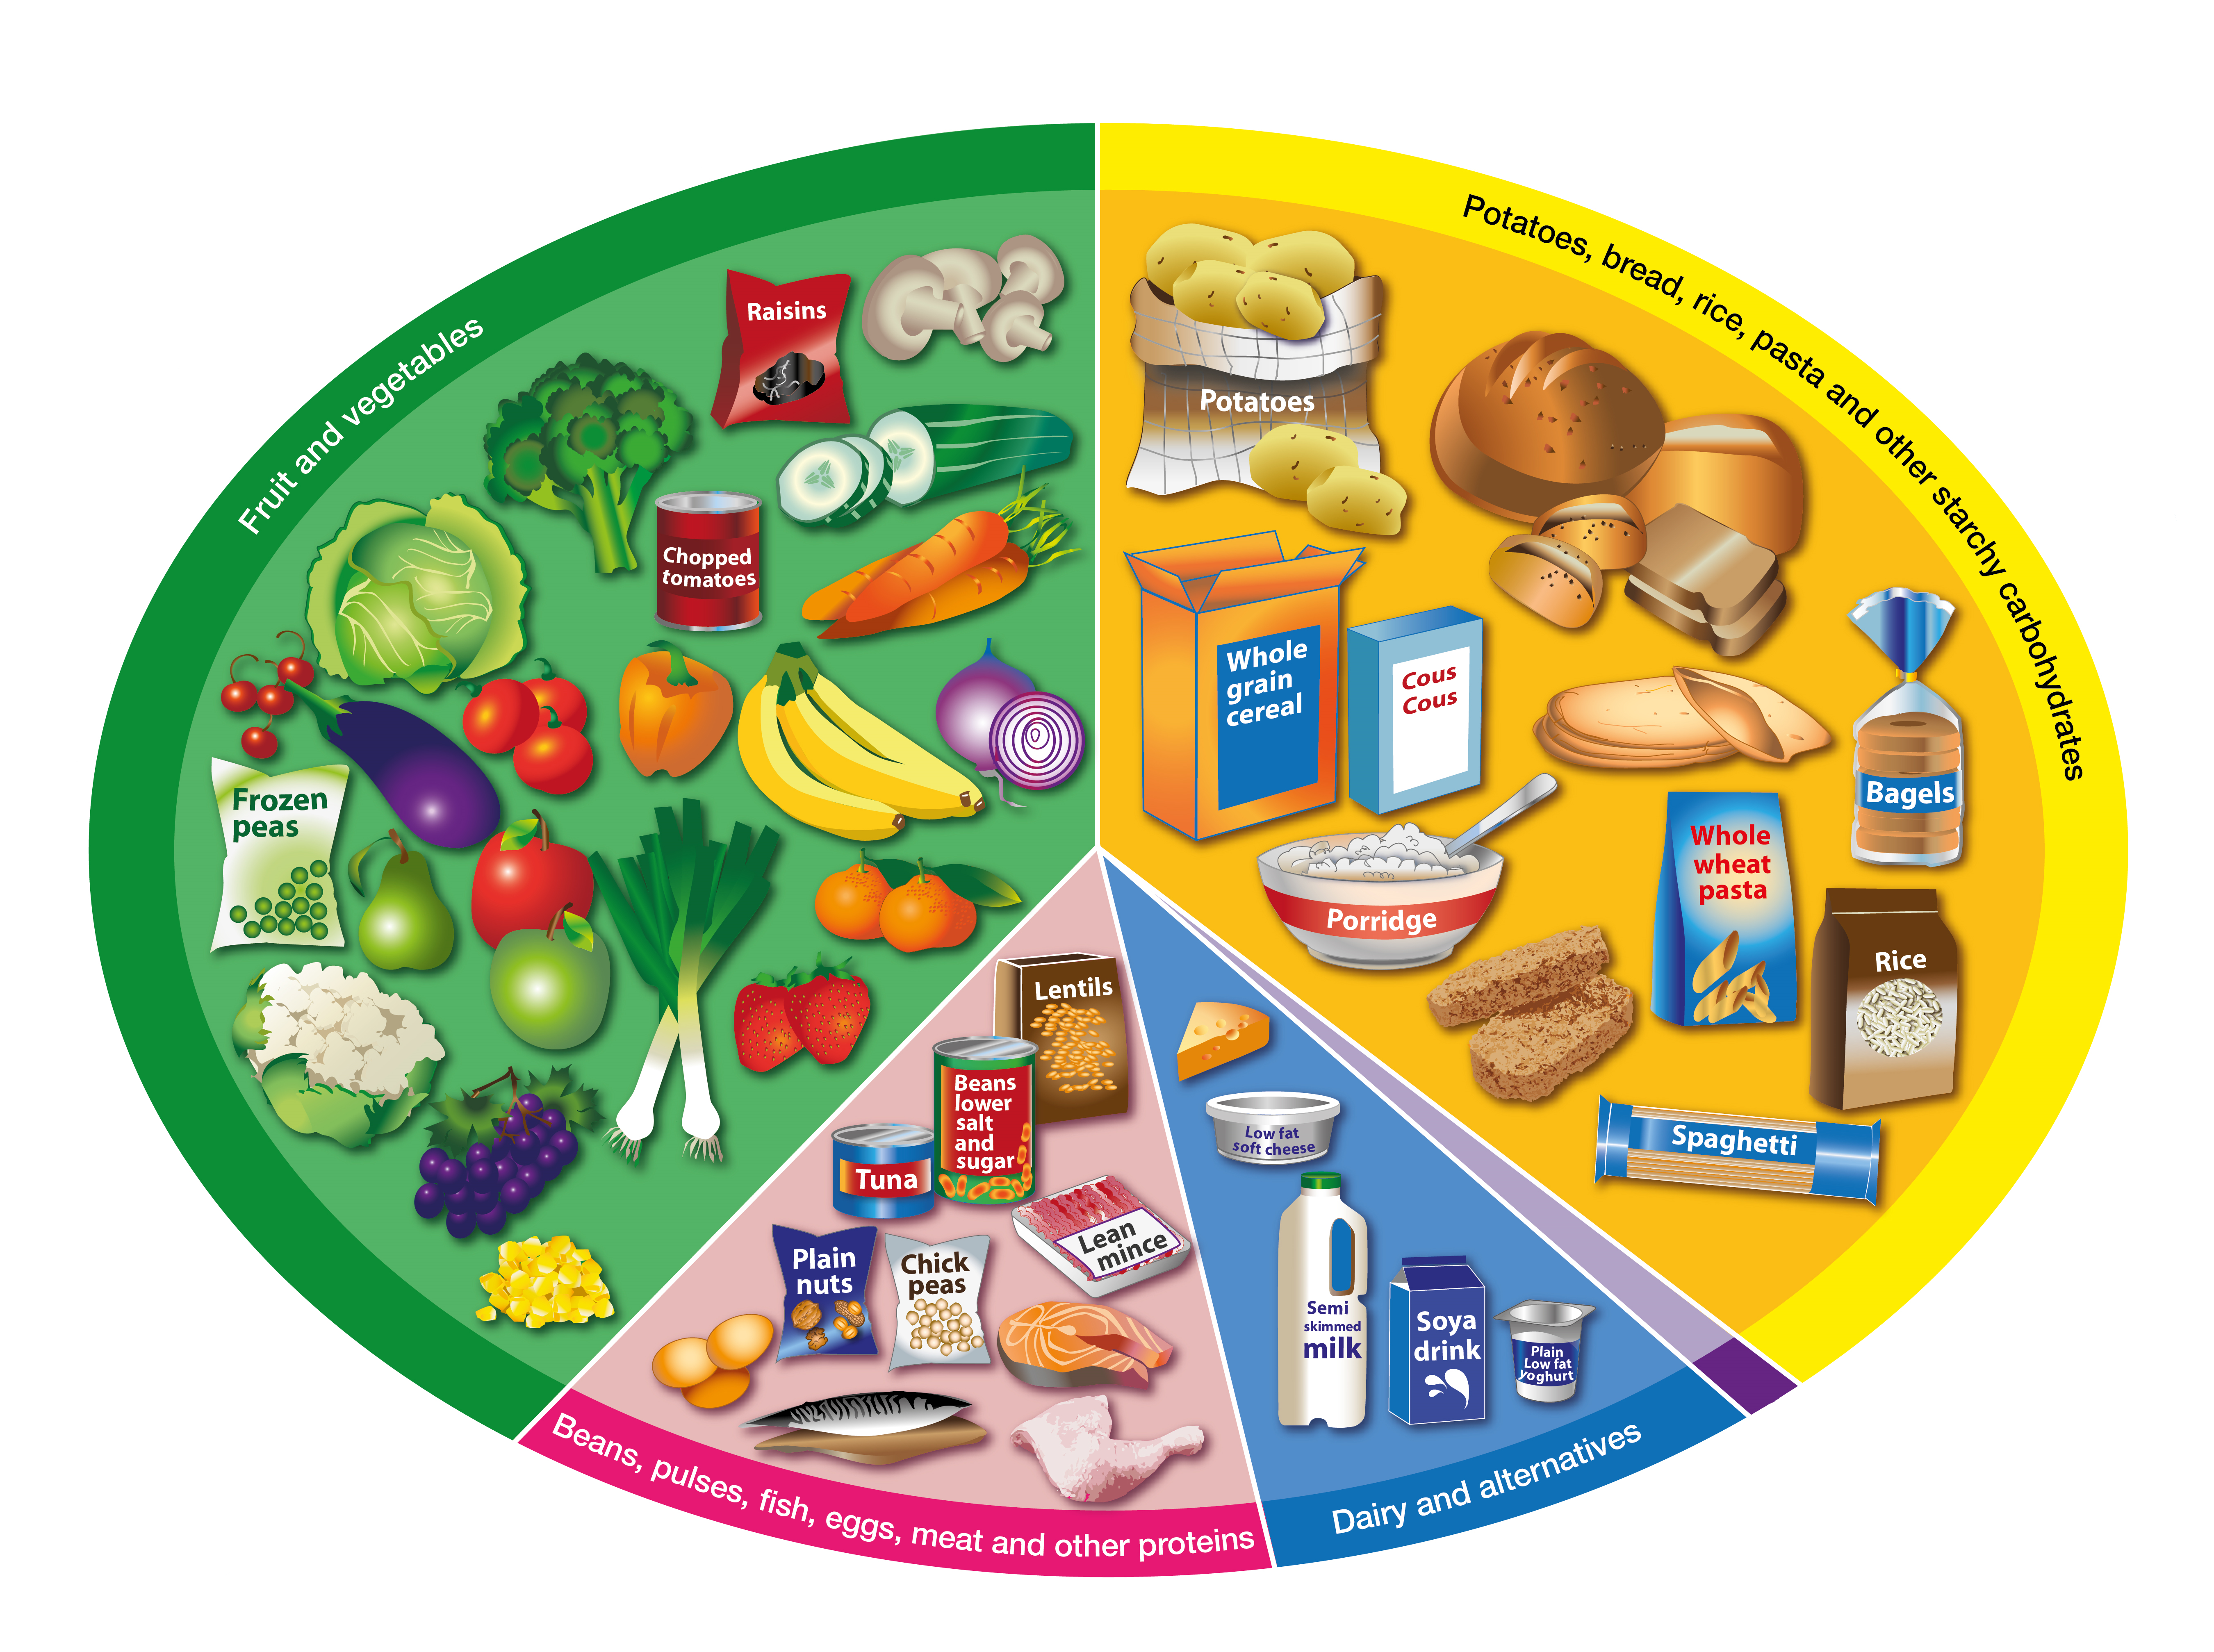
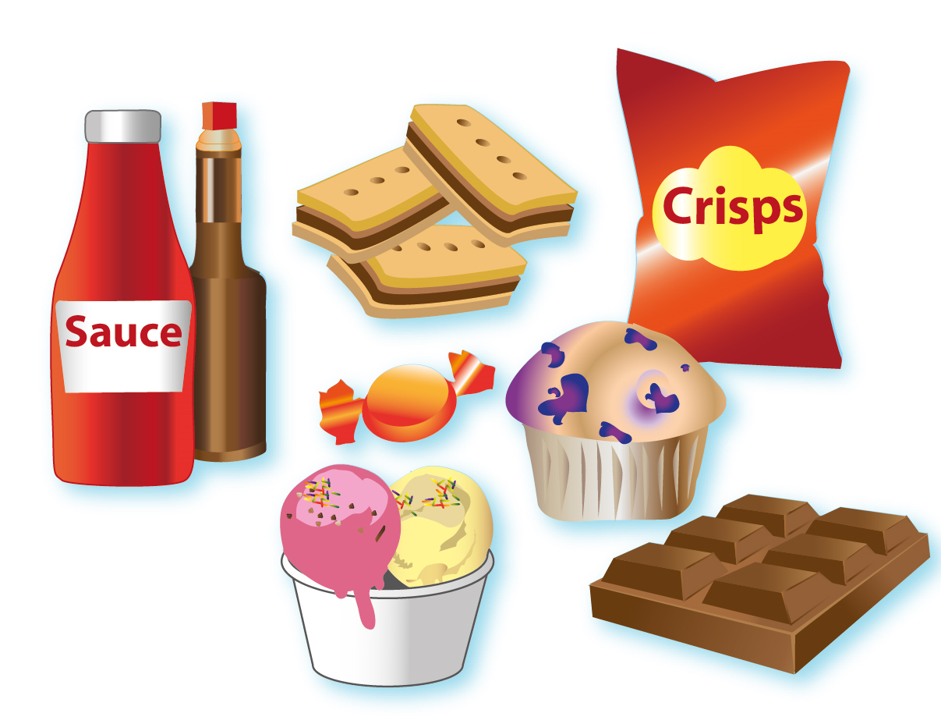
Eatwell Guide
Notes:
But we are missing some things! –
Purple – very little oils, spreads
Other foods – little & rarely
Drinks – water is the best thing you can drink but if you have fruit drinks as well these should be no more than 150ml a day

Slide 5
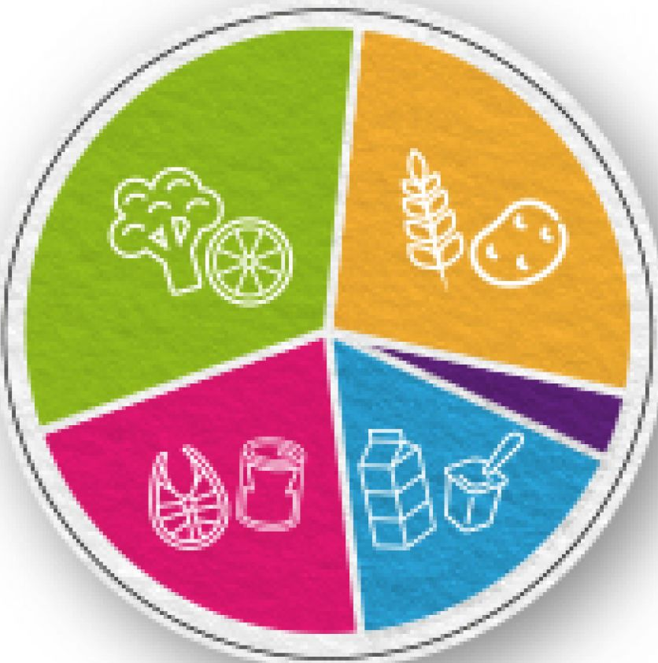
Portion Size
Fistful
3-4
5+
Cupful
2-3
2-3
Finger & Thumb
Palmful
Notes:
So are you already eating healthily? You might think so but are your portion sizes correct?
How do you know if you are eating too much of any one thing?
Its hard to measure 39% on a plate so we use our hands
Everyone is a different size and our hands are no different as they are the right size for our bodies
So does anyone know how many potions of ???? We should have per day?

Slide 6
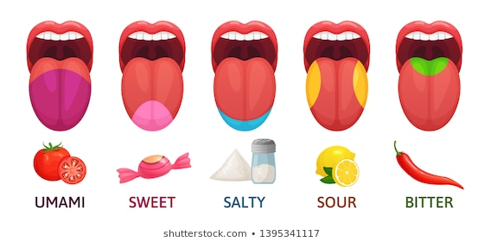
Taste & Flavour
Savoury
Sweet
Salty
Sour
Bitter
Notes:
Did you know that there are different parts to your tongue and that these parts all taste different flavours of our food?
What do you think the main/Front/Tip/Sides/Back part of your tongue tastes?
Did you know that you have to try each food at least 5 times on different occasions to know whether you like it or not? The reason for this is that when you taste something for the first time it can be a shock to your taste buds so they have to get used to it before your brain can process if you like it or not!
Another things to remember is that our taste buds change as we get older – so something you might not like now you might like when you older and visa a versa!
So constantly trying and tasting food is really important!

Slide 7
Do You Know What Healthy Eating Means?
Is it just eating fruit
and vegetables?
Is it about not
eating chocolate?
Notes:
So what do we think? Is it just……

Slide 8
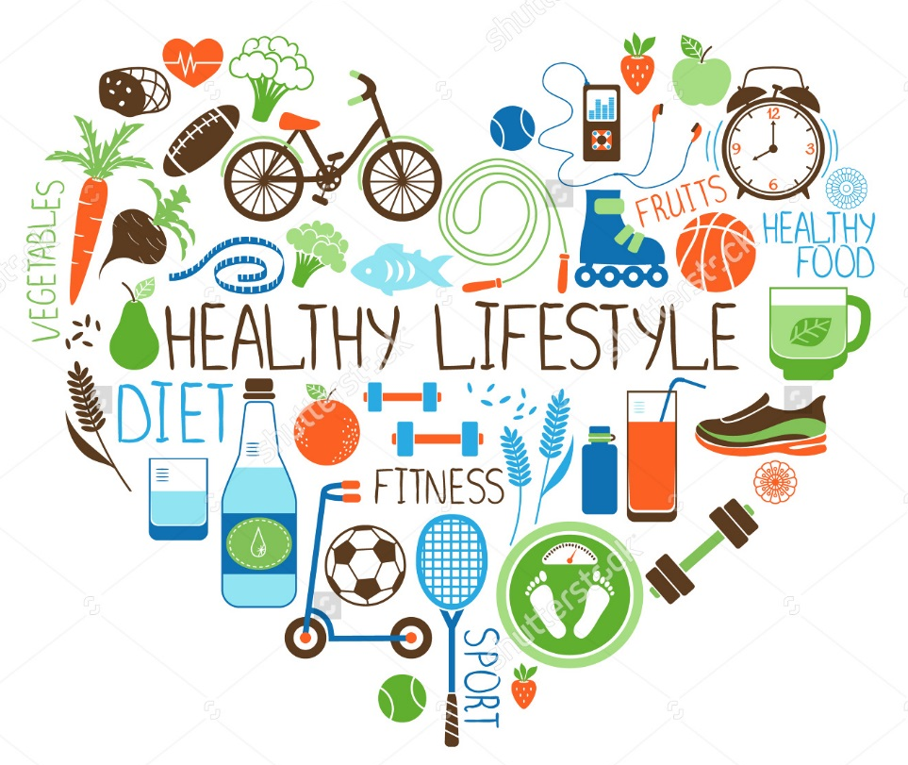
Healthy eating is only
one part of a
healthy lifestyle –
are you making the
right choices in
other things as well?
Notes:
So food is really important, having a healthy balanced diet will
Enable you to concentrate at school
Help your body develop correctly
Give you energy
But it is only one part of a healthy lifestyle so are you choosing the right choices in other areas as well?
Playing outside
Walking and cycling
Extra sports
Maybe you can make some little changes which will make a big difference to you

