Slide 1
Mental Health, Wellbeing & Resilience
Notes:
Intro self and programme.

Slide 2
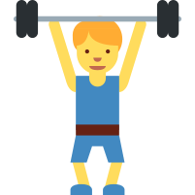
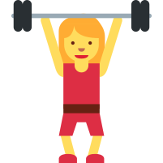
MENTAL HEALTH
Mental Health is something we ALL have.
Mental Health is DIFFERENT to mental illness.
We can TRAIN our mental health!
Cambridge United Community Trust
Mental Health, Wellbeing & Resilience

Slide 3
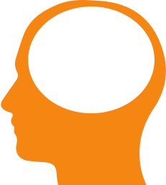
MENTAL HEALTH
?
What comes to mind when you think about mental health?
Cambridge United Community Trust
Mental Health, Wellbeing & Resilience

Slide 4
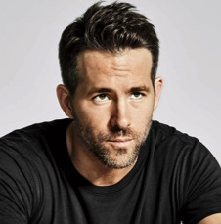
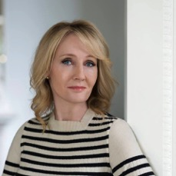
WHICH OF THESE FAMOUS PEOPLE HAVE EXPERIENCED MENTAL HEALTH CHALLENGES?
Cambridge United Community Trust
Mental Health, Wellbeing & Resilience

Slide 5
ALL OF THEM!
Ryan Reynolds
Opened up about
the anxiety he experienced whilst filming Deadpool. ‘I never, ever slept. The expectations were eating me alive.’
Aaron Lennon
Burnley winger was detained under the Mental Health Act after police became concerned for his welfare. He received treatment stress related disorder.
Demi Lovato
Was diagnosed with addiction, bulimia, and cutting. After those diagnoses, while scary at first, she was able to focus on gaining control and coping.
JK Rowling
Struggled with depression and suicidal thoughts before her fame. ‘We’re talking suicidal thoughts here, we’re not talking ‘I’m a little bit miserable’.
Justin Bieber
Spoke about how fame had a negative effect on his mental health: ‘I’m struggling just to get through the days. I get depressed all the time. And I feel isolated.
Zayn Malik
The One Direction star has been praised for his honesty over his ‘extreme anxiety’.
Cambridge United Community Trust
Mental Health, Wellbeing & Resilience

Slide 6
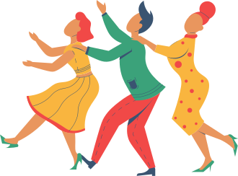
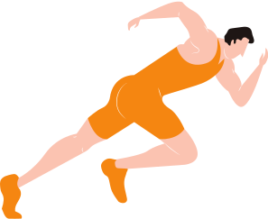
WELLBEING
G
ive something back
R
elate to other people
E
xercise your body
A
ppreciate your world
T
ry something new
Cambridge United Community Trust
Mental Health, Wellbeing & Resilience

Slide 7
RESILIENCE
Cambridge United Community Trust
Mental Health, Wellbeing & Resilience

Slide 8
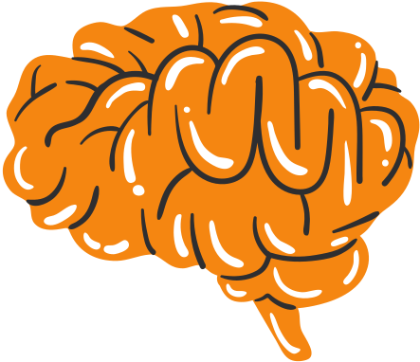
SIGNS OF POOR MENTAL HEALTH
What are some of the signs that someone may be experiencing difficulties with their mental health?
Cambridge United Community Trust
Recognising the signs of mental health concerns

Slide 9
SIGNS OF POOR MENTAL HEALTH
Decreased energy
Difficulty making decisions
Isolated & Withdrawn
Tearfulness
Changes of mood
Irregular sleep
Cambridge United Community Trust
Recognising the signs of mental health concerns

Slide 10
SIGNS OF POOR MENTAL HEALTH
Persistent sad, anxious or empty mood
Thoughts of death
or suicide
Feelings of guilt & emptiness
Feelings of hopelessness & pessimism
Restlessness
Insomnia
Cambridge United Community Trust
Recognising the signs of mental health concerns

Slide 11
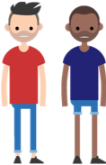
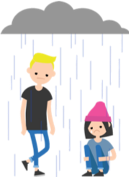
GROUPS AT RISK
Young People
Males
Here are 4
groups of people we are going to think about today
Athletes
LGBTQ+ Community
Cambridge United Community Trust
Recognising the signs of mental health concerns

Slide 12
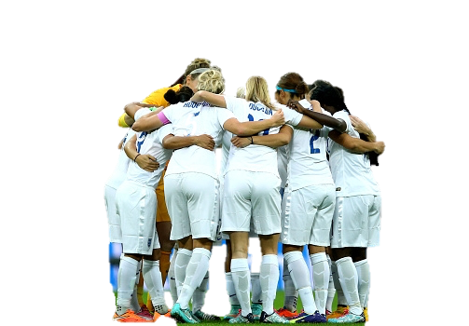
TRAITS OF PROFESSIONALS
Set high, realistic goals
Maintain a high level of self-motivation
Use positive self-talk
Use positive mental imagery
Manage negative thoughts effectively
Maintain concentration
Cambridge United Community Trust
Recognising the signs of mental health concerns

Slide 13
WHAT DOES SOCIAL MEDIA MEAN TO YOU?
Cambridge United Community Trust
Social media & its impact on our wellbeing
Notes:
Definition: websites and applications that enable users to create and share content or to participate in social networking.

Slide 14
WHAT IS THE POINT
OF A POST?
Cambridge United Community Trust
Social media & its impact on our wellbeing

Slide 15
HOW DO LIKES MAKE YOU FEEL?
999
Cambridge United Community Trust
Social media & its impact on our wellbeing
Notes:
Positive/Negative Response
Inc. Anx, need for approval/validation from others,

Slide 16
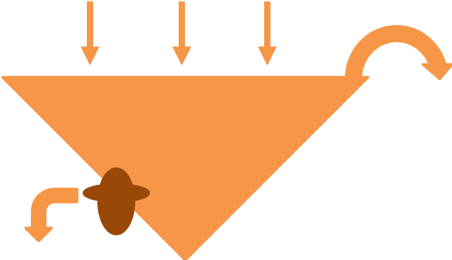
WHAT'S IN YOUR STRESS CONTAINER?
Stress flows in
Negative response if container overflows
Fatigue
Worrying
Anger
Sleeplessness
Helpful coping strategies relieve stress
Cambridge United Community Trust
Coping with stress

Slide 17
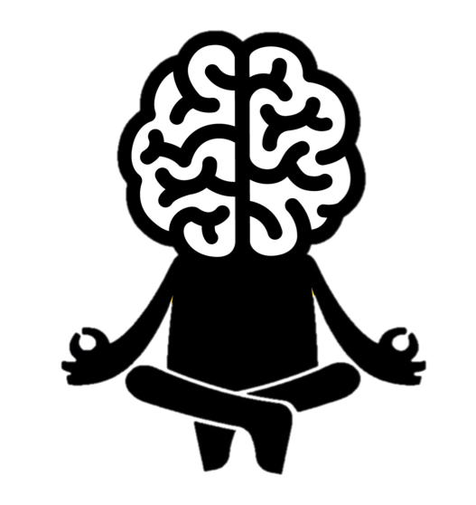
MINDFULNESS
Acceptance
Present-moment
Awareness
Cambridge United Community Trust
Coping with stress

Slide 18
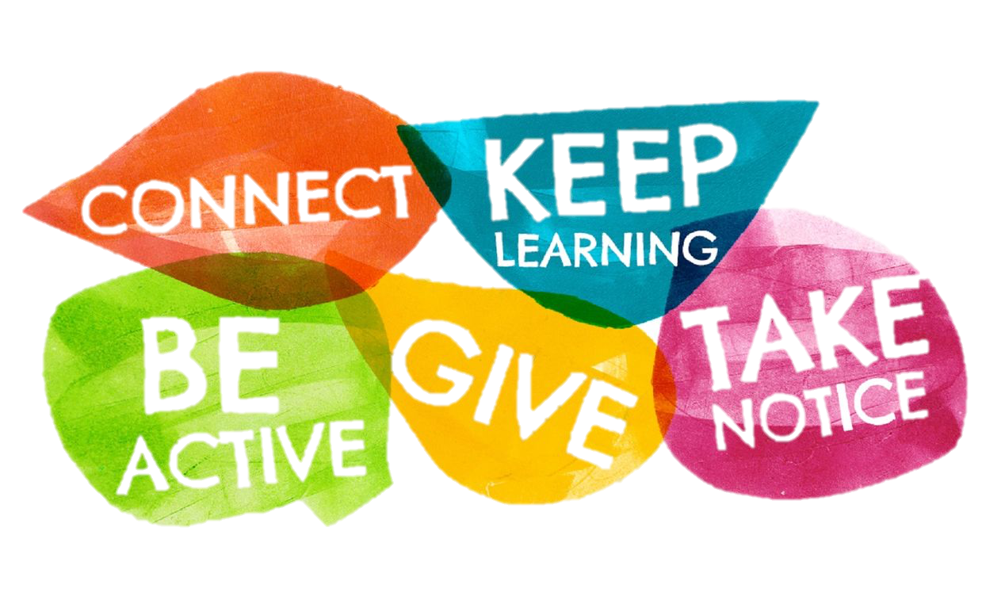
HELP YOURSELF
HELP YOUR STRESS
What can help young people when they feel stressed or anxious:
Talking to someone
Listening to music
Art or colouring
Dancing
Playing Sport
Going out with friends
Cambridge United Community Trust
Coping with stress

Slide 19
What have you learnt today?
Any questions?
Notes:
Intro self and programme.

