Slide 1
Cambridgeshire and Peterborough Healthy Lifestyle services.
Healthy Breakfast KS3/4

Slide 2
Learning outcomes
To recognise the importance and role of having breakfast
To be aware of healthier breakfast options available
To plan a week of healthier breakfast options

Slide 3
Breakfast
Who had breakfast this morning?
Notes:
By show of hands see who in the class had breakfast this morning?
Explore this further- ask the students to stand one side of the room if they have breakfast everyday, stand to the other side if they don’t.
Then ask them to separate to male and female on the sides of the room to make it easier to see the difference in numbers between genders.
Statistically 1 in 7 teens rely on sugary snacks, 1 in 20 rely on an energy drink, 1 in 3 have a cooked breakfast, and 4 in 10 skip breakfast completely for fear of weight gain.

Slide 4
Barriers To Breakfast?
Why do some people choose not to have breakfast?
Notes:
Write student responses on white board/ flipchart.
Ask the student in pairs to come up with suggestions on how people could overcome their barriers and still eat breakfast. Record these responses too.

Slide 5
Breakfast Foods
What have you had for breakfast
in the last week?
Notes:
Distribute the handouts for the students to write their breakfast foods on.
How could these breakfast choices be made healthier?
Ask for few volunteers to read out some examples of the breakfast foods they have had during the week – decide as a group how healthy these choices are , could they be improved?

Slide 6
Breakfast Options
Put the breakfast foods in order from the highest to lowest nutritional value.
Notes:
See resources for cards

Slide 7
Breakfast Plan
Design a healthy breakfast menu for a local café making sure there are foods from multiple groups of the Eatwell plate included.
Notes:
Reference the next slide for the Eatwell Guide

Slide 8
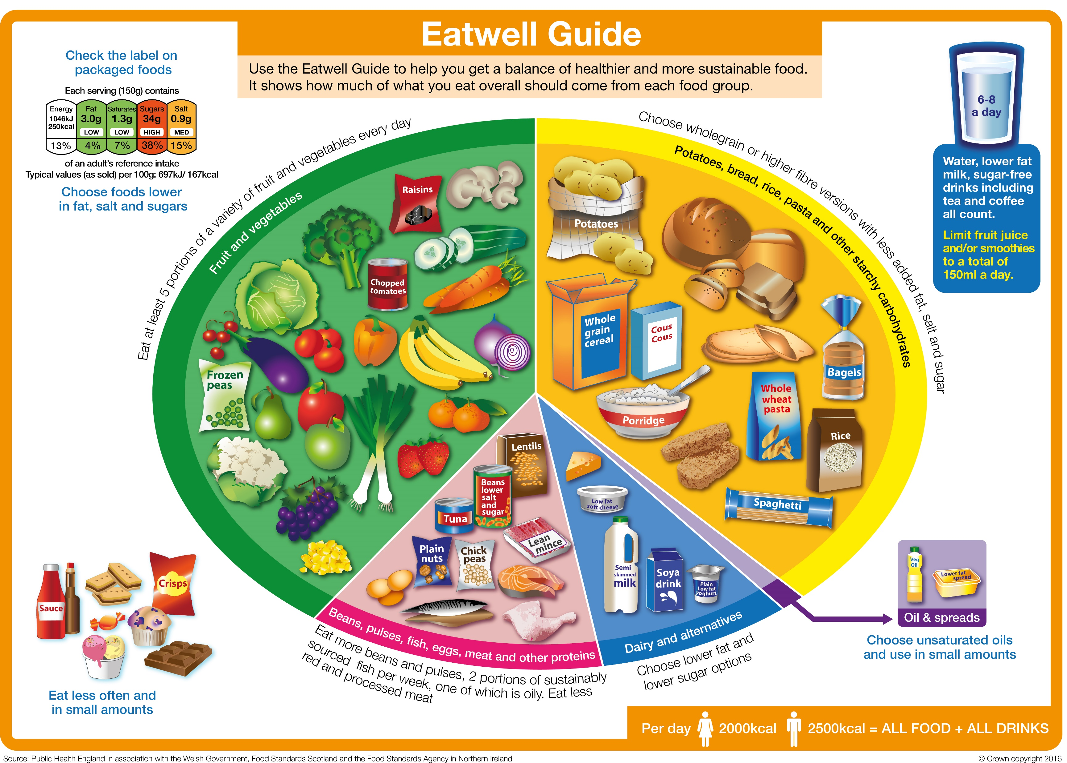
Notes:
Try to include foods from multiple sections of the plate for better vitamin and mineral balance.
ie: beans on toast with fruit and yogurt.

Slide 9
Recap
Will you be:
Changing your breakfast choices?
Starting to eat breakfast?
Questions?

