Slide 1
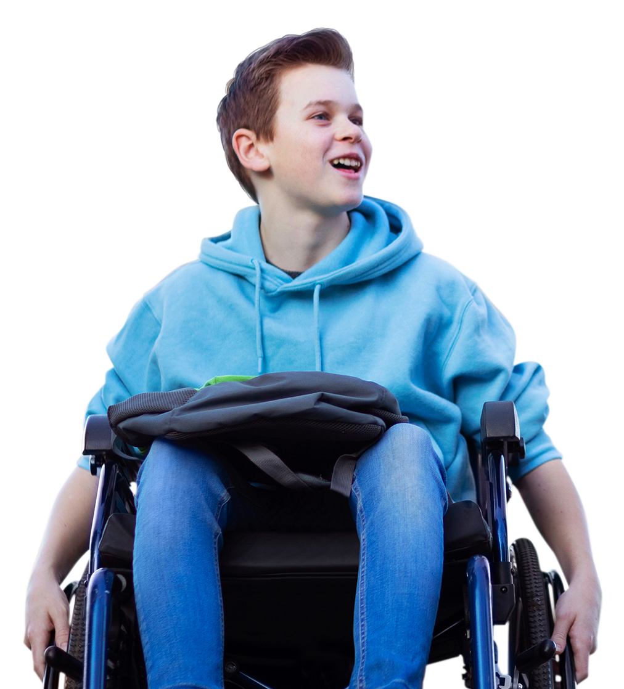
Building
Connections
Building
connections

Slide 2
Overview
In this lesson, students explore the meaning of loneliness and connection and learn actions they can take to build connections with themselves, with friends and family and with their wider community.
Recommended age group
Education providers for ages 11-16 (KS3/KS4)
Time
45-60 minutes approximately
Preparation
Before delivering the lesson:
consider cross-curricular links and how this could be related to other content such as Every Mind Matters resources on puberty and positive relationships
familiarise yourself with the film content on slides 10 and 14 of this PowerPoint
read through the classroom tips on slide 3 and key facts for teachers on slide 5
This lesson has been designed to be part of the planned programme for PSHE education and should be taught within the context of other PSHE education lessons. It supports the mental wellbeing strand of the Relationships and Sex Education (RSE) and Health Education statutory guidance. See the Curriculum Links for further information.
Resources
Blank A5 and A4 paper and colouring pencils/pens
Post-it notes
Key vocabulary
Loneliness, connection, community, socialising (spending time with people), friendship, sharing, identity, stigma (shame), wellbeing (feeling good)
Follow up
You may wish to extend students’ learning with one of the extended learning projects on slide 22.

Slide 3
Classroom tips
Climate for learning
Read through Guidance for Learning in a Safe Environment. This includes advice on:
developing and revisiting effective ground rules drawn up with students
familiarity with your school’s safeguarding policy and procedures, including Child Protection and other relevant policies
being prepared in case students make a disclosure
including and protecting vulnerable students
using distancing techniques so that students can discuss sensitive issues without being encouraged to make a disclosure
handling sensitive questions
involving students with special educational needs and disabilities (SEND) and autism
You may also wish to familiarise yourself with any schemes or offers available in your school, organisation or local area to support young people’s mental health. Your local public health team or school nurse should be able to help signpost you to local sources of support.
Anonymous question box
Place a question box or envelope somewhere in the classroom. students write down any questions that occur to them during the lesson and submit them anonymously. You can address these questions in the next lesson.
Identify students for whom this topic may be challenging
For children and young people who have moved to a new area or education setting (especially if this is due to being in care, because of poverty or because they are a refugee) it can be especially difficult to build connections. It is important to be aware of these students before teaching this lesson and any sensitivities or issues that may come up.

Slide 4
Social distancing
Preparation
Returning to school and managing the changes that have come about in their lives because of Covid-19 will have posed many different challenges for young people. Every young person will have been affected differently and it will be more important than ever before for students to have a safe space to explore their feelings and experiences.
Reassure students that its normal to worry about the impact of Covid-19 and that everyone will have had different responses. For example, some may have experienced loneliness, while others may have enjoyed lockdown – for many, there will have been a mixture of different emotions.
This lesson has a scenario related to Covid-19 and this may be particularly sensitive for any students who have experienced significant distress, loss or trauma prior to Covid-19 or during this time. There is clear guidance for teaching sensitive issues in the Guidance for Learning in a Safe Environment document and it is important that this is read before delivering this lesson.
Adapting lessons to social distancing
Activity 1 (Slide 9-11): The gallery of loneliness and connection
Students could draw their images and then all hold up the images of loneliness and then connection at the same time. Students could also be given blue tack and could take it in turns to stick their images up and then take it in turns to look at the galleries. Ask students to feedback reflections as a whole class which the teacher can add to the board.
Activity 2 (Slide 13): Four levels of connection – combatting loneliness
Students could each complete their own individual diagram. Alternatively, a large one could be done on the board and contributions given through discussion or students could add their thoughts to post-it notes and take it in turns to go up and add them to the class diagram if this is viable to do whilst maintaining social distancing.

Slide 5
Key facts for teachers
School belonging
56% of young people said they felt like they belong in their school. Boys were slightly more likely than girls to report a sense of belonging to their school (60% vs 52%). Younger adolescents were most likely to report feeling like they belong in their school.
Teacher connectedness
Nearly three quarters (74%) of young people said that they felt they had at least one teacher they could go to if they had a problem. There were minimal gender differences (73% of boys compared with 75% of girls). However, younger adolescents were more likely to agree they had at least one teacher they can go to.
Peer relationships
Over half of young people (58%) agreed that other students in their class were kind and helpful.
Family
Just under a third of young people (60%) agreed that they could talk to their family about problems.
Friends
Just under half of all young people reported that they had supportive friendships. Girls were slightly more likely than boys to report that they could talk to their friends about their problems and their friends were there to help them.
Electronic media communication (EMC)
Over a third (37%) of 15 year old girls said they contacted their close friends via EMC “almost all the time”.
Source: Health Behaviour in School Age Children Survey 2020 (HBSC)
This is a long-standing international study conducted in collaboration with the World Health Organization (WHO). The HBSC study is repeated every four years providing trends in young people’s wellbeing. Data for England spans over a decade (2002-2018) The HBSC study uses a survey methodology, collecting data through self-completed questionnaires administered during school. The surveys are completed by young people aged 11, 13 and 15 years old.
Access full report here
Notes:
Access the full report on these findings by clicking above or copying and pasting the URL below into your web browser:
http://hbscengland.org/wp-content/uploads/2020/01/HBSC-England-National-Report-2020.pdf

Slide 6
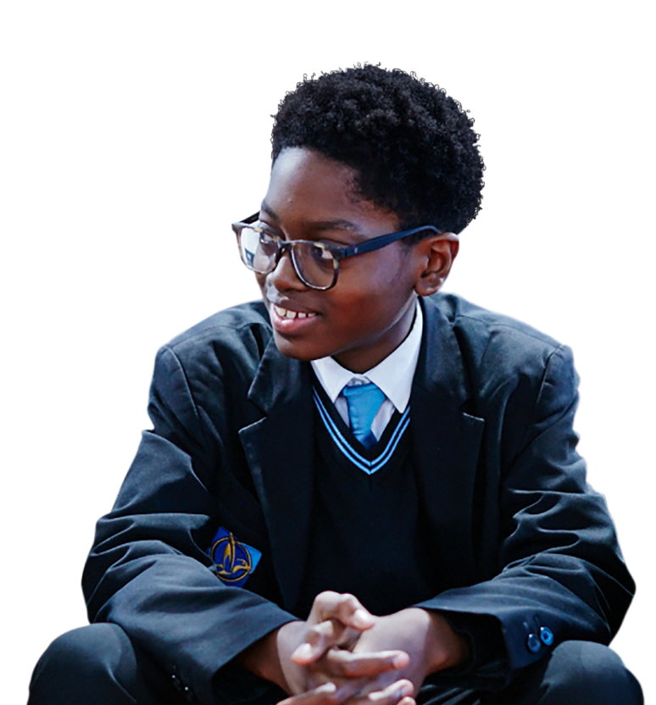
What are we learning?
Learning outcomes
Learning objectives
Key vocabulary
loneliness
connection
community
socialising (spending time with people)
friendship
sharing
identity
stigma (shame)
wellbeing (feeling good)
explain what loneliness and connection mean
give advice to a young person experiencing loneliness
evaluate different actions that can be used to build connections
We are learning about how to manage loneliness through making meaningful connections.
Notes:
Briefly share the learning outcomes, objectives and key vocabulary with students. Note that easier-to-understand words are provided in brackets.
Note that this slide features animated content and should be viewed in presentation mode.

Slide 7
What might prompt this message?
How could you reply?
“I’ve been feeling kind of alone recently…”
Notes:
Lesson stimulus (3-4 mins)
Ask students to discuss with the person next to them, considering why the friend could be feeling lonely and how they might respond to the message.
Introduce students to the topic of loneliness and connection and explain that loneliness is a normal emotion that everyone experiences.

Slide 8
How confident are you in…
10
Extremely confident
9
8
7
6
explaining what loneliness and connection mean?
giving advice to a young person who wants to feel more connected?
evaluating different actions that can be used to build connections?
5
4
3
2
1
0
Not confident
8
Notes:
Baseline assessment: How do you feel? (3-4 mins)
Show the students the three statements and ask them to rate their confidence in each using a scale from 0-10 (0 = not confident, 10 = extremely confident).
There are lots of ways you might do this activity. Students could respond to the statements individually by writing their three numbers down on paper, or verbally by discussing their feelings in pairs/groups. You could also use ‘traffic lights’ (red/amber/green) or ask students to hold up the relevant number of fingers in response to each statement.

Slide 9
Draw it
1.
Loneliness
2.
Connection
Notes:
Core activity 1: The gallery of loneliness and connection (10 mins)
Give students two pieces of A5 paper each and ask them to spend two minutes drawing an image or diagram that represents loneliness on the first piece and then another two minutes drawing an image or diagram that represents connection on the second. Click to reveal the following definitions to support their images:
Loneliness is an unwanted emotion that can include feeling excluded, isolated, disconnected from others or an unhappiness with relationships.
Connection is a feeling of being included, of belonging and able to enjoy positive relationships. That includes relationships with friends, family and people in our community as well as ourselves – being able to enjoy being in our own company, it is not just about having lots of friends.
Note that students’ images can be as abstract as they like. Before drawing, explain to students that they should draw images that represent the ideas of loneliness and connectivity more generally, instead of drawing images based on their own personal experience.

Slide 10
Loneliness vs. connection
Watch the first part of the video
Notes:
Core activity 1: The gallery of loneliness and connection (10 mins) continued
Before sharing the discussion questions on the next slide, play the first part of the video, pausing at 01:36.
You can click on the slide to play the video or copy and paste this URL into your web browser: https://bcove.video/3mtdbrV

Slide 11
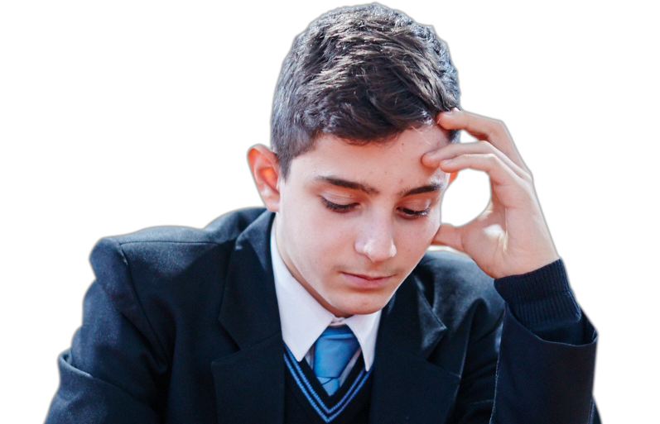
Loneliness vs. connection
What stands out to you when looking at the different galleries or watching the video?
What are the main factors that could lead to feeling lonely?
What are the main factors that could lead to feeling connected?
Notes:
Core activity 1: The gallery of loneliness and connection (10 mins) continued
In small groups or as a whole class, ask the students to put their images of loneliness together and their images of connection together to create a gallery of loneliness and a gallery of connection.
Give each group three different coloured post-it notes. Students can put responses to the questions on the post-it notes and stick them around each of the galleries.
Example answers to support students:
What stands out to you when looking at the two different galleries?
For examples, colours, images, themes, how they make you feel.
What are the main factors that could lead to feeling lonely?
For example, being left out, feeling different, change, family dynamics, falling out with friends, and lots of time spent alone.
What are the main factors that could lead to feeling connected?
For example, new experiences, close relationships with family and friends, making a contribution to something, having people know you and remember things about you, hobbies.

Slide 12
Discussion questions
Challenge
Why might loneliness be hard to talk about?
How might Covid-19 have impacted loneliness and connection?
What is the difference between being alone and loneliness?
Do you think it’s possible to feel connected and lonely at the same time?
If so, give examples.
Notes:
Discussion questions (5 mins)
What is the difference between being alone and loneliness?
Being alone can be positive and doesn’t mean you are lonely, for example a person might enjoy time alone reading a book or listening to an audiobook or podcast. Being alone can help us feel more connected to things like nature or our own creativity. On the other hand, it’s possible to feel lonely, even when with others. For example, a person might have lots of friends or a big family but still feel lonely.
Do you think it’s possible to feel lonely and connected at the same time? If so give examples.
For example, a person could feel lonely in school but connected at home or feel connected during lessons, when they are doing learning they enjoy but lonely at break-times.
Further challenge:
Why might loneliness be hard to talk about?
Reasons might include feelings of stigma (that other people will disapprove in an unfair way), shame or embarrassment. People might think it’s their fault or their family or friends might not speak about loneliness.
How might Covid-19 have impacted on loneliness and connection?
Students may wish to explore examples of connection they have witnessed as a result of Covid-19, from communities coming together and having more time for each other but also how lockdown has led to isolation for certain groups of people and how it has led to people missing contact with friends and family.
Optional further question:
Do you think there might be differences in how connected people want to be?
Connection is an important part of being human and while everyone wants to feel connected to others, the world and to themselves, there may be individual differences in how much time people want to spend alone (remember, just because a person is alone it doesn’t mean they are lonely!). However, someone who looks comfortable being alone might also be lonely.

Slide 13
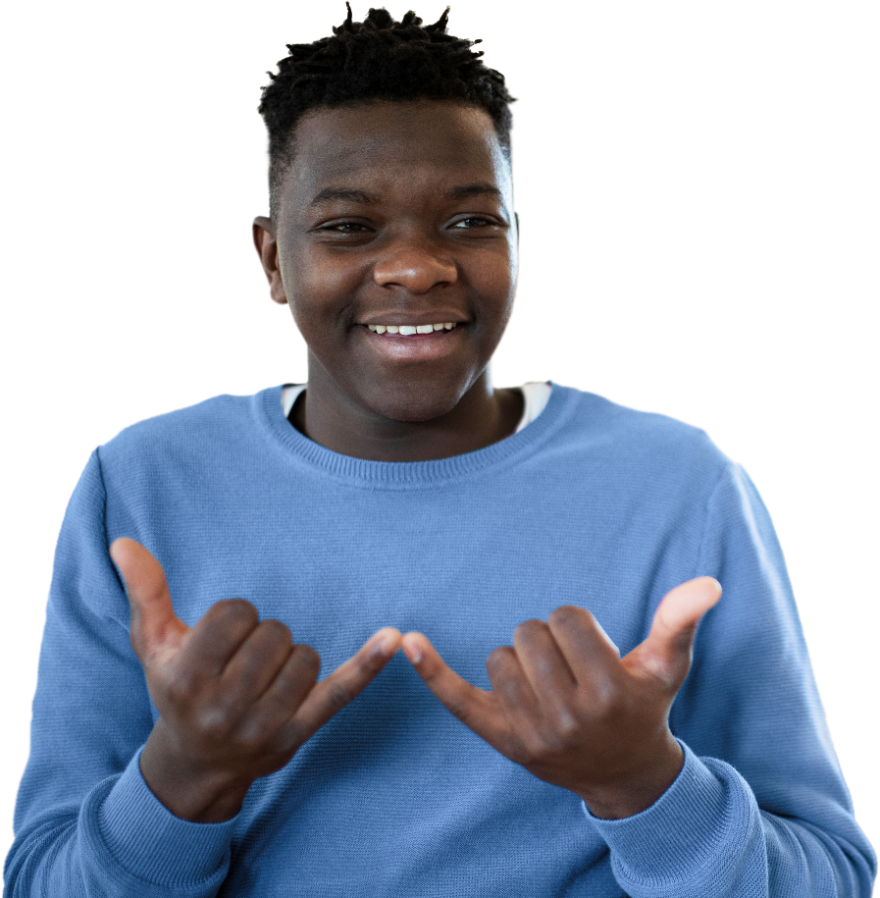
Four levels of connection
How could young people build connections on each level?
Notes:
Core activity 2: Four levels of connection – combatting loneliness (15 mins)
Explain to students that there are different levels of connection (see below for more information). In groups, give students a few minutes to draw the diagram and write or discuss any ideas they have for young people to build connection on each level. Note, if relevant, you may want to caveat that students’ strategies should be based on current Covid-19 social distancing guidance.
Individual: What things could a young person do on their own to tackle loneliness and build connection? For example, reading or listening to music.
Friends and family: What could a young person do to increase connection with friends and family? For example, a cinema trip with friends.
Local community (includes school, youth centres, parks, scouts, guides, or local youth or faith groups etc.): What could a young person do in their local communities to increase connection and help stop loneliness among young people? For example, volunteering to be a mentor in school or visiting a nearby leisure centre.
Wider community: What else could be done in society to tackle loneliness? This could be something that’s done across the country, online or ways of connecting with people, places or things outside of the local community. For example, volunteering at a community event or space such as park, or with older people.
Support: It may be helpful to write some of the examples from the lists above on the board and then ask students who may need more support to put them in each of the categories and then add on their own examples (this strategy may be particularly helpful to young people with autism who find the task challenging).
Optional Challenge: Ask students to use a different coloured pen to either underline ways of building connection that they think were particularly important during Covid-19 or add on any exampled that that were specific to this time period e.g. Clap for Carers
Highlight to students that we all have a responsibility to look out for others who might feel lonely. What can we do to help others feel included?

Slide 14
What helps build connections?
Watch the second part of the video
Notes:
Core activity 2: Four levels of connection – combatting loneliness (15 mins) continued
Watch from 01:37 to the end of the video. You can click on the slide to play the video or copy and paste this URL into your web browser: https://bcove.video/3mtdbrV

Slide 15
What helps build connections?
Using social media positively
Learning or starting a new activity
Getting active
Showing kindness to others, with oneself and others
Reaching out and talking about the feeling of loneliness
Arranging to spend time with friends or family
Being in nature or spending time outdoors
Volunteering is a great way to get connected
Getting to know someone new
Notes:
Core activity 2: Four levels of connection – combatting loneliness (15 mins) continued
Share this slide with students and ask them to add in anything new.
Note that, if relevant, you may wish to discuss how these activities can be carried out under social distancing measures. For example, it might be a case of arranging to spend some virtual time with friends, joining a virtual youth group or club, reaching out to elderly relatives or spending some quality time with family members they live with.
It is also important to emphasise the safety implications for getting to know someone new.

Slide 16
Discussion questions
Which ideas do you think are the most effective for building connection and why?
Which ideas do you think would be the hardest for young people to implement and why?
Notes:
Core activity 2: Four levels of connection – combatting loneliness (15 mins) continued
In pairs or groups, can they circle the ideas that they think would be the most effective? In a different colour pen, can they add the challenges or possible barriers to those ideas?
If students need extra support in evaluating the actions provided on slide 15 in this way, consider simply showing the slide and asking students to do a class vote.
Alternatively, print off slide 15 and ask students to arrange the actions in a diamond nine; ordering the actions in a diamond shape, with those they think would be most useful at the top and least useful at the bottom.

Slide 17
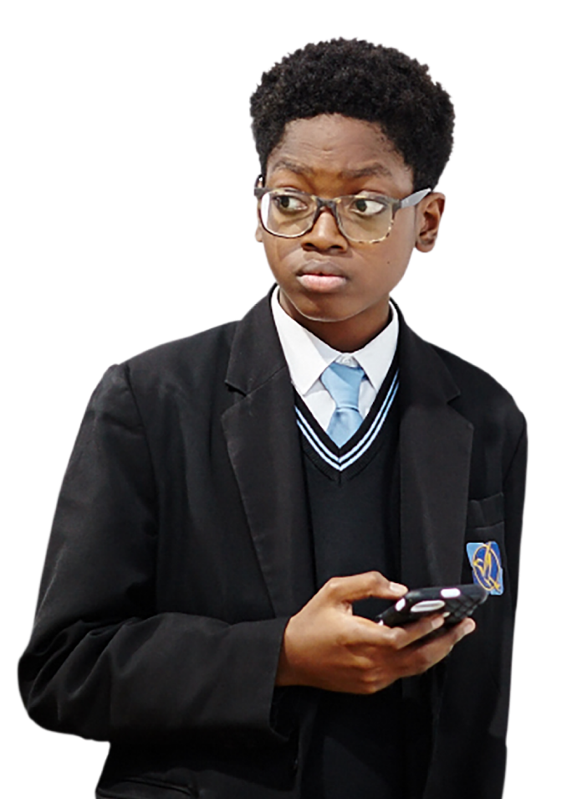
Challenge
Young people have been highlighted as one of the age groups that can sometimes feel lonely. Why do you think this might be?
What more could be done in schools (or colleges) to build connections?
How do you think technology affects loneliness?
How could stigma in society around loneliness be changed?
Notes:
Core activity 2: Four levels of connection – combatting loneliness (15 mins) continued
Further challenge:
Young people have been highlighted as one of the age groups that can sometimes feel most lonely. Why do you think this might be?
Period of transition and change, generation very connected to social media and technology, less life experience. Stress to students that as a group, young people are also more likely to take action to combat loneliness.
What more could be done in schools (or colleges) to build connections?
Peer support groups, more involvement with local community (e.g. through volunteering opportunities), after school clubs or activities, talking about loneliness and connection more.
How do you think technology affects loneliness?
Examples to discuss include social media, instant messaging, people ignoring messages, having followers or likes.
How could the stigma in society around loneliness be changed?
For example, encouraging people to talk more openly about loneliness. Research shows that 74% of people said when they feel lonely, they don’t tell anyone despite most having someone they could count on.
(Source: YouGov Plc)
Encourage students to reflect privately on what they as individuals could do to prevent others feeling lonely in school.

Slide 18
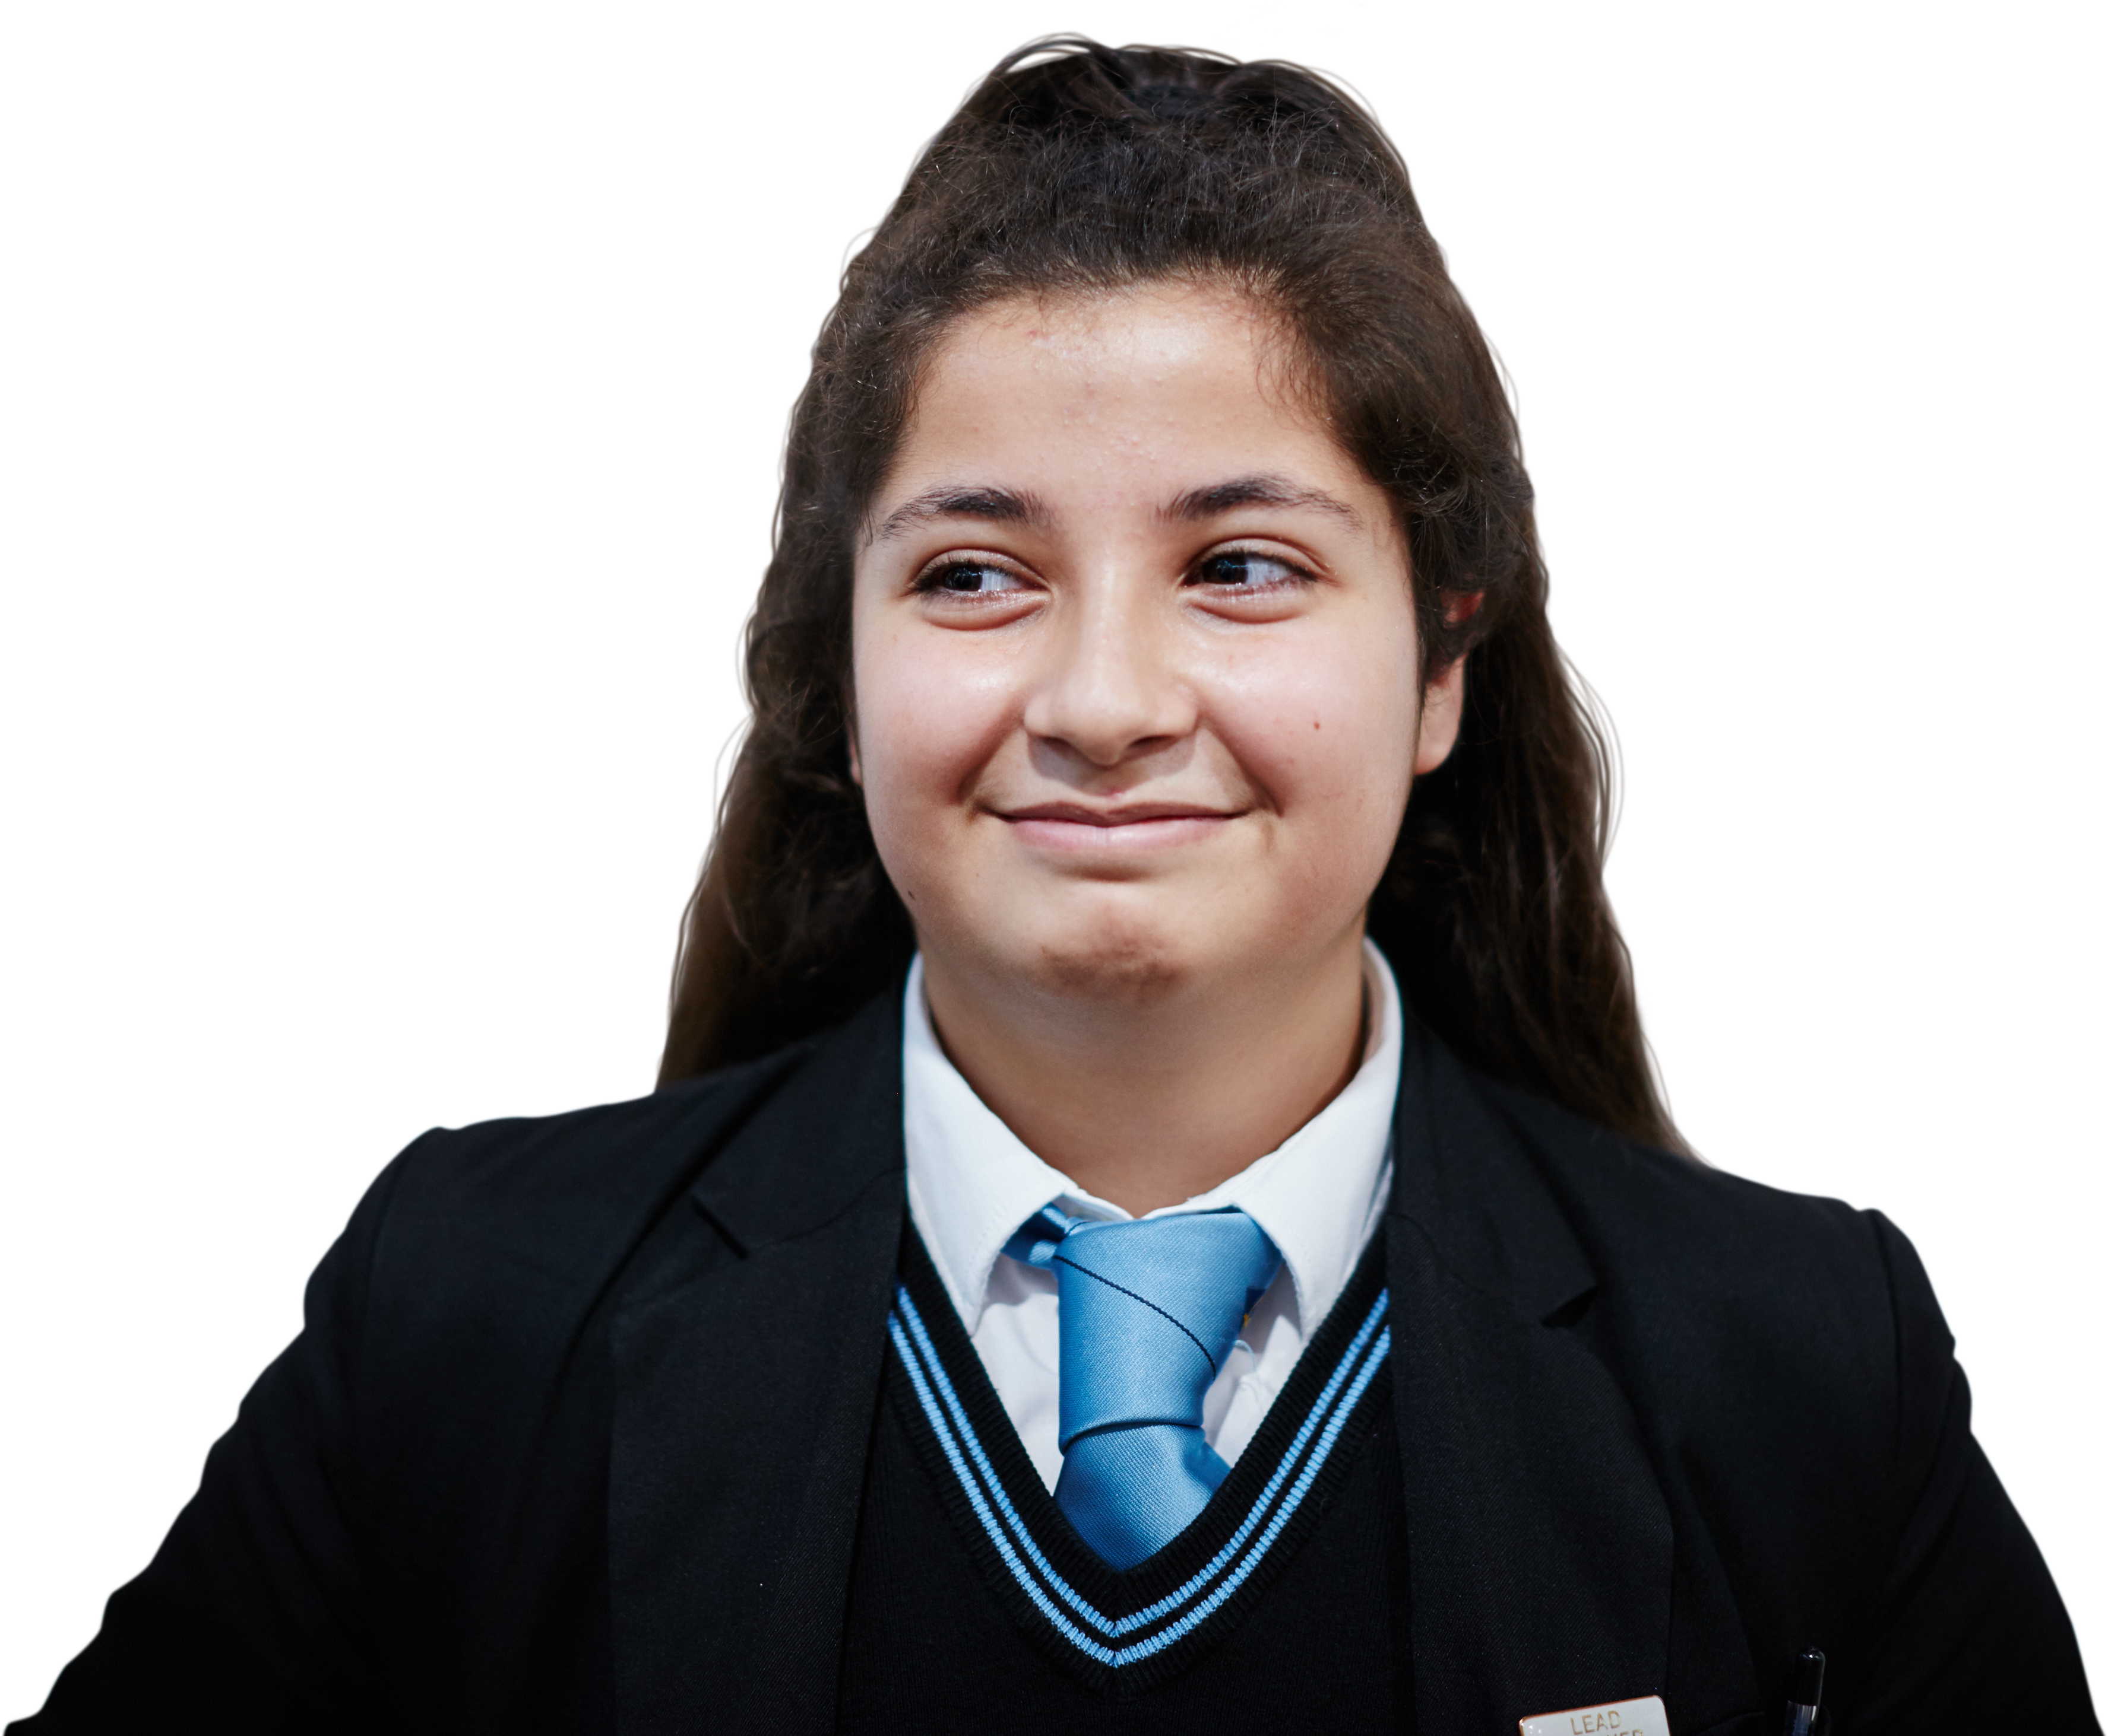
How to connect
1.
‘I’ve been feeling lonely during lockdown, I’ve missed my friends and I’m not sure what the best way to reconnect with them is now we are back at school.’
Tara
Choose one of the scenarios. What tips and advice could you give to these students?
2.
‘I’ve moved to a new town and I don’t know anyone. I’m nervous about making new friends.’
Jamal
Notes:
How to connect (3-4 mins)
Ask students to choose one of the scenarios on the slide. What tips and advice could you give them?
Tips and advice for school include:
Say hello and be friendly
If you see someone on their own, say hello and ask how their day is
Ask people about their interests, hobbies or experiences
Asking people for help can be a good way to get to know/reconnect people
Remember, it takes time to settle in and get to know/reconnect with people

Slide 19
How confident are you in…
10
Extremely confident
9
8
7
6
explaining what loneliness and connection mean?
giving advice to a young person who wants to feel more connected?
evaluating different actions that can be used to build connections?
5
4
3
2
1
0
Not confident
Notes:
Follow up assessment: (2-3 mins)
Show the students the statements A-C for a second time and ask them to rate their confidence in each using a scale from 0-10 (0 = not confident, 10 = extremely confident).
There are lots of ways you might do this activity. Students could respond to the statements individually by writing their three numbers down on paper, or verbally by discussing their feelings in pairs/groups. You could also use ‘traffic lights’ (red/ amber/green) or ask students to hold up the relevant number of fingers in response to each statement.
Students should answer the three questions on a confidence scale: 0 = not confident, 10 = extremely confident.

Slide 20
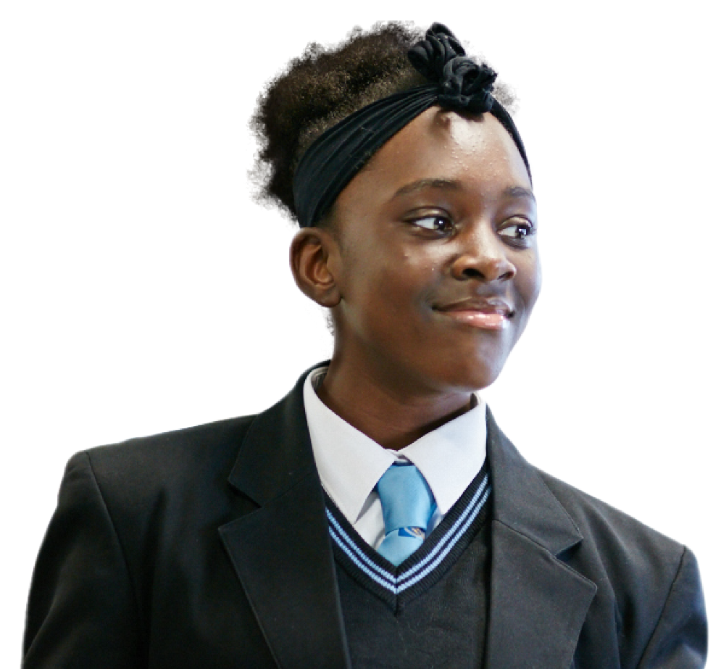
How could you reply now?
“I’ve been feeling kind of alone recently…”
Can you compose a message back?
Notice if your reply is different.
Notes:
Plenary: Message a friend (3-4 mins)
Show students the same message once more. Compose a message back.
Students can discuss their reasons with the person next to them or in a group. Can they develop their response from the beginning of the lesson based on what they have learned?

Slide 21
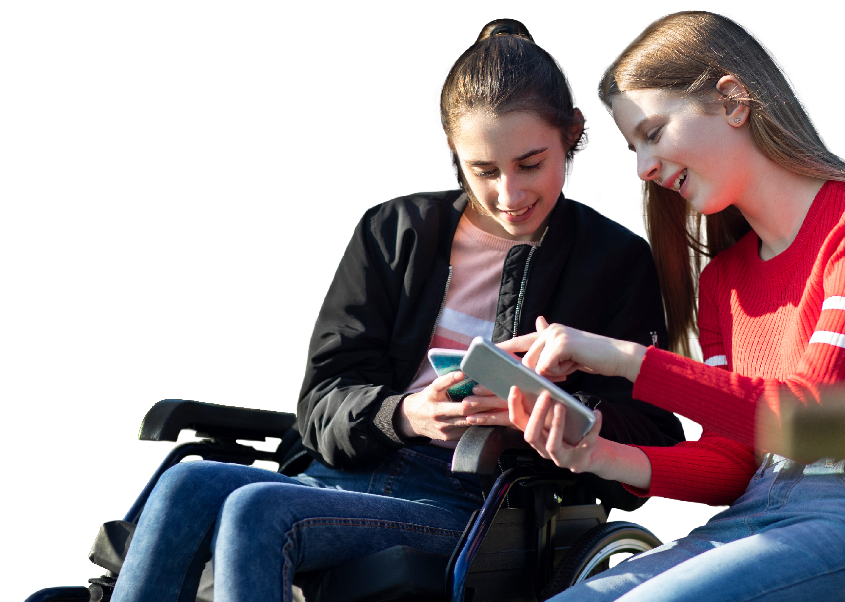
It can be common to experience feelings of loneliness
It is always good to talk about it to friends and trusted adults and there are lots of organisations that can give support such as Childline or the Mix.
Childline: childline.org.uk/info-advice Or call 0800 1111
The Mix: Call 0808 808 4994
21
Notes:
Signposting (1 min)
Let students know that it can be very common to experience feelings of loneliness, but it is always good to talk about it to friends and trusted adults and there are lots of organisations that can give support such as Childline or the Mix which run free telephone helplines for children and young people. You could also remind students of school support services they can access, such as their tutor or school counsellor.

Slide 22
Extended learning projects
Ask students to form a ‘Connection Collective’ – can they create a plan of different things the school or educational organisation could do to encourage feelings of connection? Students could organise a meeting with the head of year to discuss how more connection can be created in the school.
Create a piece of artwork inspired by the lesson. Students could look back at their gallery of connection (from Core activity 1) for ideas, and think about how they involve the wider school or even the local community in developing their art. For example, each student or community member could complete a different ‘tile’ in a mosaic.
Students create an anonymous questionnaire to find out what other students think the main causes of loneliness are and the best ways to build connections. Students could think about whether they want to gather quantitative or qualitative data and what questions they would need to ask.
Students could find out about volunteering initiatives in their area and create a brochure to share options with other students. Students could use the websites below to support their research. Students will need to ask their parent/carer before volunteering.
Volunteering matters
Do-it
Timebank
Notes:
Extended learning projects
These can be given to students as projects to extend their learning, these could be done either in school as group projects or at home.

