Slide 1
Building connections

Slide 2
Overview
Pupils explore the meaning of loneliness and connection. This lesson is particularly relevant to pupils preparing for secondary school as they’ll learn actions they can take to build connections with themselves, with friends and family and with their wider community.
Recommended age group
Education providers for ages 10-11 (Year 6)
Time
60 minutes + (note, you may wish to extend this content over two sessions)
Preparation
Before delivering the lesson:
consider cross-curricular links and how this could be related to other subjects
familiarise yourself with the film content on slides 11 and 13 of this PowerPoint
read through the classroom tips on slide 3. Loneliness could be a particularly sensitive subject for pupils so make sure clear classroom guidelines are set
Resources
Blank A5 paper and colouring pencils/pens (for each pupil)
Support Squad writing frame (for pupils who may need support)
Strips of coloured paper (one per pupil)
Glue sticks (optional)
Key vocabulary
Loneliness, feeling, alone, together, belonging, connection, wellbeing (feeling good), strategies (actions)
Follow up
You may wish to extend pupils’ learning with one of the extended learning projects on slide 23.

Slide 3
Classroom tips
Climate for learning
Read through Guidance for Learning in a Safe Environment. This includes advice on:
developing and revisiting effective ground rules drawn up with pupils
familiarity with your school’s safeguarding policy and procedures, including Child Protection and other relevant policies
being prepared in case pupils make a disclosure
including and protecting vulnerable pupils
using distancing techniques so that pupils can discuss sensitive issues without being encouraged to make a disclosure
handling sensitive questions
involving pupils with special educational needs and disabilities (SEND) and autism
You may also wish to familiarise yourself with any schemes or offers available in your school, organisation or local area to support young people’s mental health. Your local public health team or school nurse should be able to help signpost you to local sources of support.
Anonymous question box
Place a question box or envelope somewhere in the classroom. Pupils write down any questions that occur to them during the lesson and submit them anonymously. You can address these questions in the next lesson.
Identify pupils for whom this topic may be challenging
For children and young people who have moved to a new area or education setting (especially if this is due to being in care, because of poverty or because they are a refugee) it can be especially difficult to build connections. It is important to be aware of these pupils before teaching this lesson and any sensitivities or issues that may come up.

Slide 4
Social distancing
Preparation
Returning to school and managing the changes that have come about in their lives because of Covid-19 will have posed many different challenges for young people. Every young person will have been affected differently and it will be more important than ever before for pupils to have a safe space to explore their feelings and experiences.
Reassure pupils that its normal to worry about the impact of Covid-19 and that everyone will have had different responses. For example, some may have experienced loneliness, while others may have enjoyed lockdown – for many, there will have been a mixture of different emotions.
This lesson has a scenario related to Covid-19 and this may be particularly sensitive for any pupils who have experienced significant distress, loss or trauma prior to Covid-19 or during this time. There is clear guidance for teaching sensitive issues in the Guidance for Learning in a Safe Environment document and it is important that this is read before delivering this lesson.
Adapting lessons to social distancing:
Please refer to the Government guidelines and your own school’s advice.
Where pair or small group discussions isn’t possible, replace with personal reflections or individual contributions to whole class discussions.
Ideas for adapting specific activities within the lesson are provided on the next slide.

Slide 5
Social distancing
Lesson stimulus (Slide 7): Similarities and differences
If pupils have mini-white boards, they could all draw an image of their favourite subject/food/hobby, hold them up to the rest of the class and then pupils could point when they see someone who has drawn the same as them or something they like.
Activity 1 (Slide 9-11): The gallery of loneliness and connection
Pupils could draw their images and then all hold up the images of loneliness and then connection at the same time. Pupils could also be given blue tack and could take it in turns to stick their images up and then take it in turns to look at the galleries.
Activity 2 (Slide 10): Support Squad
The class could be split into three sections (A,B,C) and each section could feedback their ideas about connecting in that area and ideas could be recorded on the board to support the letter writing. Pupils could then choose one of the scenarios and individually write a letter to that pupil using the ideas on the board.
Plenary (Slide 21): Chain of connection
This activity could be carried out completely individually without the paperchain or it could be carried out as a verbal chain of connection where pupils take it in turns to say one thing they have learnt until everyone has had a turn.

Slide 6
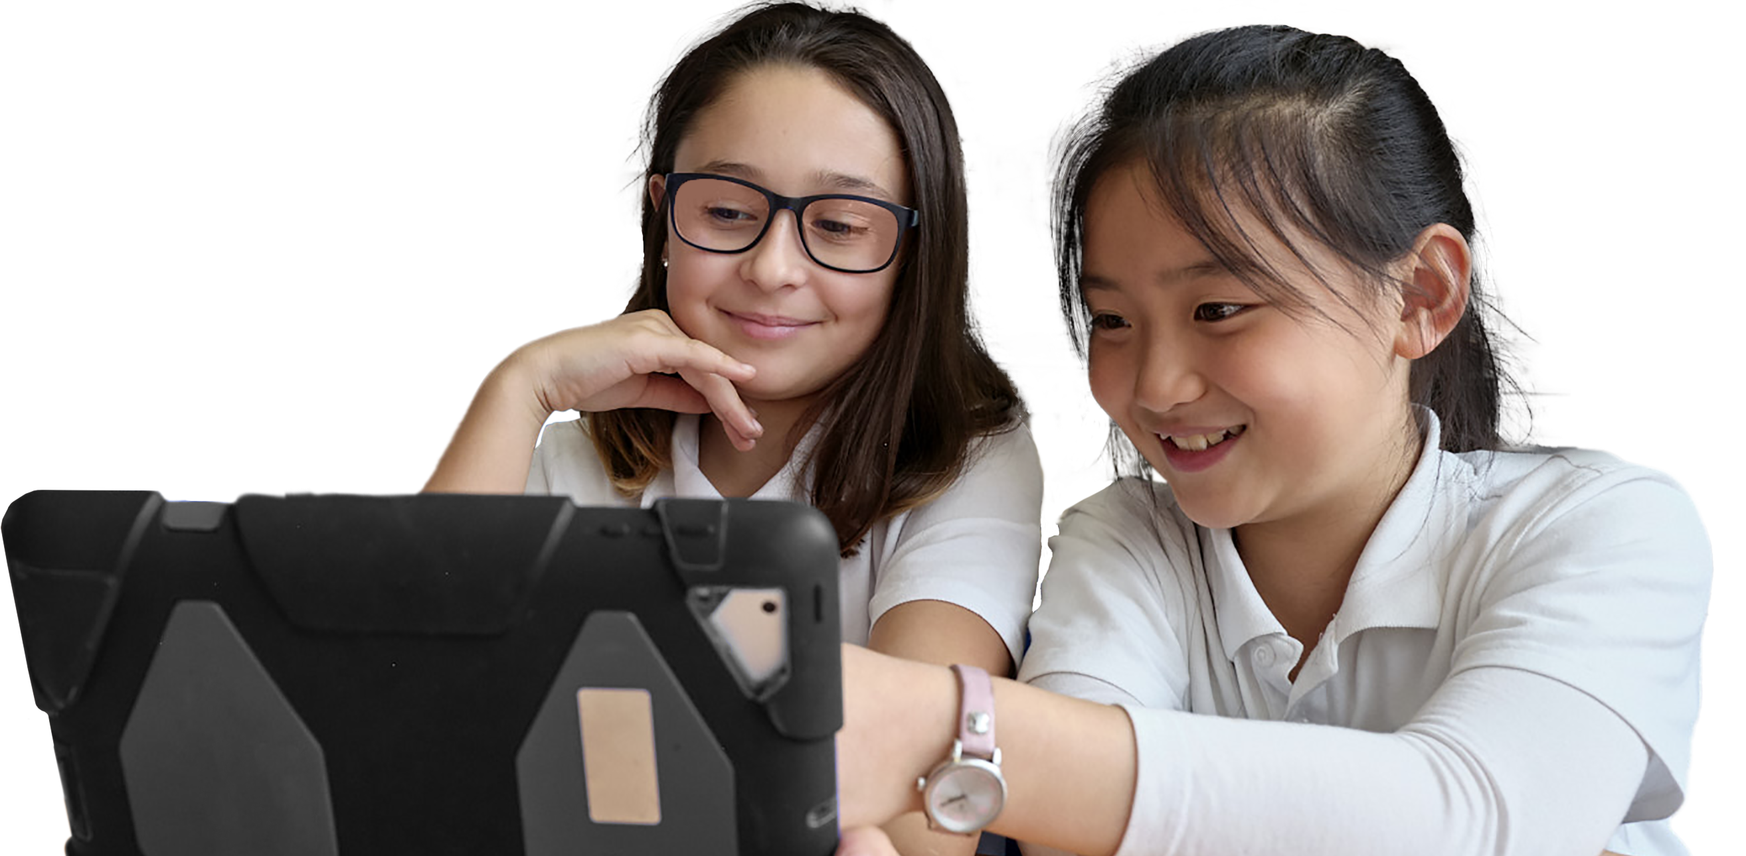
What are we learning?
Learning objectives
Learning outcomes
Key vocabulary
We are exploring what loneliness and connection mean
We are learning actions young people can take to build connections if they are feeling lonely
loneliness
feeling
alone
together
belonging
connection
wellbeing (feeling good)
strategies (actions)
explain what loneliness means
explain what connection means
give advice to a young person who wants to feel more connected
Notes:
Briefly share the learning objectives, outcomes and key vocabulary with pupils. Note that easier-to-understand alternative words are provided in the brackets.
Note that this slide features animated content and should be viewed in presentation mode.

Slide 7
Similarities and differences
Favourite subject
Can you find one similarity between you?
Can you find one difference between you?
Food or drink
that you like
Hobbies
Notes:
Lesson stimulus (3-4 mins)
Show pupils the slide and ask them to move around the classroom. When you clap your hands, they should pair up with the person closest to them (or this can be done with the person they sit next to). Ask them to talk to their partner and find one similarity and one difference between them. When they have found a similarity and a difference they can sit down in their usual seat. Support pupils by clicking in PowerPoint to reveal prompts they could discuss (for example, favourite subject, food or drink that they both like, or favourite hobby).
If pupils need extra challenge, see if they can find new similarities/differences, i.e. things that they didn’t know about before they started talking. Ask some of the pupils to share their examples.
Introduce pupils to the topic of connection and explain to them that sometimes connecting is easier than we think. Explain that this lesson will also be about loneliness and that loneliness is a normal emotion that everyone experiences from time to time.

Slide 8
How confident are you in…
10
Extremely confident
9
8
7
6
explaining what loneliness means?
explaining what connection means?
giving advice to a young person who wants to feel more connected?
5
4
3
2
1
0
Not confident
8
Notes:
Baseline assessment: How do you feel? (3-4 mins)
Show pupils the statements A-C and ask them to rate their confidence in each using a scale from 0-10 (0 = not confident, 10 = extremely confident). There are lots of ways you might do this activity. Pupils could respond to the statements individually by writing their three numbers down on paper, or verbally by discussing their feelings in pairs/groups. Alternatively, you could ask pupils to reflect silently, before holding up the relevant number of fingers in response to each statement.
How confident are you in:
A) explaining what loneliness means?
B) explaining what connection means?
C) giving advice to a young person who wants to feel more connected?

Slide 9
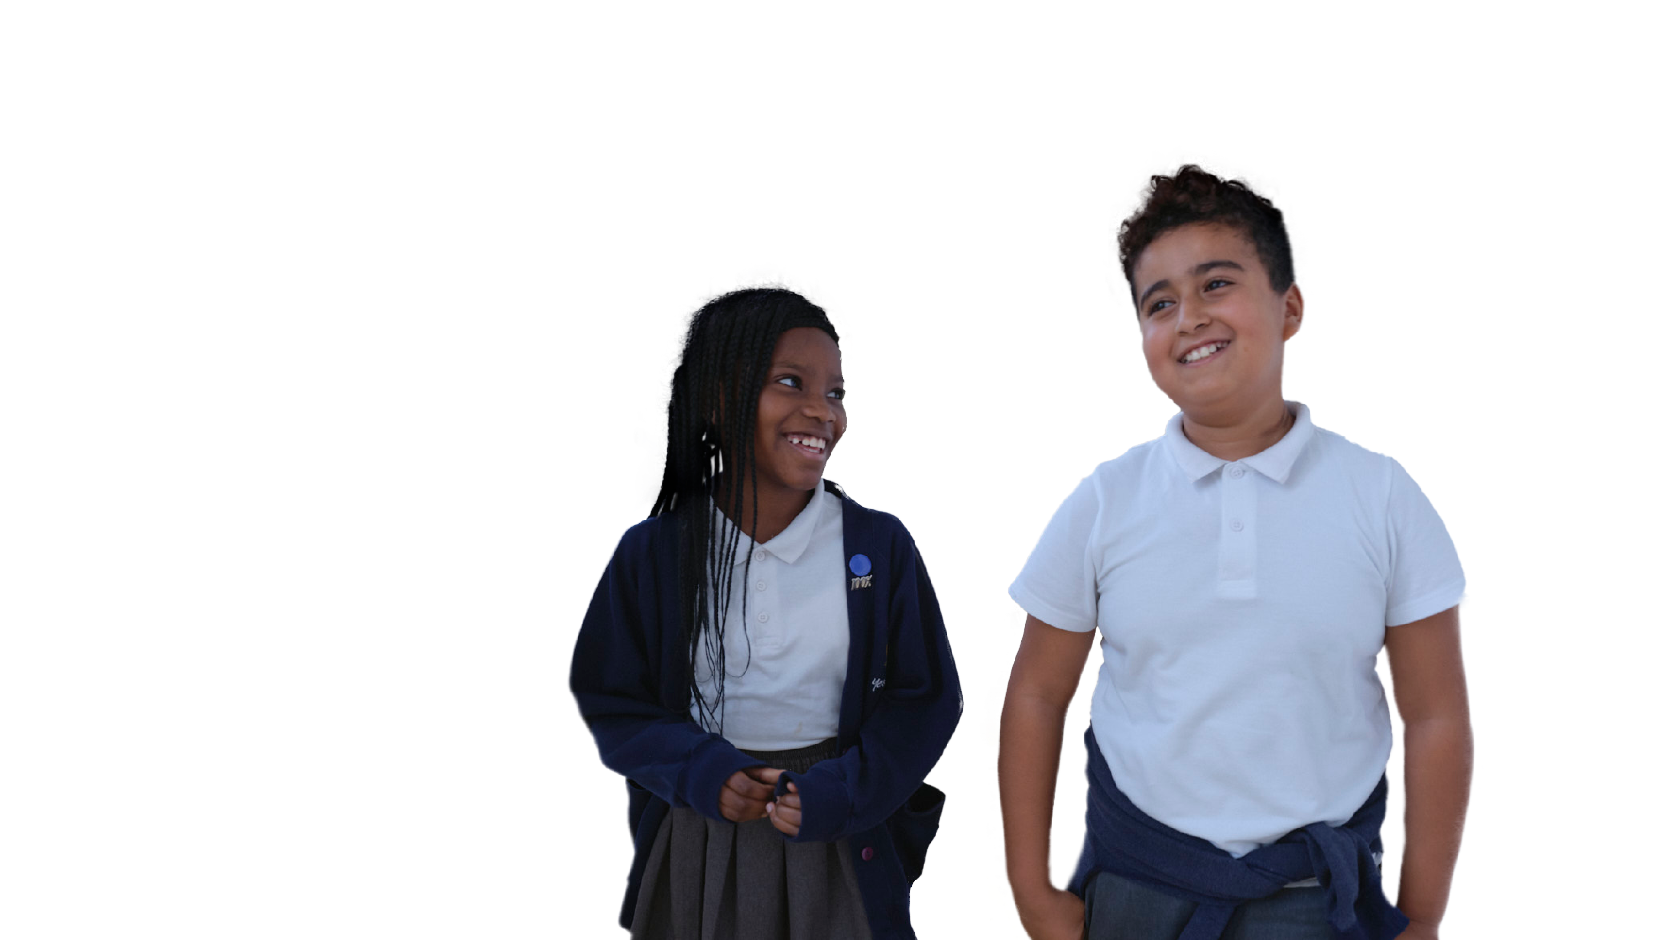
Draw it
1.
Loneliness
2.
Connection
Notes:
Activity 1: Gallery of loneliness and connection (10 mins)
Give pupils two pieces of A5 paper each. On their first piece of A5 paper, ask pupils to spend two minutes drawing a picture that represents loneliness, and then another two minutes drawing a picture that represents connection.
You may wish to share these definitions before or after pupils do their drawings:
Loneliness is an unwanted feeling of sadness that can come from being left out or not having others to talk or connect with. People can still feel lonely in the company of others.
Connection is a feeling of being included, of belonging and being able to enjoy being with others and in our own company.
In pairs or small groups, ask the pupils to share their images of loneliness and connection and write down any key words that link to their images.
Note that the images can be as abstract as they like. For example, pupils might think about colours or shapes they associate with loneliness/connection, or they might draw a situation where someone feels lonely/connected.

Slide 10
Loneliness vs. connection
Challenge:
What is the difference between being alone and loneliness?
Why might loneliness be hard to talk about?
Can you think of examples when people might have felt lonely or connected during Covid-19?
Discussion questions
What might happen to make someone feel lonely?
What might happen to make someone feel connected?
Notes:
Activity 1: Gallery of loneliness and connection (10 mins) continued
Show pupils the discussion questions and give them a few moments of thinking time.
Before asking them to discuss the questions in pairs or small groups, show them the first part of the video (on the following slide) to give them some further ideas.
What might happen to make someone feel lonely?
For example, being left out, finding it hard to make new friends, feeling different, change, moving to a new area/new school, having no one to play with at the weekend or during holidays.
What might happen to make someone feel connected?
For example, new experiences, being part of a group, spending quality time with friends or family, having people know you and remember things about you, doing hobbies or activities alone or with others.
Further challenge:
What is the difference between being alone and loneliness?
Being alone can be positive and doesn’t mean you are lonely, for example people can enjoy reading or listening to stories, writing, drawing or spending time outside on their own. People can also be in groups and feel lonely.
Why might loneliness be hard to talk about?
For example, people might feel embarrassed or that it’s their own fault if they are feeling lonely.
Can you think of examples when people might have felt lonely or connected during Covid-19?
For example, elderly people or people who missed seeing their friends may have felt lonely. People who took part in community projects or who spent more time with their family might have felt connected.
You may wish to emphasize to pupils that a person can be virtually connected (or connecting to others through technology, such as social media) but still be lonely. Face-to-face connection is important.

Slide 11
Loneliness vs. connection
Watch the first part of the video
Notes:
Activity 1: Gallery of loneliness and connection (10 mins) continued
Show pupils the first part of this video (up to 01:36) to give them some further ideas about the discussion questions.
To play the video, either click on the play button on the slide or copy and paste this URL into your web browser: https://bcove.video/37NJ5v7

Slide 12
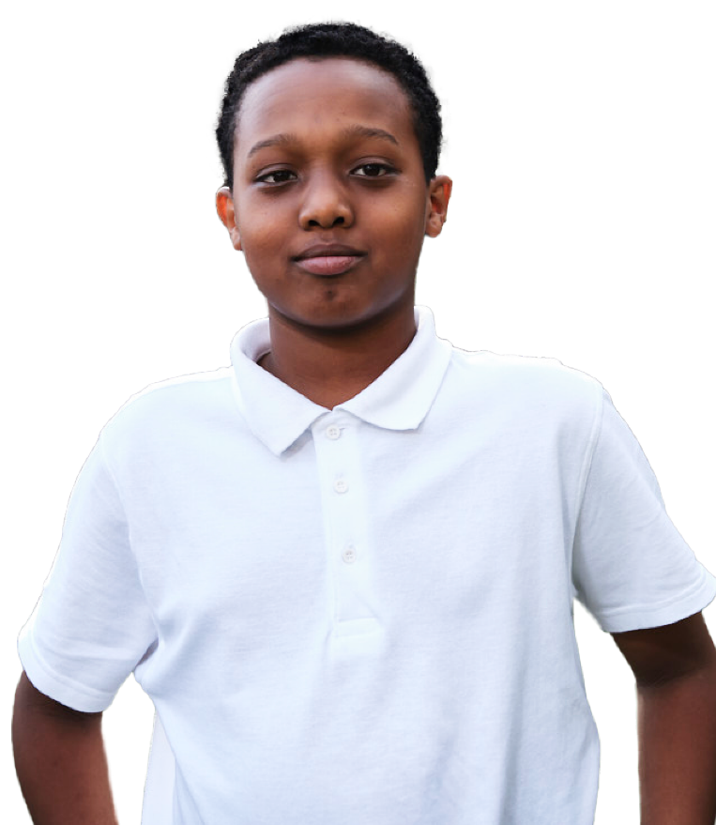
Support Squad
How could young people build connections on each level?
A. Connect with themselves
B. Connect with friends and family
C. Connect with the community
Notes:
Activity 2: Support Squad (30-35 mins)
Put pupils into groups of three and explain to them they are going to become a support squad – a group of pupils who can offer advice about what to do if other young people are feeling lonely. You may wish to give them paper to take notes.
Pupils will need to assign themselves a letter (A, B or C) to decide which area of connection they will focus on:
A) Connect with themselves: help young people think of what they can do when they are on their own to feel more connected to themselves.
B) Connect with friends and family: help young people think about what they can do to feel more connected to friends and family.
C) Connect with the community: help young people think about what they can do in their local communities (schools, parks, leisure centres, faith groups) to feel more connected to others and the place they live.
Note: Remind pupils that connecting safely is very important and that they should speak to their parents or carers before finding out about, or signing up to, any community activities.
Ask pupils to come up with some ideas that might help young people to build connections in their area. As they watch the video and look at the images on the following slides, they can add more ideas to their list.
Highlight to pupils that we all have a responsibility to look out for others who might feel lonely. What can we do to help others feel included?
Support: for pupils who need additional support you may wish to print out this slide and ask pupils to circle A, B or C so they can have their role in front of them. This may be particularly useful for pupils with autism and SEND who may struggle with this task.

Slide 13
What helps build connections?
Watch the second part of the video
Notes:
Activity 2: Support Squad (30-35 mins) continued
Once they have thought of their own ideas, show pupils the second part of this video, from 01:37 to the end, and ask them to add in any new ideas.
To play the video, either click on the play button on the slide or copy and paste this URL into your web browser: https://bcove.video/37NJ5v7

Slide 14
What helps build connections?
Thinking positively
Showing kindness to others
Getting active
Getting to know someone new at break time
Talking to people you trust about how you feel
Being in nature or spending time outdoors
Speaking to a parent or carer about starting a new club or activity
Volunteering is a great way to get connected
Doing things you enjoy, like listening to music
Building connections with others brings benefits to you and the people you connect with. The best way to build connection will be different for everyone. Experts suggest these ideas are some of the most helpful.
Notes:
Activity 2: Support Squad (30-35 mins) continued
Click to reveal the different actions that can help pupils to manage loneliness and build connections. Ask them to add any new ideas to their lists.
Thinking positively
Showing kindness to others
Getting active
Getting to know someone new at break time
Talking to people you trust about how you feel
Being in nature or spending time outdoors
Speaking to a parent or carer about starting a new club or activity
Volunteering is a great way to get connected
Doing things you enjoy, like listening to music

Slide 15
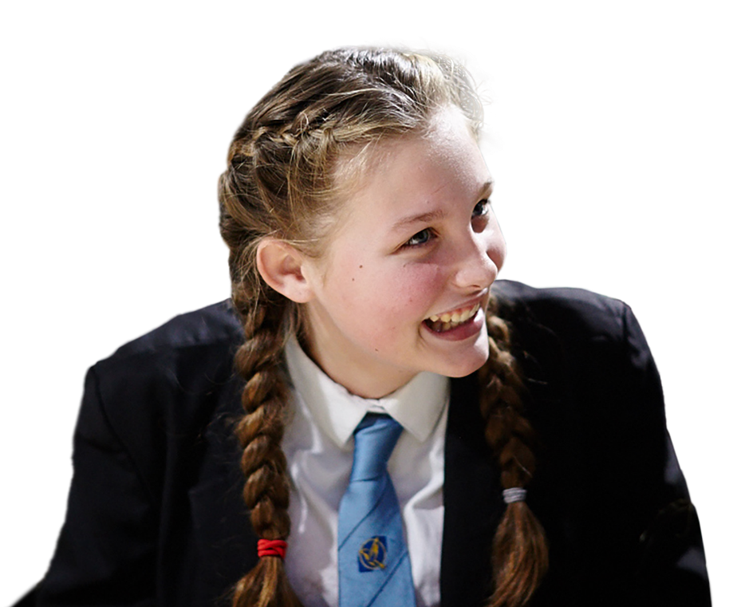
Conversation starters
Tips for making friends and starting conversations:
Smile, say hello and introduce yourself
Find out things you have in common
Ask people questions, e.g. what do you like to do? What is your favourite book / food / animal / film?
Notes:
Activity 2: Support Squad (30-35 mins) continued
Explain that sometimes it can be hard to know what to say to other people to make new friends. Here are some tips and suggestions for making friends in school.

Slide 16
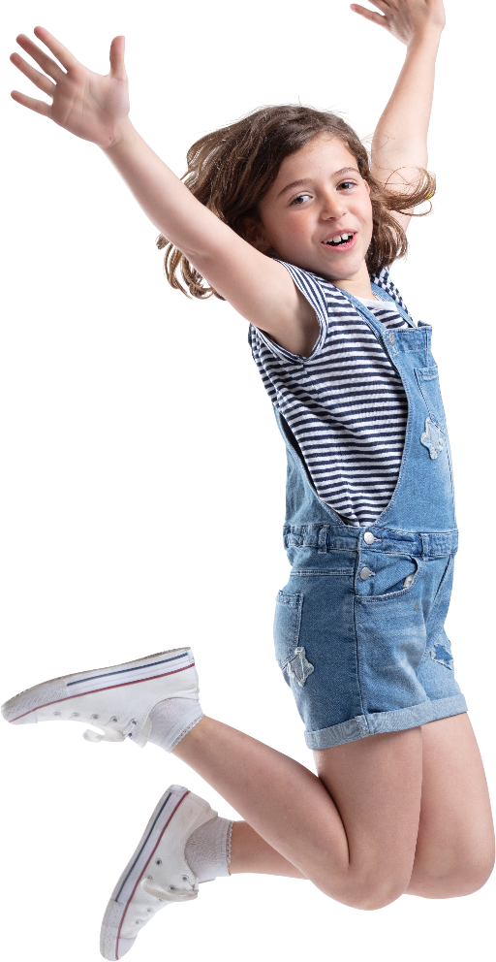
Dear Support Squad,
I’ve just started Year 6. The classes were mixed up and all my best friends are together in one class and I’m in a different class. I don’t really know anyone in this class. I’m worried that I won’t have anyone to play with and that my friends will forget about me.
My favourite things are being outside and playing sport. I could do with some advice as I’m feeling kind of lonely at the moment.
Kya
Notes:
Activity 2: Support Squad (30-35 mins) continued
Give each support squad one of the three case studies. Note each case study is on a separate slide (16, 17 and 18). Slide 18 is an optional scenario if this lesson is being taught during or recently after the Covid-19 pandemic to help pupils explore some of their feelings and experiences in a safe and distanced way. Is it important that pupils have the right to pass on working with this scenario as it may be a sensitive subject area for some young people.
You can print these out or have pupils read them from the board. Ask pupils to write a letter together to Kya, Myles or Ruby to give them some support. Alternatively, pupils could act out their messages of support – they could even record their message as a voice note or in a video response.
Remind pupils to think about the different areas of connection (A, B and C) and make sure that the advice includes things from each of them.
Support: For any pupils who need more support, print the Support Squad writing frame to help them structure their response.

Slide 17
Dear Support Squad,
I’ve just moved to a new school and a new city! Everything is new and I don’t know anyone. I also have a hearing impairment and this can make school more difficult.
I talk to my sisters about it sometimes but they are at secondary school and are really busy. I don’t want to bother them or stress my parents out. I love music and drawing but I need some advice!
Myles
Notes:
Activity 2: Support Squad (30-35 mins) continued
Give each support squad one of the three case studies. Note each case study is on a separate slide (16, 17 and 18). Slide 18 is an optional scenario if this lesson is being taught during or recently after the Covid-19 pandemic to help pupils explore some of their feelings and experiences in a safe and distanced way. Is it important that pupils have the right to pass on working with this scenario as it may be a sensitive subject area for some young people.
You can print these out or have pupils read them from the board. Ask pupils to write a letter together to Kya, Myles or Ruby to give them some support. Alternatively, pupils could act out their messages of support – they could even record their message as a voice note or in a video response.
Remind pupils to think about the different areas of connection (A, B and C) and make sure that the advice includes things from each of them.
Support: For any pupils who need more support, print the Support Squad writing frame to help them structure their response.

Slide 18
Dear Support Squad,
I’ve just gone back to school for the first time since the beginning of lockdown. I missed all my friends so much. I used to go to a swimming club with my friends, but we haven’t been able to do that in months.
I’m also in a different class to my best friend this year and I’m worried she will make new friends and I will be lonely.
Do you have any advice?
Ruby
Notes:
Activity 2: Support Squad (30-35 mins) continued
Give each support squad one of the three case studies. Note each case study is on a separate slide (16, 17 and 18). Slide 18 (this slide) is an optional scenario if this lesson is being taught during or recently after the Covid-19 pandemic to help pupils explore some of their feelings and experiences in a safe and distanced way. Is it important that pupils have the right to pass on working with this scenario as it may be a sensitive subject area for some young people.
You can print these out or have pupils read them from the board. Ask pupils to write a letter together to Kya, Myles or Ruby to give them some support. Alternatively, pupils could act out their messages of support – they could even record their message as a voice note or in a video response.
Remind pupils to think about the different areas of connection (A, B and C) and make sure that the advice includes things from each of them.
Support: For any pupils who need more support, print the Support Squad writing frame to help them structure their response.

Slide 19
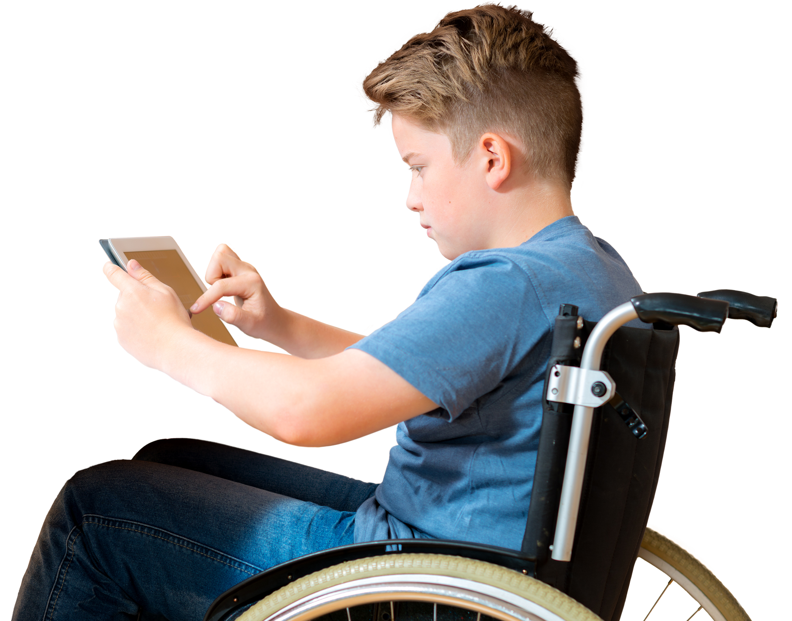
Dear Support Squad…
1.
One piece of advice I really liked was …………….. because ……………………………………
2.
One other idea they could have included is ………………………
…………………………………....
What could you do to help this young person feel more included and less lonely?
Notes:
Peer assessment (5-7 mins)
Ask groups to give their letter (or deliver their voice note or video response) to another group. The groups can give feedback using these prompt sentences.
What could you do to help this young person feel more included and less lonely?

Slide 20
How confident are you in
10
Extremely confident
9
8
7
6
explaining what loneliness means?
explaining what connection means?
giving advice to a young person who wants to feel more connected?
5
4
3
2
1
0
Not confident
Notes:
Follow up assessment (3-4 mins)
Show pupils the statements A-C from the initial assessment and ask them to rate their confidence in each using a scale from 0-10 (0 = not confident, 10 = extremely confident) or whichever response method was used in the initial activity. It is an opportunity for pupils to reflect on what they have learnt in the lesson. Ask pupils to consider why their scores have changed and give an example of something new they have learned or thought about.
How confident are you in:
A) explaining what loneliness means?
B) explaining what connection means?
C) giving advice to a young person who wants to feel more connected?

Slide 21
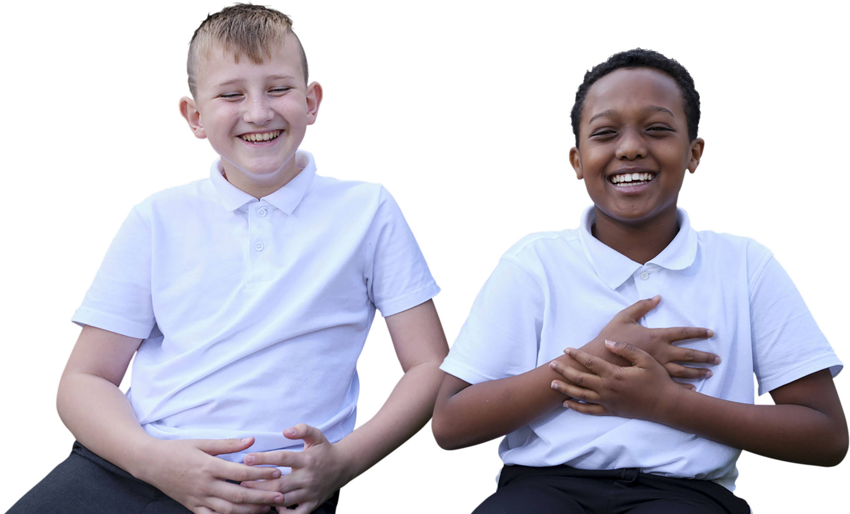
The chain of connection
Can you think of two things you have learned about building connections?
Write one on either side of your paper.
Notes:
Plenary: The chain of connection (5 mins)
Give each pupil a strip of coloured paper and ask them to add to their paper two things they have learned about building connection in this lesson (one on each side).
Pupils can use glue to assemble the strips of paper into a ‘chain of connection’. This could be done in small groups or you could create a whole class chain! This can then then be displayed in the classroom as a reminder of what pupils can do if they feel lonely.
Optional reflection: If this lesson is being taught during or recently after the Covid-19 pandemic, you may wish to also offer the chance for the following personal reflection: What have you learned in this lesson that could help build connections during the time of Covid-19? Note: This reflection can be kept as private for the pupils.

Slide 22
It can be common to experience feelings of loneliness
It is always good to talk about it to friends and trusted adults and there are lots of organisations that can give support such as Childline or Shout.
Childline: childline.org.uk/info-advice Or call 0800 1111
Shout: text 85258
22
Notes:
Signposting (1 min)
Remind pupils that if they are finding things difficult, it is important that they speak to an adult they can trust. Organisations like Childline are open 24 hours, 7 days a week. Shout 85258 is a free, confidential, 24/7 text messaging support service for anyone who is struggling to cope.

Slide 23
Extended learning projects
Ask pupils to work in small groups to create a PowerPoint or an A3 poster to share what they have learned in the lesson about loneliness and building connections. They could present this in assembly or to another year group.
Create a directory of activities, clubs and volunteering roles taking place in the school (or educational organisation) with details of when and where each activity takes place. Put it on display in the school for other pupils to see.
As an extended art project ask pupils to create a drawing, painting, story, poem, model or sculpture which has the title ‘connection’. These could then be displayed and the idea of creativity and connection could be discussed. For example, how being creative can help someone feel more connected with themselves or others.
Ask pupils to help design a new peer mentoring scheme. They could imagine that a scheme has been set up in the school where Y6 pupils help younger pupils solve Maths problems. Can pupils come up with:
a name for the scheme
an explanation of how it would work
a list of the benefits that could come from having a peer-mentoring scheme.
Notes:
Extended learning projects
These can be given to pupils as projects to extend their learning, these could be done either in school as group projects or at home.

