Slide 1





At a glance…
The Active Lives Survey
The Healthy Schools Rating Scheme
The Healthy Schools Award

Slide 2




School is randomly selected by
Sport England to participate in
Active Lives Survey
School volunteers to take part and contacts the local Active Partnership: anna.oleary@livingsport.co.uk
OR
Receive a bespoke report on:
Physical literacy
Swimming proficiency
Well-being
Self-efficacy
Levels of social trust
Complete online:
Student survey (minimum 30 responses)
Teacher survey
Parent survey (only if Y1&2 are requested to participate)

Slide 3
Gain access to The Healthy Schools Rating Scheme (an online teacher survey only) covering four key areas of assessment:
Food Education
School Food Standards
Physical Education
Active Travel
Receive a rating – bronze, silver, gold – based on the responses to the online survey
Cross reference the outcomes of the Active Lives Survey and the Healthy Schools Rating Scheme to the standards for the local award to achieve Healthy Schools status
Notify Ofsted about the rating achieved (optional) and promote participation in the scheme as evidence of the provision to pupils

Slide 4

Personal Development
Inspectors will make a judgement on the personal development of learners by evaluating the extent to which:
the curriculum extends beyond the academic, technical or vocational. It provides for learners’ broader development, enabling them to develop and discover their interests and talents
the curriculum and the provider’s wider work support learners to develop their character – including their resilience, confidence and independence – and help them know how to keep physically and mentally healthy
at each stage of education, the provider prepares learners for future success in their next steps
the provider prepares learners for life in modern Britain by: − equipping them to be responsible, respectful, active citizens who contribute positively to society − developing their understanding of fundamental British values − developing their understanding and appreciation of diversity − celebrating what we have in common and promoting respect for the different protected characteristics as defined in law.

Slide 6
To find out how active and happy your pupils are complete The Active Lives Survey
This comprises of the following:
An on-line 20 minute student survey – to be undertaken by students (Yr1 – Y11) across 3 classes. The responses build a picture of local data to inform planning on a school, area and national level.
A teacher survey.
A parent survey (this is only a requirement when a school is asked to involve the Y1 and 2 children in the completion of the survey.)
Notes:
Selected or opt-in schools - pupils from 3 randomly selected classes across 3 preselected 3 year groups from within (or 2 in infant schools), one teacher and parents of Y1/2 at a time of the schools choice within the term. For small schools 30 surveys requirement is slightly reduced.

Slide 7

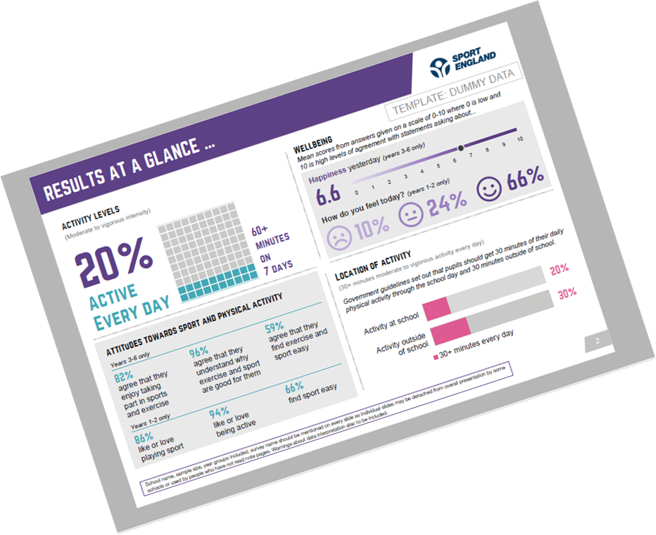
WHAT ARE THE BENEFITS FOR THE SCHOOL?
BESPOKE REPORT
Levels of activity
Participation at and outside school
Activity breakdown
Attitudes towards sport and physical activity
Indicators of well-being
Resilience and trust
Healthy eating

Slide 8

HEALTHY SCHOOLS RATING SCHEME: Participation provides access to the Health Schools rating scheme (subject to 30 completions).
ADDITIONAL BENEFITS FOR A SCHOOL
THAT IS SELECTED TO PARTICIPATE:
The school also receives equipment
vouchers from ESPO – at least
10 credits provided (to be used
against a brochure of 31 sports
items).
Example of items.
Notes:
Schools can opt in to receive HS rating but do not get vouchers and will need to participate again if selected in the future (although this can give good data). Selected schools can opt more classes in if they wish.

Slide 9
The Healthy Schools Rating Scheme
What is it?
Is a national scheme and has been designed to recognise and encourage schools’ contribution to pupils’ health and wellbeing.
It is part of a wider series of government actions to support pupils’ health and wellbeing and is a commitment from the government’s Childhood Obesity Plan.
This voluntary scheme is available for both primary and secondary schools. Schools complete a self-assessment and then receive a rating based on their responses to four key areas:

Slide 10
The Healthy Schools Rating Scheme
Four Key Areas of Assessment
Food
education
Time spent on
physical education
Compliance with the
school food standards
The promotion of active travel

Slide 11
The Healthy Schools Rating Scheme
What is involved?
Having completed the Active Lives Survey, a school is then provided access to the on-line Healthy Schools Rating Scheme.
Schools do not have to wait to be selected to take part – they can opt in to the Active Lives and Healthy Schools Rating Scheme by contacting the local Active Partnership: David.Welch@LivingSport.co.uk
An on-line teacher survey is required to be completed and the responses given are calculated to determine the rating achieved. (Information on the number and type of questions and the scoring system can be found in this document. )

Slide 12
The Healthy Schools Rating Scheme
What are the benefits?
Each participating school receives a report based on its survey answers and a rating in accordance with the number of points scored.
A certificate is awarded in accordance with a school achieving a bronze, silver or gold rating.
The rating will remain confidential to the school/DfE although schools can choose to notify Ofsted about the rating achieved and promote their participation in the scheme as evidence of their provision to pupils.
Ofsted inspectors may wish, where relevant, to consider the scheme as evidence when reaching the judgement on “personal development.”

Slide 13
The Healthy Schools Rating Scheme and
The Local Healthy Schools Award
Completion of the national Healthy Schools Rating Scheme can be cross referenced to the nutrition and physical activity standards for the Cambridgeshire and Peterborough Healthy Schools award. This can help accelerate the school’s progress to achieving Healthy Schools status and being granted use of the local authority Healthy Schools logo. A plaque is also awarded in acknowledgement of the achievement and provides good evidence of the schools commitment to Health Education.
For more information on the local Healthy Schools programme visit: www.healthyschoolscp.org.uk

Slide 14
The Healthy Schools Rating Scheme
How to use your school’s rating
Schools are encouraged to consider their overall rating as well as the responses to the Active Lives Survey in order to identify areas for additional future action.
If it is evident that a school is not delivering against a key aspect of health provision for students or simply wishes to enhance its delivery then there is a range of support locally available.

Slide 15
Who can help?
School Games/ School Sports Partnerships
www.scssp.co.uk (South Cambridgeshire)
https://www.cambridgessp.com/ (Cambridge)
http://www.huntsssp.org/ (Huntingdonshire)
www.improveit.education (Witchford)
https://livingsport.co.uk/school-games/ (Peterborough)
Specialist Adviser Physical Education and School Sport
(Cambridgeshire County Council/ Peterborough City Council)
https://www.cambslearntogether.co.uk/services-to-schools/pe
Living Sport
https://www.livingsport.co.uk/
Healthy Schools
https://healthyschoolscp.org.uk/
Healthy You
https://healthyyou.org.uk/healthy-lifestyles-2meet-the-team/

