Slide 1
KS3
How food impacts our mood
Food & Mood
Notes:
We all know that what we eat impacts on our health, there is guidance everywhere we look to ensure we are ‘healthy’.
Does anyone have any examples?
5 a day
2000 calories
What influences what you eat and your choices?
But does what we eat impact how we feel?
Class Discussion
Are there any foods that have a direct impact on how we feel?

Slide 2
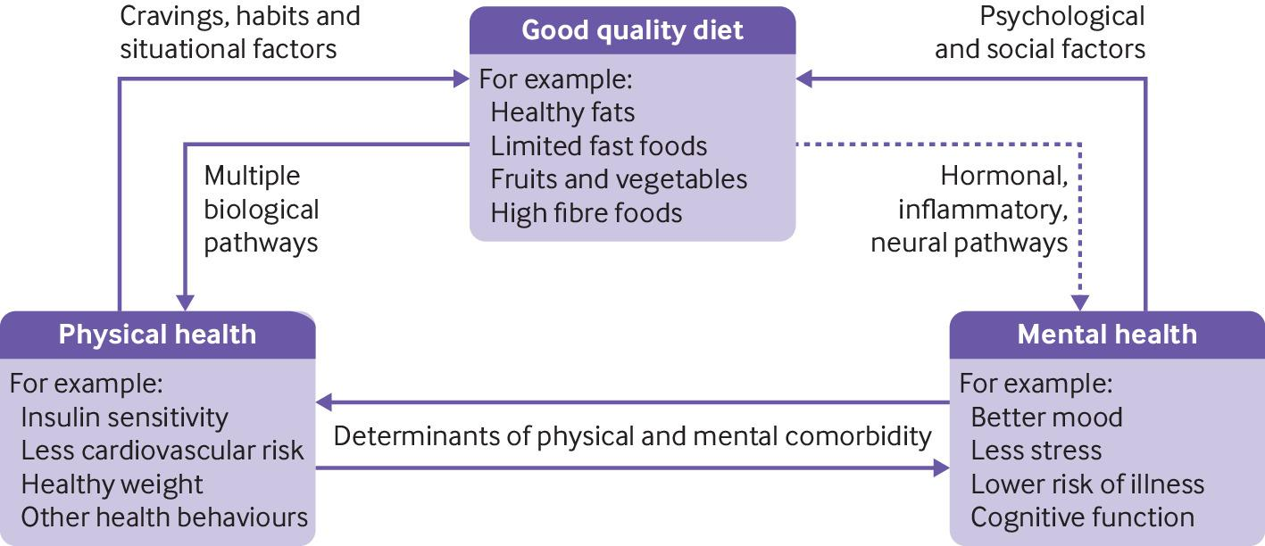
Food and Mood: how do diet and nutrition affect mental wellbeing Firth et al 2020
Food and mood: how do diet and nutrition affect mental wellbeing?
BMJ 2020; 369 doi: https://doi.org/10.1136/bmj.m2382 (Published 29 June 2020)Cite this as: BMJ 2020;369:m2382
Notes:
Poor nutrition may be a causal factor in the experience of low mood, and improving diet may help to protect not only the physical health but also the mental health of the population, say Joseph Firth and colleagues
Key messages
Healthy eating patterns, such as the Mediterranean diet, are associated with better mental health than “unhealthy” eating patterns, such as the Western diet
The effects of certain foods or dietary patterns on glycaemia, immune activation, and the gut microbiome may play a role in the relationships between food and mood
More research is needed to understand the mechanisms that link food and mental wellbeing and determine how and when nutrition can be used to improve mental health
https://doi.org/10.1136/bmj.m2382

Slide 3
Impact of too few calories
Reduction in
Increase in
Strength
Endurance
Speed
Coordination
Motivation
Confidence and self-esteem
Growth and development
Reproductive function
Achievement of performance goals
Preoccupation with food and body
Anxiety
Agitation and irritability
Fear
Risk of Injury
Risk of upper-respiratory tract infections
Fractures
Impaired bone health in later life
Notes:
Calories are a unit of measurement of the amount of energy there is in a food or drink item.
For our bodies to function we require energy, from breathing and brain function all the way to running and weightlifting. So, when we eat and drink we put calories into our bodies, which we then use through unconscious bodily functions (heart beating, breathing and growing) to conscious activities such as sport and travelling to school (cycling, walking, running).
If we eat more calories than the energy we use, it will result in putting weight on. On the contrary, if we do not eat enough calories for the energy we are using, we will lose weight. There are several other side effects besides weight loss which we need to be aware of.

Slide 4
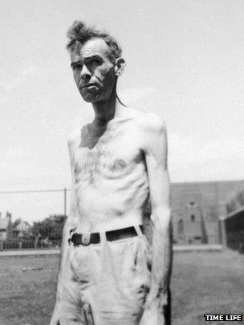
Minnesota Starvation Study
Will you starve that they be better fed?
A participant of the Minnesota experiment, BBC News
Notes:
May want to touch on the ethics of the experiment

Slide 5
The Study
Taking place in 1944, author Ancel Keys and his colleagues wanted to examine effects of prolonged dietary restriction and rehabilitation diets for those who had experienced starvation during the war.
The first 3 months the researchers observed and collected data regarding the participants normal eating patterns.
The participants ate approximately 3500 calories a day.
For the following 6 months the men’s diet was restricted to half of their normal intake (two meals per day, eating around 1570 calories) to reflect the conditions of war.
Notes:
Subjects
200+Volunteer conscientious objectors
The experiment was conducted in the following way: The first 12 weeks was a control period, the next 24 weeks involved semi starvation and the last 12 weeks involved
controlled rehabilitation. An additional 8 weeks of unrestricted rehabilitation was held for twelve of the subjects for 8 to 12 months following the starvation recovery, the study conducted follow up examinations. During the first 3 months the researchers observed and collected data about their participants normal eating patterns. The participants ate a maintenance diet of around 3500 calories a day. For the following 6 months the men’s diet was restricted to half of their normal intake to reflect the conditions of war in Europe. They were given two meals a day and ate approximately 1570 calories a day. A s a result they lost approximately 25% of their body weight. For the final 3 months of the study, the participants were refed and rehabilitated. They were divided into 4 separate groups and refed with different amounts of calories starting at a low quantity. A small group of subjects stayed on for an additional 8 weeks and were fed an unrestricted diet. Each participant from this group was allowed to choose their own meals and consequently ate between 7,000 and 10,000 calories a day.

Slide 6
Results
Participants cognitions were affected - thoughts, dreams and conversations focused on food.
Participants became protective over their food.
Participants developed new anxiety and depressive symptoms that weren’t reported at the start of the study.
Participants who described themselves as once outgoing, reported themselves as being withdrawn
Alongside weight loss, participants experienced headaches, dizziness, decreased need for sleep and edema (swelling)
Men who were noted as both physically and psychologically healthy at the beginning had developed symptoms of Anorexia, Bulimia and Binge eating disorder.
Notes:
Notable changes were made through all periods of the experiment on the participants physical, psychological behavioural and social aspects of the volunteers’
lives.
• Their psychological well being had been impacted as well as their physical body. Keys noticed a significant different in the themes of the participants cognitions,
Compared to the start of the study. The participants became far more preoccupied with food. Food and eating became focal points in conversations, reading material
and dreams. Some volunteers also experienced concentation difficulties due to their preoccupation with food. The participants became more interested in reading
cookbooks and collecting recipes. Three participants even changed their occupations to reflect their extreme interest in eating and food.
• During mealtimes participants were recorded being possessive over their food. They would be worried that others would try and take their food so they would guard it.
At mealtimes participants were recorded eating all the food on their plates to the last crumb, and some even licked their plates clean.
• Some participants resorted to excessive chewing gum usage and tobacco smoking to help provide some sort of relief from the hunger they experienced during the semi-
starvation phase.
• During the rehabilitative phase men started eating “several” meals in one sitting and consequently developed gastrointestinal discomfort and headaches. They
experienced difficulties in reading their own hunger signals. Participants described feeling hungrier and using binge eating and purging behaviours during the refeeding
period. Even after 5 months of refeeding they continued to use these behaviours and developed body image concerns.
• Many participants were observed collecting food themed items and even rummaging through the rubbish to find food. The participants developed an extreme distaste for
wasting food. The participants would take longer to eat their meals and cut their food into small pieces. Participants who were once outgoing described themselves
as becoming withdrawn and isolated. These behaviours and changes have been observed in those diagnosed with Anorexia Nervosa
• Participants were recorded developing new anxiety and depressive symptoms that were not present at the start of the study. Especially during the semi-starvation
period participants became more sensitive and started arguing more with each other. The participants weight changed throughout the study, they also experienced new
issues such as stomach upset, headaches, dizziness, decreased need for sleep, edema, hair loss and cold intolerance. In the semi-starvation period, the volunteers
weight dropped by 25% and their muscle mass decreased by 40%.
• The men in this study were physically and psychologically healthy at the start of the experiment but at the end the participants had developed symptoms of anorexia,
bulimia and binge eating disorder.
• In summary this study shows that the act of restriction and extreme dieting impacts an individuals physical, social, behavioral and psychological well-being. To this day
the Minnesota starvation experiment is considered one of the most critical pieces of psychoeducation to share in the treatment of eating disorders.

Slide 7
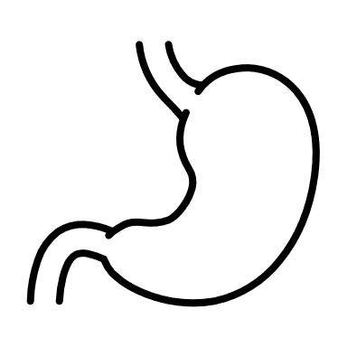
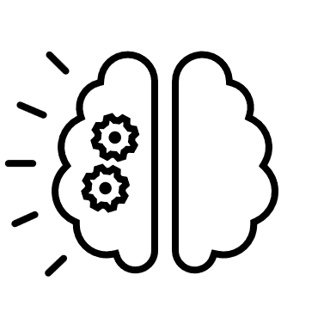
Side effects of malnutrition
Notes:
Not only can lack of calories affect our bodies and mood but a lack of balance in our diets can result in malnutrition, a condition that results from lack of sufficient nutrients in the body. Many diets talk about removal of whole food groups, this can lead to;
Effects
Dry hair which fails out easily
Thin dry inelastic pale and cold skin
Lack of appetite
Cold intolerance
Irritability
Lack of concentration
tiredness
Muscle and subcutaneous fat wasting
Poor wound healing
Depression
Reduced fertility

Slide 8
Balanced Diet
Notes:
A healthy balance leads to a happy body. But what are the impacts of each food group on our mood and bodies?

Slide 9
Fuel for Body and Brain
Low Intake Side Effects
Constipation
Bad breath
Fatigue
Mood swings
Poor concentration
Poor immune response
Risk of health problems
Keep energy levels up for everyday routines and internal bodily functions
Maintain energy during exercise
Restore muscle energy storage during rest and recovery from exercise
Carbs make you put on weight
Fluid loss, a reduction in overall energy intake, and the loss of muscle tissue, but research suggests this will not be maintained and can be detrimental for our bodies
Eating carbs at night makes you gain weight
The body metabolises carbohydrate in the same way regardless of the time of day or night.
Centre for Clinical Interventions
Sources:
Wholesome-rice, bread & potatoes
Processed-biscuits, cereal bars
myths
Carbohydrates
Notes:
Eating Disorders Information Sheet - 06 - Carbohydrates (Myths and Facts) (health.wa.gov.au)
Low Intake Side Effects
Constipation, poor digestion and bloating-due to lack of dietary fibre
Bad breath-due to the release of ketones
Fatigue, low energy, tiredness
Mood swings, low/depressed mood
Poor concentration
Poor immune response
Increased risk of health problems e.g., bowel cancer
Myths-Centre for Clinical Interventions
Carbs make you put on weight
Initially result in some rapid weight loss due to fluid loss, a reduction in overall energy intake, and the loss of muscle tissue, but research suggests this will not be maintained and can be detrimental for our bodies. Wholesome carbs such as brown rice, wholegrain breads, potato that in balance help to regulate energy levels and processed carb foods, such as biscuits, cakes, cereal bars that impact blood glucose levels and energy, and are more likely to contribute to weight gain.
Eating carbs at night makes you gain weight
the body metabolises carbohydrate in the same way regardless of the time of day or night.

Slide 10
Low Intake Side Effects
Thin hair and nails
Dry Skin
Swelling
Gassy
Mood & Brain Changes
Sleep Issues
Inability to build & maintain muscle
Brain Fog
Grow and Repair
Make new cells
Build and repair bones, muscle, skin and blood
Muscles hormones enzymes and antibodies all make of proteins
Powders can substitute whole sources of protein entirely
Short term, maybe
Protein makes you bulky
Protein is not stored in muscle tissue
.
Sources:
Chicken, lean beef, eggs, black beans & tofu
myths
Proteins
Notes:
Protein is required for your brain to regulate thoughts and feelings and control blood sugar levels. This is due to the amino acids in protein that are required for this body function.
Low Intake Side Effects
You don’t feel full so are likely to crave sweet things. As protein maintains blood sugar level, your glucose can vary making you crave it.
Think hair and nails-hair and nails are mostly made of protein, so without protein intake they get britte
Dry skin-you can get rashes and be more susceptible to sunburn
Swelling-protein is responsible for preventing build up of excess fluid in tissue, swelling can occur in ankles, cheeks, hands and feet.
Gassy-amino acids are also support metabolic functions and digestion, without enough you can feel gassy, bloated and
Mood and anxiety-amino acids are essential for mood neurotransmitters which enable your brain to produce positive feelings from serotonin and dopamine.
Sleep can be affected, this is thought to be due to blood sugar changes, reduced serotonin and increased cortisol.
Muscle impacts-reduced protein is responsible to make new cells, without enough you can experience muscle atrophy or inability to repair tissue
Brain fog-without enough amino acids, there is a reduction in neurotransmitters (as mentioned above serotonin and norepinephrine, epinephrine and dopamine) which are required for concentration, learning new skills and motivation.
Bone health- protein is need to absorb calcium during digestion, without it you won’t have enough calcium intake and impact on your bone density.
You Get Ill Frequently-protein is needed for antibodies, whilte blood cells and red blood cells. Without enough protein you are likely to have poor immune health and can develop allergies.
Healing-protein is needed to replace damaged tissue, without enough protein this process takes longer.
Myths
Powders can substitute whole sources of protein entirely
FALSE, these can provide sufficient macro and micronutrient for a limited time only. Powers should never be a replacement but a supplement only. It is also worth noting that the content of powders are not always as they seem. They can be high in sugars and calories and the Clean Label Project undertook research that identified a range of toxins within supplement powders.
Protein makes you bulky
Protein is not stored in muscle tissue. It will only work with hours of training.

Slide 11
Strong Building Blocks
Low Intake Side Effects
Muscle cramps
Osteoporosis
Tooth decay
Low mood
Calcium, Vitamin D, Protein
Keeps bones strong
Teeth
Dairy is Bad for Your Heart
Dairy can actually reduce the risk of heart disease
All dairy is high in fat and sugar
No type of milk is in the high fat category.
Dairy contains a natural type of sugar called lactose but this doesn't need to be limited as it has mane beneficial nutrients
Sources:
Milk / soy / almond milk, cheese & yoghurt
myths
Dairy
Notes:
Myths
Dairy is Bad for Our Heart
Recent research has shown that diary might actually reduce the risk of heart disease. Dairy consumption and CVD: a systematic review and meta-analysis - PubMed (nih.gov)
All Dairy is High in Fat and Sugar
Yes cheese is high in fat and yoghurt can be high in added sugar. However when not processed dairy is not high in fat or sugar.
Lactose is a naturally occuring sugar in dairy which doesn't need to be limited due to its combination with useful nutrients.

Slide 12
Function and Fitness
Low Intake Side Effects
Poor digestion
Skin effects
Vitamin deficiency-immunity
Low mood
Vitamin C, Iron, Fibrre
Health immune system
Eyesight and skin
Digestive System working
Sources:
Watermelons, apples, bananas, spinach, carrots & broccoli
Sugar in fruit is bad for you
It is not added sugar which has health promoting qualities provided by phenols, fibre, vitamins and minerals
Fresh is best
Not one form is better than another. However you like it, eat it
myths
Fruits and Vegetables
Notes:
Low intake side effects
Digestion-constipation, bloating
Immunity-'poor immune health' i.e. frequent coughs and colds, prolonged fatigue
Myths
Sugar in fruits is bad for you
Yes, fruits contain sugar, but this sugar is different from added sugar! Added sugar lacks the multiple health-promoting qualities of fruits
Fresh is best
Not one form of fruit or vegetable is better for you than another! Fruits and vegetables in all forms are full of essential nutrients . However you like it, fresh, canned, juiced or dried, the most important thing is that you eat your fruits & veggies!

Slide 13
Maintenance
Low Intake Side Effects
Vitamin deficiencies
Dermatitis
Hair loss
Sickness
Low mood
Store energy, Keep you warm
Absorb vitamins from other food groups
Protect organs
Healthy immune system
Brain function
Fats make you fat
Including fats in your diet help you regulate your metabolism
Foods with cholesterol are unhealthy
We need blood cholesterol for a number of processes, build cell membranes, sex and adrenal hormones, production of vitamin D
Sources:
Natural-Fish, nuts, avocados, olive oil, canola oil and flaxseed oil (Omega-3)
Refined-processed foods
myths
Fats and Oils
Notes:
Fat is needed for your body to;
Absorb vitamins
Enable cell growth
Maintain brain and eye health
Production of hormones
Provide energy (Each gram of fat you consume provides you with about 9 calories of energy. For comparison, each gram of carbohydrate or protein yields only 4 calories of energy.)
Low Intake Side Effects
Vitamin deficiencies, without A, D, E and K you are likely to experience, night blindness, infertility, swollen gums, dry hair, easy bruising, loose teeth, depression and muscle pain.
Dermatits (skin inflamation-dryness, rashes). Fat is needed in skin cells
Hair loss-hair texture can change and even loss can be experienced as fat is required for prostaglandins which promotes hair growth.
Poor immune health-fat is needed stimulate and for the growth of immune cells. So you are likely to catch more illnesses
Myths
Fats make you fat.
Eating fat-rich foods as part of a healthy, balanced diet does not lead to weight gain. Eating fat is likely to make you full between meals. It must be noted that there are differences between highly process fats e.g. fast food, fried and sugary foods which can cause you to out on weight and beneficial fats such as nuts, whole eggs and avocados-these help you regulate your metabolism.
Foods containing cholesterol are unhealthy.
Cholesterol has had a bad reputation as being unhealthy. What we dont realise is our blood requires cholestorl for a range of things including, cell membranes and ability to produce and use vitamin D. As above there are good cholesterol food and bad ones, aim to have whole eggs, organic meat, shellfish, cheese, full-fat yoghurt and sardines.

Slide 14
The Cambridgeshire Children and Young People's Health and Wellbeing Survey 2022
What we are eating
18% pupils didn't have breakfast (food or drink) before lesson on day of survey
17% pupils didn't have any lunch the day before the survey and no breakfast on day of survey
11% pupils didn't eat any fruit of veg on day before th survey
18% ate at least 5 portions of fruit and vegetables on the day before the survey
23% pupils found healthy eating lessons not at all useful
Notes:
A report for Cambridgeshire secondary-The Schools Health and Education Unit
Sample
Year 8 boys 2300
Year 8 girls 2298
Year 10 boys 1968
Year 10 girls 1824
NB 374 pupils answered that the describe their gender in some other way or identified with more than one of the options listed. Theses pupils are not included in any data split by sex but are included in total figures

Slide 15
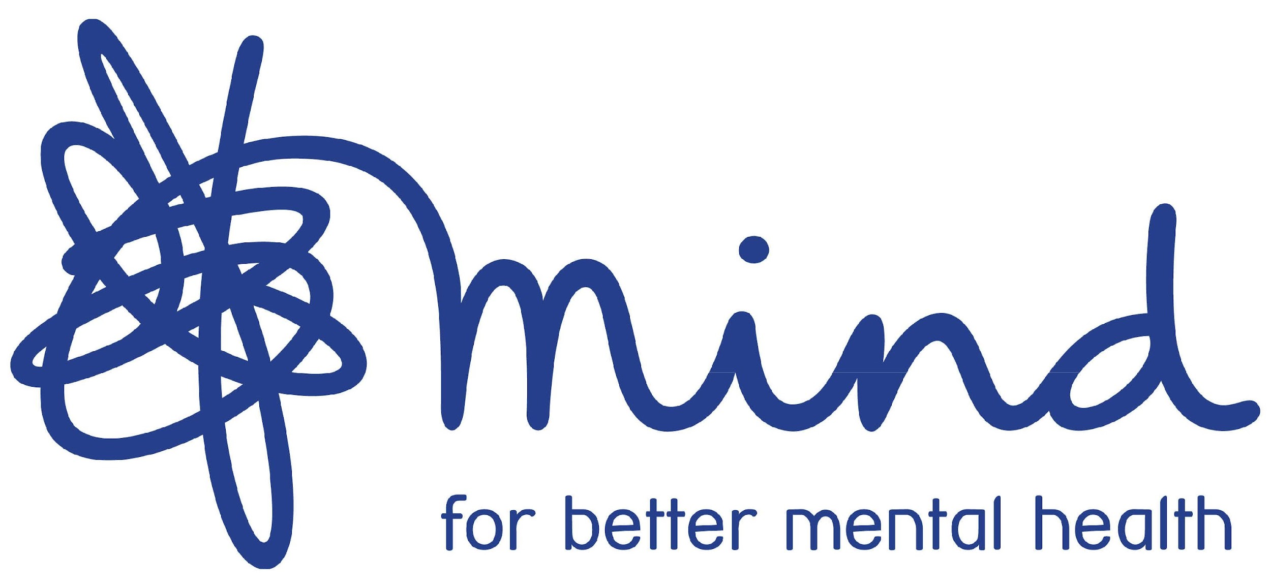
8 Top Tips
https://youtu.be/CSHO9VdVRfg
Notes:
So what can we do to look after ourselves with food?
Play video
Potenital to play Body functionality video, remind children that their bodies do so much so it is important to look after it Body Functionality - YouTube

