Slide 1
KS3
What can we do to help?
Eating Disorders 2

Slide 2
Registered Charity Number: 1156578
Saphna, School Nursing Toolkit (2022)
Notes:
Listen believe and value what they say
Show empathy, compassion and respect
Open ended questions
Time, give people your time, dont rush them
Listen carefully, without judgment
Be honest/blunt/factual
Use affirmation
Empower and promote self efficacy
Ensure they know this is not their fault, not a choice, its an illness
Ask if there are any triggers you can collaboratively work on whilst the person is with you

Slide 3
What not to say
“People would die for your figure”
“You should eat this, not that”
“You’re looking well”
“Look at you, you’re fine”
“Oh you've lost a pound, "well done" or "this is bad"
“You’re not thin enough to be Anorexic”
Notes:
*The typical "you're looking well" in most cases, does not help and leaves the person feeling they have gone against their ED and failed. An alternative dialogue might be "it is good to see you looking more animated with more energy today".
*Oh you've lost a pound, "well done" or "this is bad". This reinforces the eating disorder. Avoid commenting on weight other than your overall concerns ie it is concerning to see how you are struggling and we want to help you.
*"You look like you need to eat more" or "you look like you could do with a good meal" or "why don't you just add in some donuts, that'll help" or "people would die to have a figure like you"- yes these have all been said!

Slide 4
Where can I seek help?
Talk about it
Self Help
Professional Help
Friends
Family
School
Trusted sites only
Involve a professional
School Nurse
GP
PEDS Patient Referral Form | PED Support
CPFT

Slide 5
What can the school do?
Notes:
SAPHNA Toolkit
Homework opportunity

Slide 6
Registered Charity Number: 1156578

Slide 7
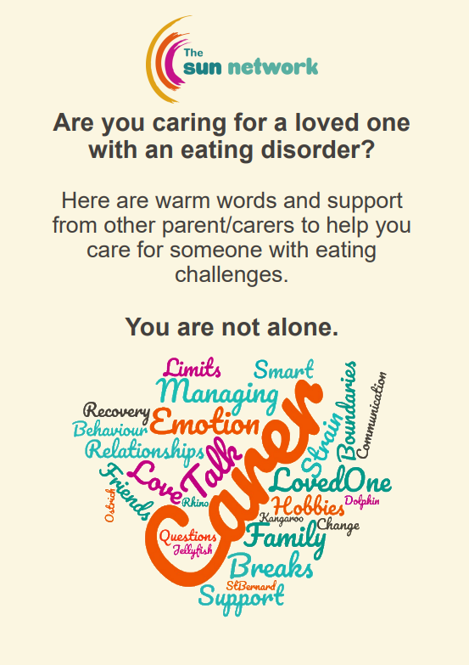
Resources
SUN Network
Notes:
Eva Musby https://anorexiafamily.com/?v=79cba1185463
BEAT - https://www.beateatingdisorders.org.uk/get-information-and-support/
Janet Treasure- Book, Skills Based Caring For a Loved One with an Eating Disorder https://www.amazon.co.uk/Skills-based-Caring-Loved-Eating-Disorder/dp/1138826634
FEAST - website specifically for parents https://www.feast-ed.org/

Slide 8
Trusted Sites-more information
Eating Disorder Toolkit | SAPHNA – School And Public Health Nurses Association
Learn about eating disorders - Beat (beateatingdisorders.org.uk)
Eva Musby https://anorexiafamily.com/?v=79cba1185463
Janet Treasure- Book, Skills Based Caring For a Loved One with an Eating Disorder https://www.amazon.co.uk/Skills-based-Caring-Loved-Eating-Disorder/dp/1138826634
FEAST - website specifically for parents https://www.feast-ed.org/
Notes:
Note that there are a range of negative sites, pro-anorexia out there. Highlight the importance of using trusted sites.

Slide 9
Trusted Sites-Support
Mental Health Resources For Children and Young People | YoungMinds
British Eating Disorders Society BREDS http://breds.org.uk/
Cambridgeshire Mental Health and Wellbeing Information https://www.keep-your-head.com/
Men’s Eating Disorder Charity – Male Voice https://www.malevoiced.com/
BEAT https://www.beateatingdisorders.org.uk/
Self-Help Podcasts and workbooks Keeping Safe Programme | CPFT NHS Trust
Notes:
Note that there are a range of negative sites, pro-anorexia out there. Highlight the importance of using trusted sites.

