Slide 1
KS3
What are Eating Disorders
Eating Disorders 1

Slide 2
What is an Eating Disorder?
“Eating disorders are biologically based, serious mental illnesses and are fully treatable with a combination of nutritional, medical, and therapeutic support - the sooner someone gets the treatment they need, the better the chance of a good recovery. They are NOT choices, passing fads or phases”.
School Nursing Toolkit, SAPHNA 2022
Registered Charity Number: 1156578
Notes:
Eating disorders are not all about food, they are largely about feelings. The person often uses food as a symbol to express how they are feeling, and it can help them assert a sense of control over their life.

Slide 3
What Causes Eating Disorders
Not about food itself
Complex
No single cause
Biological
Psychological
Socio-Cultural
ED
Registered Charity Number: 1156578
Notes:
Genetic factors: Not predictive but can contribute
Berrettini, Wade. “The Genetics of Eating Disorders.” Psychiatry (Edgmont) 1.3 (2004): 18–25. Print.
Family, twin, and adoption studies have shown compelling evidence that genetic factors contribute to a predisposition for eating disorders [2]. Those that are born with specific genotypes are at a heightened risk for the development of an eating disorder.
Those who have a family member with an eating disorder, are 7-12 [2] times more likely to develop an eating disorder
Social/Environmental factors could be:
Pressure at school/work/family
Bullying
Abuse
Criticism for your body shape or eating habits
Difficult relationships
Having a job or hobby where being thin is seen as ideal
Internalising the western beauty ideal of thinness, and muscularity and leanness
Societal pressure to achieve and succeed
Involvement in a sport or industry with an emphasis on a thin body shape and size (e.g. ballet dancer, gymnast, model, athlete)
Psychological factors could be:
Being vulnerable to depression and anxiety
Finding stress hard to manage
Worrying a lot about the future
Being a perfectionist
Controlling your emotions
Having obsessive or compulsive feelings
Fear of being labelled ‘fat’ or overweight

Slide 4
Notes:
This slide illustrates the potential factors that can influence the development of an eating disorder or disordered eating behaviours.
It is key to keep in mind that a patient may discuss several of these factors as a potential cause, but also explain other factors that are not included in the infographic. Therefore, it is important to remember that this is not an exhaustive list, a patient can have just one factor as a potential cause, they may have several factors, or they may have none.
These potential stressors are;
Bullying
Difficulties at home
Stressful periods such as school transitions and exam periods
Trauma
Hobbies such as individual and aesthetic sports
Social media influence
Identity acceptance
And Other medical conditions

Slide 5
Prevalence & Prognosis
High morbidity​
Highest mortality of all psychiatric illnesses​
Often comorbid conditions
Average duration of illness 7 years, with fluctuating course, often chronic condition
Impact on quality of life for sufferers and those who care for them.
1.25 mil in UK
¼ thought to be men
Increasing numbers of those under 15 years
Registered Charity Number: 1156578

Slide 6
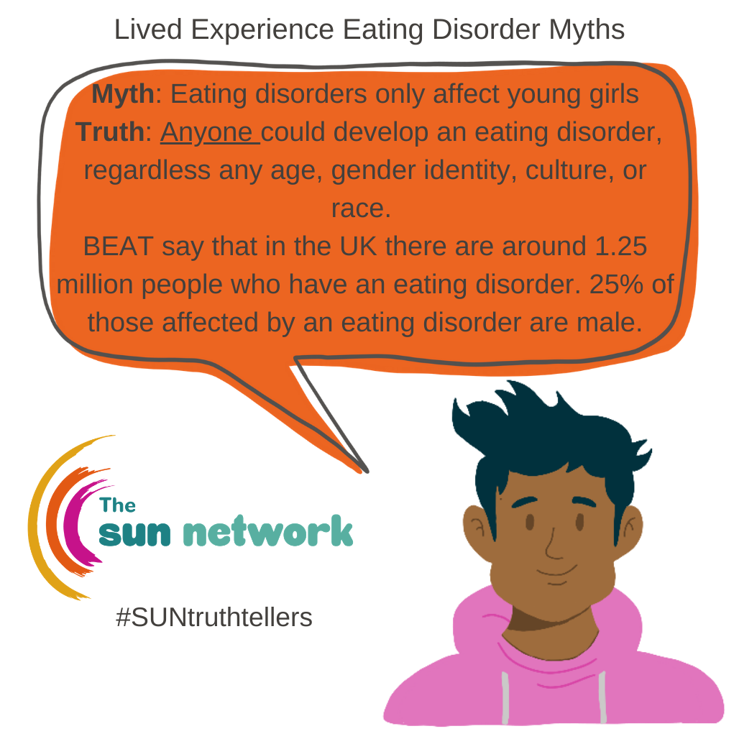
Notes:
https://youtu.be/A8cU59Feaos can be used as a video to outline ED

Slide 7
Suggested videos –to be viewed in advance of session and decision made on what would work for the class if time
Do Men Get Eating Disorders? - YouTube
Freddie Flintoff reveals the eating disorder he has kept secret for over 20 years - BBC - YouTube
Anorexia Recovery Story: How I Survived An Eating Disorder - YouTube
Kirsty's story: Anorexia | BBC Teach - YouTube
Dealing with an Eating Disorder | BBC Teach - YouTube

Slide 8
Types of Eating Disorders
There are three main types of eating disorders:

Slide 9
Types of Eating Disorders
There are three main types of eating disorders:
AN
Low weight
Restriction
Fear
Distorted Body Image
Exercise/Binge/Purge
Sense of Control
Any Age, Gender, Background
Notes:
The sufferer is often (but not always) a low weight due to severely limiting their food.
The sufferer will often refuse to maintain a weight which is considered healthy by professionals.
There will be a restriction of food intake leading to weight loss or failure to gain weight (for example in adolescents as part of normal expected growth and development).
It can affect anyone of any age, gender, or background.
A fear of becoming fat or gaining weight and / or a distorted view of themselves.
As well as restricting the amount of food they eat, the person may do a lot of exercise to get rid of any food that they do consume.
Some people who suffer from anorexia may engage in cycles of bingeing and purging.
Anorexia is often linked to a desire to feel in control. They may not feel able to control any other aspect of their life, so restricting their food and controlling their weight is a way for them to assert a sense of control over their lives (Beat, undated).

Slide 10
Types of Eating Disorders
There are three main types of eating disorders:
AN
BN
Binge
Compensating
1p/w for at least 3m
Healthy weight
Any Age, Gender, Background
Notes:
Those who suffer from Bulimia are often caught in a cycle of bingeing and then compensating for food they have consumed by vomiting, taking laxatives, fasting, or exercising excessively.
Binge eating and compensatory behaviours occur at least once a week for at least 3 months.
It can affect anyone of any age, gender, or background.
Getting the person support as quickly as possible gives the sufferer the best chance for a rapid and sustained recovery.
The binge/ purge cycles can dominate the person’s daily life.
Bulimia can cause serious physical complications. For example, frequent vomiting can cause problems with the teeth, affect their electrolyte levels, and cause burst blood vessels. Laxative misuse can seriously affect the heart and digestive system.
Sufferers often appear to be a healthy weight, and often find it easy to hide their illness from others.

Slide 11
Types of Eating Disorders
There are three main types of eating disorders:
AN
BN
BED
Binging
1p/w for more than 3m
Any Age, Gender, Background
Notes:
A person with binge eating disorder can experience a loss of control around food and eat large quantities of food in a short period of time on a regular basis (at least once per week for more than 3 months).
It can affect anyone of any age, gender, or background.
(BED) is not about choosing to eat a large amount of food; they are not just “overindulging”. Binges can be very distressing, and the person may find it impossible to stop even though they may want to. Some describe it as a compulsion or addiction.
The person may feel disconnected from themselves during a binge, and they may struggle to remember exactly what they consumed during the binge.
Binges may be planned, or they may be more spontaneous.
The person may experience uncomfortable feelings and / or intense negative emotions such as sadness, anger or loneliness.
The above can also be triggers for someone with BED.
Binge eating usually takes place in private, although they may eat regular meals in front of others outside their binges, or they may restrict their food outside of binges and follow strict rules about what they can consume.
Those with (BED) DO NOT regularly partake in self-induced vomiting or excessive exercise behaviours to rid themselves of the food that they consume (beat, undated).

Slide 12
The Most Common Eating Disorders
There are three main types of eating disorders:
AN
BN
BED
Also, OSFED, ARFID, PICA, Rumination, Orthorexia, Diabulimia, MODE
Registered Charity Number: 1156578
Notes:
For teacher information-
OSFED (other specified feeding or eating disorder):
Sometimes a person’s symptoms do not fit the expected symptoms for Anorexia, Bulimia or Binge Eating Disorder, in these cases a person may be diagnosed with OSFED.
Some examples of OSFED include atypical anorexia, bulimia nervosa (of low frequency and/ or limited duration), binge eating disorder (of low frequency and/or limited duration), purging disorder and night eating syndrome.
People with OSFED may work hard to hide their illness and someone may have been suffering for a long time before physical symptoms start to emerge (Beat, undated).
The term ‘OSFED’ applies primarily to people with some or most of the symptoms of Anorexia, Bulimia or Binge Eating Disorder but weight has changed very little, the person hasn’t been suffering for very long or the symptoms are not frequent / regular (DSM-V).
Treatment involves guided self-help, support groups and talking therapies.
ARFID (Avoidant / Restrictive Food Intake Disorder):
Someone may be avoiding and / or restricting their food intake for several different reasons.
They may be overly sensitive to the taste, texture, smell, or appearance of certain types of food.
They may have had a distressing experience with food. This could be an episode of choking, vomiting, or experiencing significant abdominal pain. This can cause the person to develop feelings of fear and anxiety around food or the act of consuming food.
The person may not be able to recognise that they are hungry in the way that someone without an E.D can / or they may have a poor appetite, or a low interest in eating, both of which can cause the person to have a reduced intake of food and therefore affect their weight (Beat, undated).
Significant weight loss and / or nutritional deficiency.
There is no evidence of a disturbance in the way in which one’s body weight or shape is experienced.
ARFID is not currently included in the NICE Guidelines for Eating Disorders but it should still be taken seriously given the risks associated with this type of restrictive eating.
Treatment options involve family-based therapy (for young people), cognitive behavioural therapy, exposure work and help with managing anxiety. Sometimes medication may be suggested to help cope with the anxiety.
PICA:
Eating foods that are not considered food.
People with this disorder crave non-food substances, such as dirt, soil, soap, paper, cloth, wool, pebbles, etc.
Rumination:
This is a newly classified eating disorder where an individual regurgitates the food, re-chews it, then either spits it out or re-swallows it.
Orthorexia:
An individual has an unhealthy obsession with healthy eating.
Unlike other eating disorders, orthorexia mostly revolves around food quality, not quantity. Instead, the individual has an extreme fixation with the “purity” of their foods, as well as an obsession with the benefits of healthy eating.
Diabulimia - Taken from Diabulimia and diabetes | Diabetes UK (27/10/2022):
Type 1 diabetes with disordered eating
Stop tackling insulin in order to lose weight
The above can happen alongside bingeing, purging and excessive-exercise behaviours
MODE (Muscularity-oriented disordered eating):
Refers to an array of disordered eating behaviours that are driven by the pursuit of the muscular ideal.

Slide 13
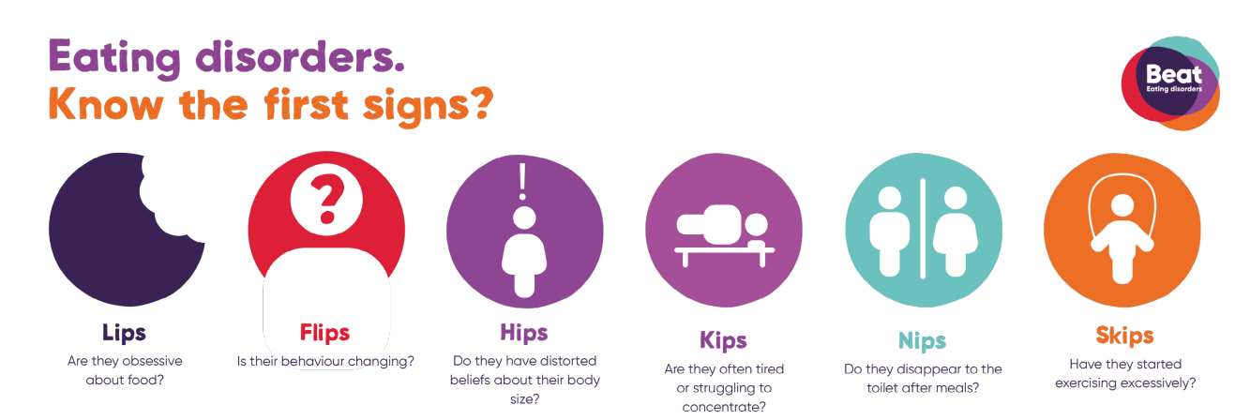
Knowing The Early Signs
If you are concerned, trust your instinct and seek advice!
Registered Charity Number: 1156578

Slide 14
Signs of Vomiting
Teeth
Facial
Hands/Body
Erosion
Sensitivity
Stains
Bleeding
Falling
Swollen Salivary Glands
Broken blood vessels in the eye
Russell’s sign = Calluses on knuckles
Ruptured Capillaries
Oedema
CPFT NNUH Training
Notes:
Chipmunk cheeks - caused by an imbalance of fluid due to vomiting

Slide 15
Notes:
The diagrams illustrate how Anorexia and Bulimia physiologically affect an individual.
As you can see, these physiological impacts are similar when compared against each other
Psychological
Low concentration
Anxious
Low mood or mood swings
Excessive fixation on weight
MH issues
Neglect-physical/sexual/emotional abuse
Negative ED thoughts
Secretive
Shame
Guilt
Irrational
Obsessive
Distracted
Isolative
Behavioural
Socially withdrawn
Changes in eating patterns
Excessive exercise
Significant weight gain/loss
Fixation on nutritional content
Difficulty sleeping
Biological
Cold
Hair loss
Physical injuries
Skin changes
Stomach pain
Amenorrhea/infertility
Heart palpitations
Blood abnormalities
Osteoporosis
Muscle loss

Slide 16
The Cambridgeshire Children and Young People's Health and Wellbeing Survey 2022
What pupils think locally
47% pupils wanted to lose weight
42% happy with their weight
11% wanted to put weight on
53% worry about how they look ‘quite a lot’ or ‘a lot’
81% had done dietary behaviours this term
50% changes their eating to manager their emotions of help feel more in control
Notes:
A report for Cambridgeshire secondary-The Schools Health and Education Unit
Sample
Year 8 boys 2300
Year 8 girls 2298
Year 10 boys 1968
Year 10 girls 1824
NB 374 pupils answered that the describe their gender in some other way or identified with more than one of the options listed. Theses pupils are not included in any data split by sex but are included in total figures
Dietary behaviours
Changed eating to manage emotions and feel more in control
Exercise to burn calories/lose weight
Worried you have lost control of how much you eat
Gone for more than one day without eating
Made yourself sick because you felt uncomfortably full

