Slide 1
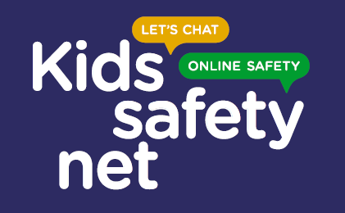
Kids Safety Net
School Poster Competition Winners

Slide 2
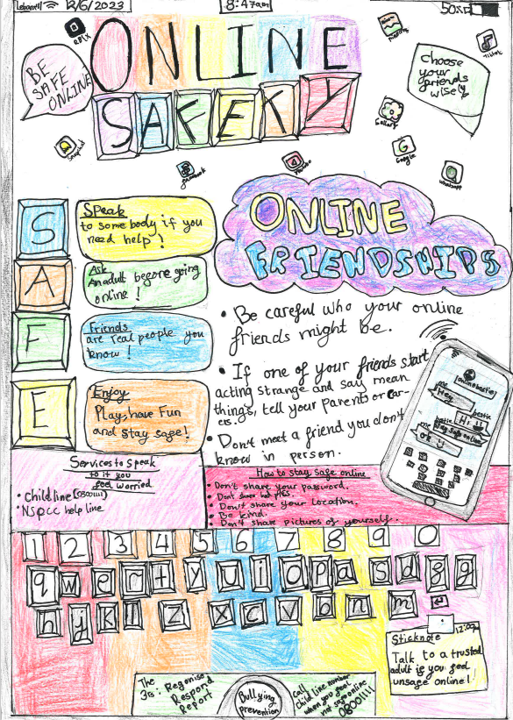
First prize winners Bewick Bridge Community Primary School
Poster completed by two year 6 students.
Winning a £25 high street voucher each and certificate, five licenses for staff of Bewick Bridge Community Primary School to virtually attend the NSPCC Learning – Keeping Children Safe Online training.
Virtual online safety workshop delivered by myself or Ellen for parents and carers of the school.

Slide 3
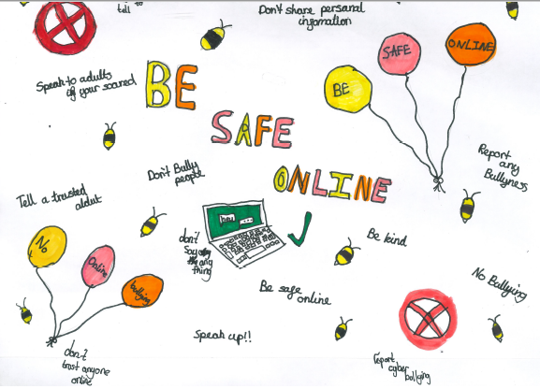
Second prize winners Sutton Primary School
Poster completed by three year students.
Winning a £10 high street voucher each and certificate.
Virtual online safety workshop delivered by myself or Ellen for parents and carers of the school.

Slide 4
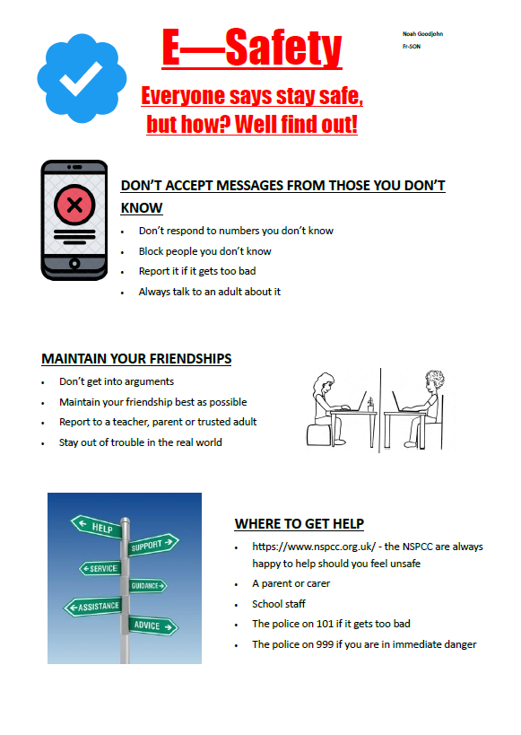
Third prize winner Ely College
Poster completed by one student.
Winning a £20 high street voucher and certificate.
Virtual online safety workshop delivered by myself or Ellen for parents and carers of the school.

Slide 5
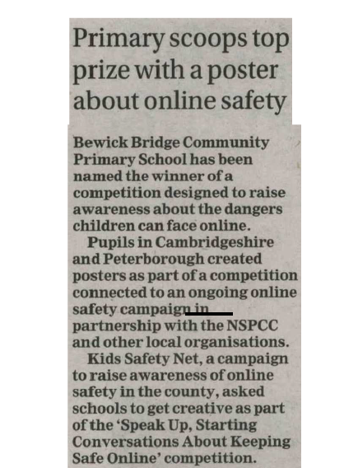
Media update
Article published surrounding the campaign within the Cambridgeshire Independent on 2nd August 2023.
Snapshot of the article shown.

